Slide 1
Qu’est-ce qu’il y a à Cambridge?
Notes:
https://www.youtube.com/watch?v=NEI-52a3YTo
Play students this (or another suitable) video clip of Cambridge and giving them a post-it note, ask them to note down words for places in the town.
Then ask them to spend one more minute thinking about any places in Cambridge that they know but did not see in the videos.
This video = 1min They will note the words in English. Take some whole class feedback and make a list of the words on a flipchart at the front. You could do this in two lists – in the video / not in the video

Slide 2
Qu’est-ce qu’il y a à Cambridge? (dans le vidéo)
Notes:
Elicit responses from pupils (in case teachers want a list of some of the things in the video, see the final slide - there’s no need to use this, as it’s not important that pupils have seen or noted everything)

Slide 3
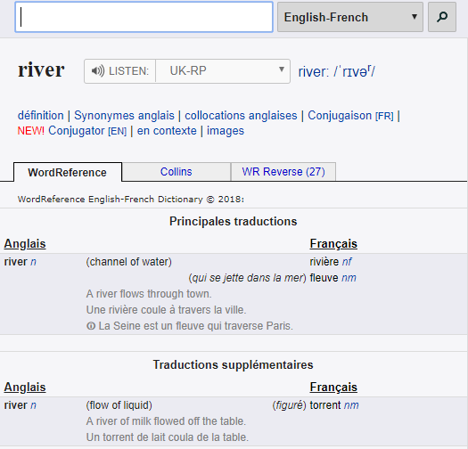
Nous allons utiliser un dictionnaire ou un dictionnaire en ligne.
nf = noun feminine
www.wordreference.com
Notes:
Use word reference to show pupils how to use it
It’s possible to use a traditional dictionary or an online dictionary.
NB: if schools do not have paper dictionaries then they can either use any computers in their room, with pupils taking turns to go up and look for the words OR it can be done from the front of the class and projected. This shared way of modelling the process of using an online dictionary can be just as effective.

Slide 4
Qu’est-ce qu’il y a à Cambridge (dans le vidéo)
English noun | French noun | gender (m/f) | word for ‘a’ | English | French
river | rivière | f | une | a river | une rivière
park | parc | m | un | a park | un parc
Notes:
model these two nouns and how the dictionary listing gives you the information you need to be able to say ‘a’ correctly for each noun. They give pupils time to look up 5 more of the nouns from their list.
Get them to feedback and the teacher can type more examples into this table in response to pupils’ contributions.

Slide 5
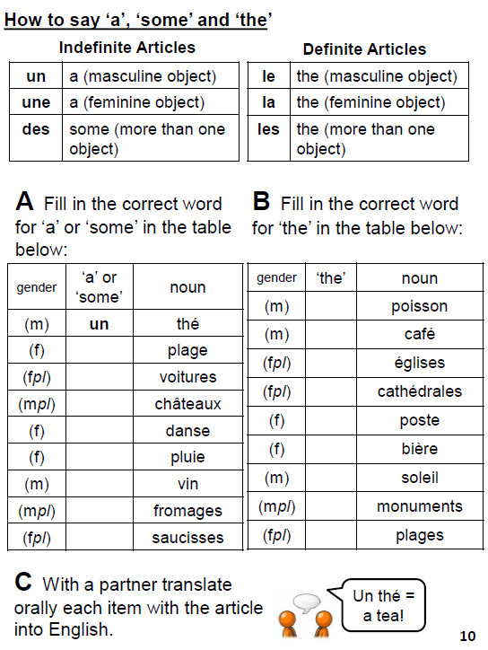
Notes:
It might be a good time for pupils to do this activity in their booklets.

Slide 6
Qu’est-ce qu’il y a à Cambridge? (dans le vidéo)
university
river
chapel
boat/punt
street
building
park
school
people
café
theatre
disco
pub
Notes:
Elicit responses from pupils (in case teachers want a list of some of the things in the video, see the final slide - there’s no need to use this, as it’s not important that pupils have seen or noted everything)

