Slide 1
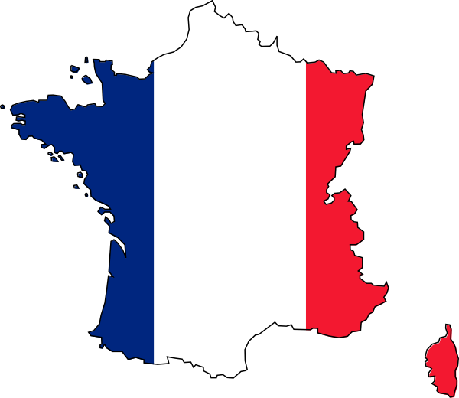
Connaissez-vous la France ?

Slide 2
Nous allons…
décrire la France
apprendre comment dire ‘a lot’

Slide 3
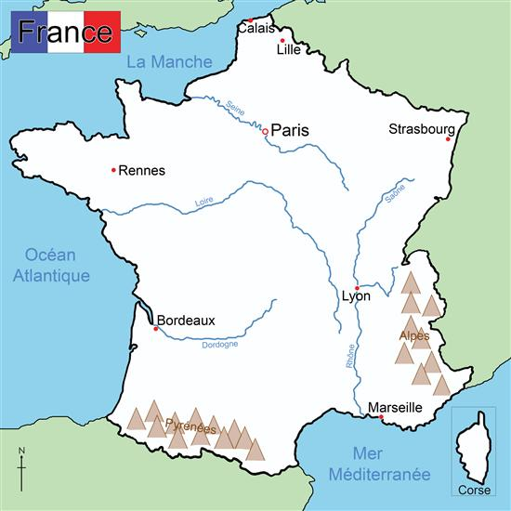
Connaissez-vous la France ?
Notes:
Students use map to find out 4 main rivers 2 countries which border France, which sea/ocean borders France and 2 mountain ranges

Slide 4
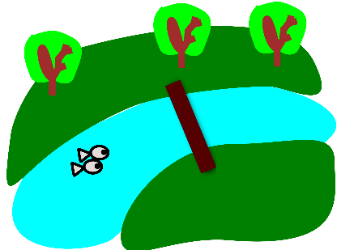
Il y a une rivière.
Il y a deux rivières.
Il y a beaucoup de rivières.
Notes:
(feminine/red noun)une rivière= There’s a river. Il y a deux rivières= There are two rivers. Il y a beaucoup de rivières= There are lots of rivers.

Slide 5
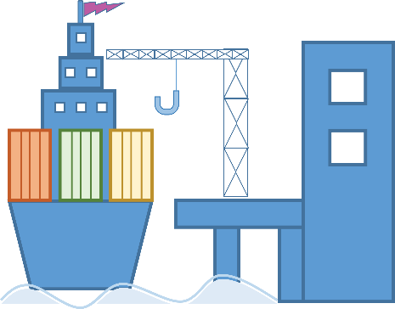
Il y a un port.
Il y a deux ports.
Il y a beaucoup de ports.
Notes:
(Masculine/blue noun) Il y a un port= There’s a port. There are two ports. There are lots of ports.

Slide 6
Il y a un aéroport.
Il y a deux aéroports.
Il y a beaucoup d’aéroports.
.
Notes:
(Masculine/blue noun) Il y a un aéroport = There’s an airport. Il y a deux aéroports.= There are two airports. Il y a beaucoup d’aéroports. = There are lots of airports.

Slide 7
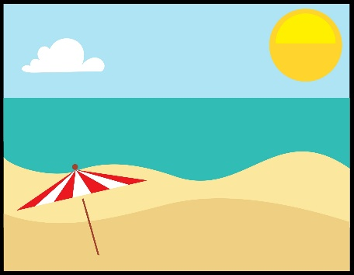
Il y a une plage.
Il y a deux plages.
Il y a beaucoup de plages.
Notes:
(Feminine/red noun) Il y a une plage. = There’s a beach. Il y deux plages. = There are two beaches. Il y a beaucoup de plages. = There are lots of beaches.

Slide 8
Il y a une montagne.
Il y a deux montagnes.
Il y a beaucoup de montagnes.
Notes:
(Feminine/red noun) Il a une montagne. = There’s a mountain. Il y a deux montagnes. = There are two mountains. Il y a beaucoup de montagnes. = There are lots of mountains.

Slide 9
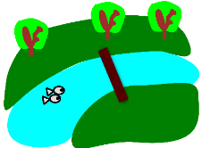
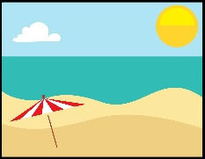
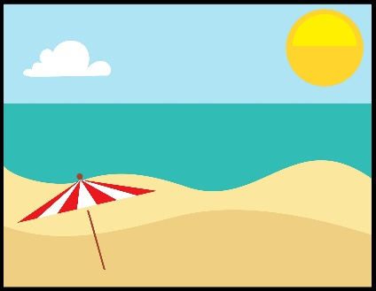
1 | 2 | 3
4 | 5 | 6
7 | 8 | 9
Notes:
Slide to practise recall of vocabulary

Slide 10
1
Notes:
Listening slide 1 Display this slide and freeze it. Go onto the other slide, which pupils must not see and click to play the audio. Call the items from left to right in 3 x rows at a slow, steady pace. Pupils will try to place their cards in the same formation (3 x 3) on their desks. I usually do this activity in pairs so they have more room to work.

Slide 11
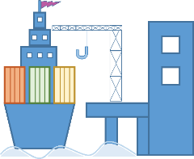
1
Notes:
Listening slide 1 NB: Don’t display this slide. Call the items from left to right in 3 x rows at a slow, steady pace. Pupils will try to place their cards in the same formation (3 x 3) on their desks. I usually do this activity in pairs so they have more room to work.

Slide 12
2
Notes:
Listening slide 2 Display this slide and freeze it. Go onto the other slide, which pupils must not see and click to play the audio. Call the items from left to right in 3 x rows at a slow, steady pace. Pupils will try to place their cards in the same formation (3 x 3) on their desks. I usually do this activity in pairs so they have more room to work.

Slide 13
2
Notes:
Round 2 of the listening activity. Do the items a little faster this time.

Slide 14
3
Notes:
3rd time. A little faster still…

Slide 15
3
Notes:
3rd time. A little faster still…

Slide 16
4
Notes:
Fastest round of all!

Slide 17
4
Notes:
Fastest round of all!

Slide 18
1 | 2 | 3
4 | 5 | 6
7 | 8 | 9
Notes:
Oral recall slide.

Slide 19
Devoirs
Find the name and location in France of a famous example of each of these:
Beach
River
Mountain
Port
Airport
Come prepared to write the name of it and where it is in France.

