Slide 1

Quelle est la date aujourd’hui?
mardi,
le vingt-sept septembre
jour = ?
mois = ?
date = ?
aujourd’hui = ?
Notes:
Pupils were introduced to this routine in the summer term of Y3 and in Y4 but may need reminding.
This will help remind them of the days of the week, keep working the numbers and help them remember some essential vocabulary e.g. day / month etc.
This slide can be adapted obviously to fit the day of the week / month.

Slide 2

C_______?
Q__?
Q__?
P_______?
Q_’e__-c_ q__?
C_______?
O_?
Q____?
Q_____?
Notes:
Starter activity – revise the question words.
The audio is actioned this time if you click on the individual speech bubbles.
Use gestures to ensure that pupils connect the word with its meaning.

Slide 3

Les opinions
Notes:
Les Opinions = Opinions. In this series of resources pupils will learn to understand and give their own opinions about singular and plural items.

Slide 4


J’aime…
Je n’aime pas …
J’adore…
Je déteste…
Notes:
J’aime= I like (or I love) , Je n’aime pas= I don’t like, J’adore = I love, je déteste = I hate
The picture appears first on mouse click and then the opinion. Both appear with the sound.
Allow pupils to repeat the French several times so that they become familiar with it.

Slide 5
Notes:
SLIDE WITH AUDIO – each picture appears on a click with the sound for the opinion phrase
Mouse click to see icons flash one by one – they disappear immediately afterwards so pupils have to pay attention to be able to volunteer the French for each picture shown. Solicit ‘J’aime’, ‘Je n’aime pas’, J’adore’, ‘ Je déteste’ – the 4 phrases from the previous slide.

Slide 6
Notes:
SLIDE WITH NO AUDIO
Mouse click to see icons flash one by one – they disappear immediately afterwards so pupils have to pay attention to be able to volunteer the French for each picture shown. Solicit ‘J’aime’, ‘Je n’aime pas’, J’adore’, ‘ Je déteste’ – the 4 phrases from the previous slide.

Slide 7


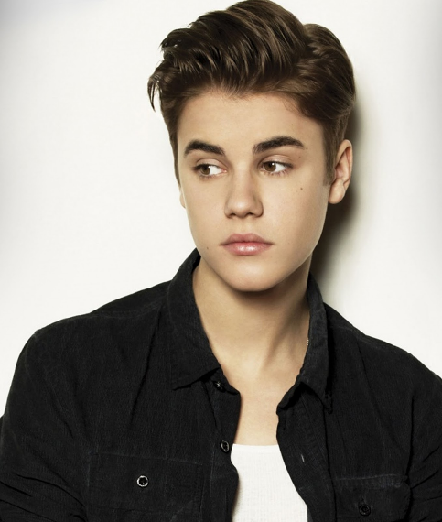
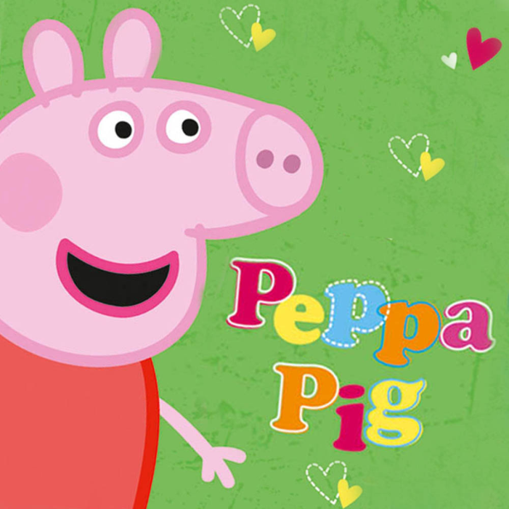

Tu aimes…?
Notes:
This slide invites pupils to give their opinion of:
1. Manchester United
2. Peppa Pig
3. Justin Bieber
4. Britains got talent
The opinion symbols appear with sound to go with the first question – Tu aimes Manchester United?
They can then be clicked again, if necessary, to prompt responses to the other three questions.

Slide 8

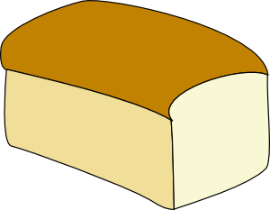

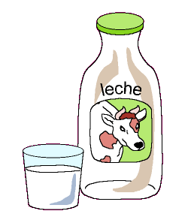
Notes:
Revise the foods, which have all been met before (but some at the end of Y3) but ensure that each is introduced with its definite article. Sandwiches, hamburgers and chips need to be plural.
The idea is for pupils to apply opinions to a range of other language that they already know (of course they will need reminding of the language as they learnt these food items some time ago).
The teacher can cue pupils in the question, though: Tu aimes le pain?...
Eg: J’aime
le pain / les sandwichs/ le thé/ le café /
le jus d’orange / les hamburgers/ l’eau/les fruits
le coca/ la limonade/ les fruits/le lait

Slide 9
Tu aimes ?
Notes:
Slide for eliciting pupils’ opinions of different food items.
Teacher asks: Tu aimes… whatever appears

Slide 10

How to say ‘a’, ‘some’ and ‘the’
indefinite articles
definite articles
un | a (masculine object)
une | a (feminine object)
des | some (more than one masculine or feminine object)
le | the (masculine object)
la | the (feminine object)
les | the (more than one masculine or feminine object)
NB: You always need the definite article (le/la les) when you say you like or don’t like something. In English, we just say ‘I like sandwiches’ but in French you say…
j’aime les sandwichs.
Fill in the correct article (word for ‘the’)
le
les
1 | J’aime _____ pain et j’adore ______ croissants.
2 | Je n’aime pas _____ limonade mais j’aime ____ jus d’orange.
3 | J’adore ________ hamburgers et aussi j’aime ______ frites.
la
le
les
les

