Slide 1
Quelle est la date aujourd’hui?
mardi,
le vingt-sept septembre
jour = ?
mois = ?
date = ?
aujourd’hui = ?
Notes:
Pupils were introduced to this routine in the summer term of Y3 and in Y4 but may need reminding.
This will help remind them of the days of the week, keep working the numbers and help them remember some essential vocabulary e.g. day / month etc.
This slide can be adapted obviously to fit the day of the week / month.

Slide 2

C_______?
Q__?
P_______?
Q__?
O_?
C_______?
Q____?
Q_____?
Notes:
Starter activity – revise the question words.

Slide 3

Les opinions
Notes:
Les Opinions = Opinions. In this series of resources pupils will learn to understand and give their own opinions about singular and plural items.

Slide 4


J’aime…
Je n’aime pas …
J’adore…
Je déteste…
Notes:
J’aime= I like (or I love) , Je n’aime pas= I don’t like, J’adore = I love, je déteste = I hate
The picture appears first on mouse click and then the opinion.
Allow pupils to repeat the French several times so that they become familiar with it.

Slide 5
Notes:
Mouse click to see icons flash one by one – they disappear immediately afterwards so pupils have to pay attention to be able to volunteer the French for each picture shown. Solicit ‘J’aime’, ‘Je n’aime pas’, J’adore’, ‘ Je déteste’ – the 4 phrases from the previous slide.

Slide 6



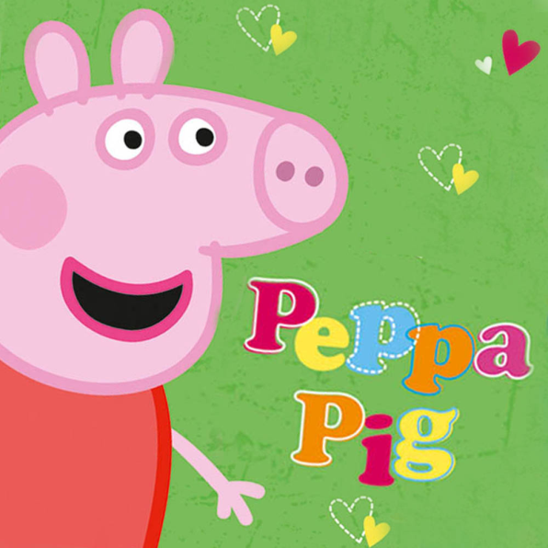
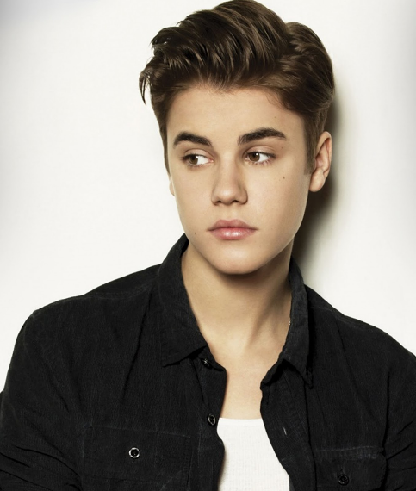
Tu aimes…?

Slide 7

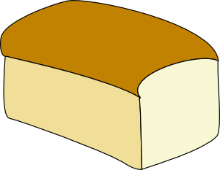

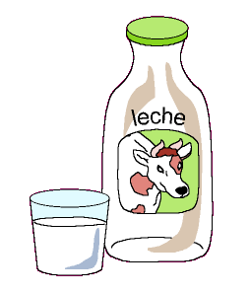
Notes:
Revise the foods, which have all been met before (but some at the end of Y3) but ensure that each is introduced with its definite article. Sandwiches, hamburgers and chips need to be plural.
Eg: J’aime
le pain / les sandwichs/ le thé/ le café /
le jus d’orange / les hamburgers/ l’eau/les fruits
le coca/ la limonade/ les fruits/le lait

Slide 8
Tu aimes ?

Slide 9
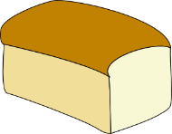
How to say ‘a’, ‘some’ and ‘the’
indefinite articles
definite articles
un | a (masculine object)
une | a (feminine object)
des | some (more than one masculine or feminine object)
le | the (masculine object)
la | the (feminine object)
les | the (more than one masculine or feminine object)
NB: You always need the definite article (le/la les) when you say you like or don’t like something. In English, we just say ‘I like sandwiches’ but in French you say…
j’aime les sandwichs.
Fill in the correct article (word for ‘the’)
le
les
1 | J’aime _____ pain et j’adore ______ croissants.
2 | Je n’aime pas _____ limonade mais j’aime ____ jus d’orange.
3 | J’adore ________ hamburgers et aussi j’aime ______ frites.
la
le
les
les

