Slide 1
Quelle est la date aujourd’hui?
mardi,
le vingt-sept septembre
jour = ?
mois = ?
date = ?
aujourd’hui = ?
Notes:
Pupils were introduced to this routine in the summer term of Y3 and in Y4 but may need reminding.
This will help remind them of the days of the week, keep working the numbers and help them remember some essential vocabulary e.g. day / month etc. This slide can be adapted obviously to fit the day of the week / month.

Slide 2
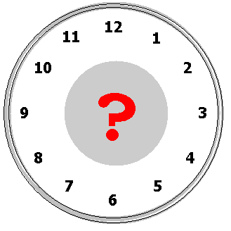
¿Q_____ h______ e__?
Quelle heure est-il ?
Notes:
Elicit the question: Quelle heure est-il?

Slide 3
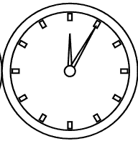
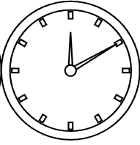
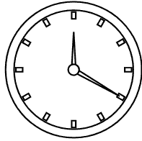
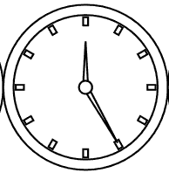
Il est midi cinq
Il est midi dix.
Il est midi vingt.
Il est midi vingt-cinq.
Notes:
It’s five past twelve. It’s ten past twelve.
It’s twenty past twelve. It’s twenty-five past twelve.

Slide 4
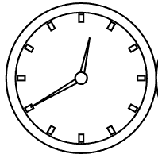
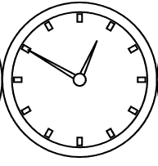
Il est une heure moins vingt-cinq.
Il est une heure moins vingt.
Il est une heure moins dix
Il est une heure moins cinq
Notes:
It’s twenty-five to one. It’s twenty to one.
It’s ten to one. It’s five to one.

Slide 5
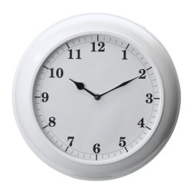
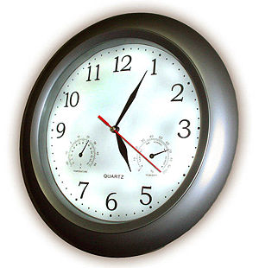
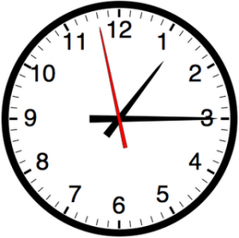
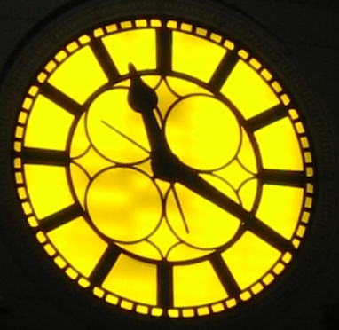
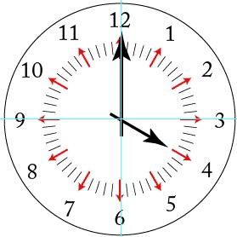
Quelle heure est-il ?
1.
2.
3.
4.
5.
6.
Notes:
Partner work: Pupils must work out what time it is as the Countdown clock ticks away (click on the COUNTDOWN icon to activate). You may have to click it again as it’s only 30 seconds long – depends how fast the class are! Then click on the individual clocks to hear if pupils are correct or not.

Slide 6
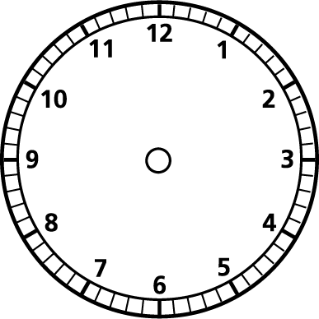
Quelle
heure
est-il ?
1.
2.
3.
4.
5.
6.
7.
8.
9.
Notes:
Pupils should use the clock face and hands (in the previous lesson) to adjust their clocks as the teacher reads out the times in French
Times are 1.25 past 3 2.quarter to 11 3.20 past 8 4.quarter past 6 5. 5 past 7 6. 5 to 6 7.25 past 7 8. 9 o’clock 9.2.30

