Slide 1
Quelle est la date aujourd’hui?
mardi,
le vingt-sept septembre
jour = ?
mois = ?
date = ?
aujourd’hui = ?
Notes:
Pupils were introduced to this routine in the summer term of Y3 and in Y4 but may need reminding.
This will help remind them of the days of the week, keep working the numbers and help them remember some essential vocabulary e.g. day / month etc.
This slide can be adapted obviously to fit the day of the week / month.

Slide 2
Question words to Jingle bells
https://www.youtube.com/watch?v=ZZQxAVtOg94
Notes:
https://www.youtube.com/watch?v=ZZQxAVtOg94
This link is the question words set to Jingle bells not as good as the Spanish !

Slide 3
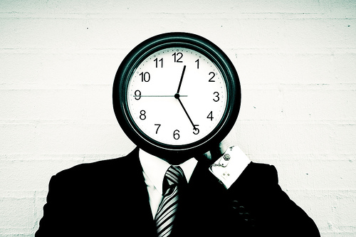
Quelle heure est-il ?
Notes:
‘What time is it?’

Slide 4
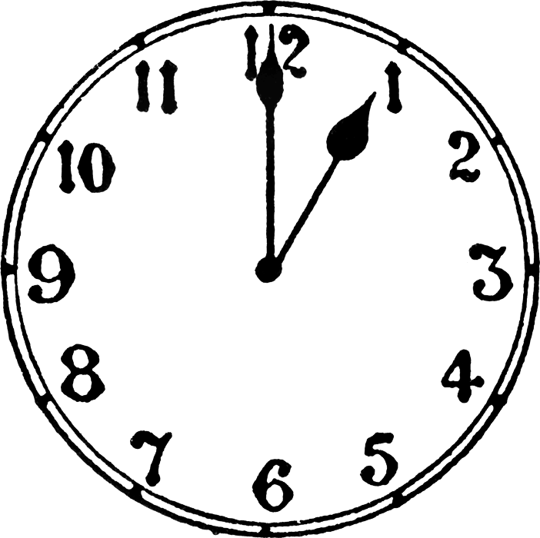
Quelle heure est-il ?
Il est une heure.
Notes:
Click if you want to hear the question (on all of the subsequent slides)
The time appears on click, with audio, on each of the slides.
It’s one o’clock.

Slide 5
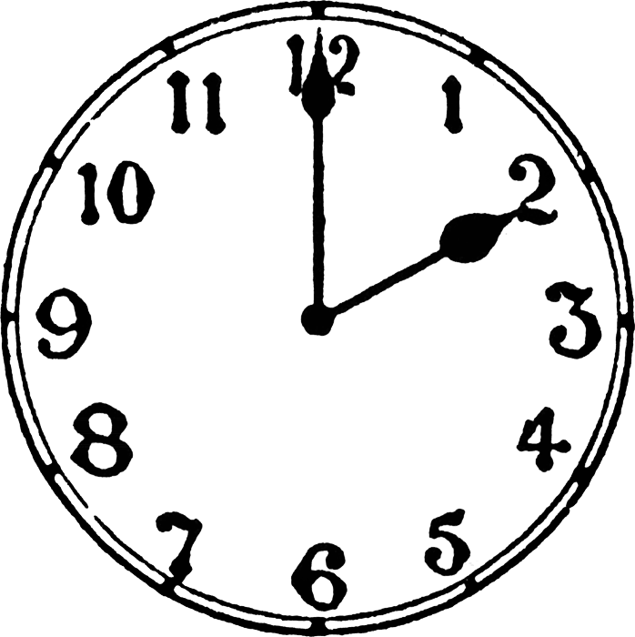
Quelle heure est-il ?
Il est deux heures.
Notes:
It’s two o’clock.

Slide 6
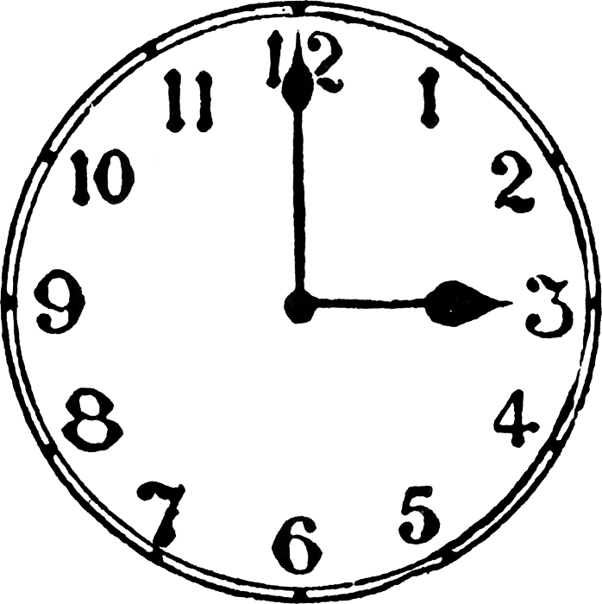
Quelle heure est-il ?
Il est trois heures.
Notes:
It’s three o’clock.

Slide 7
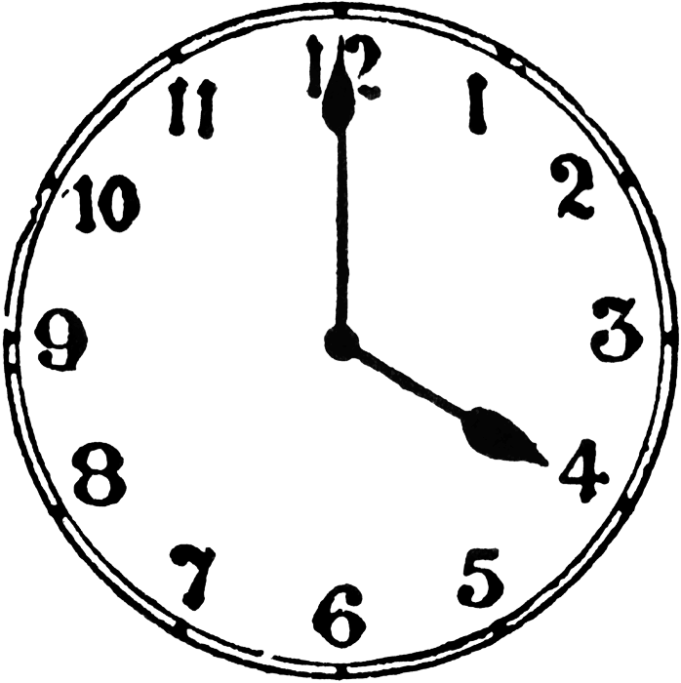
Quelle heure est-il ?
Il est quatre heures.
Notes:
It’s four o’clock.

Slide 8
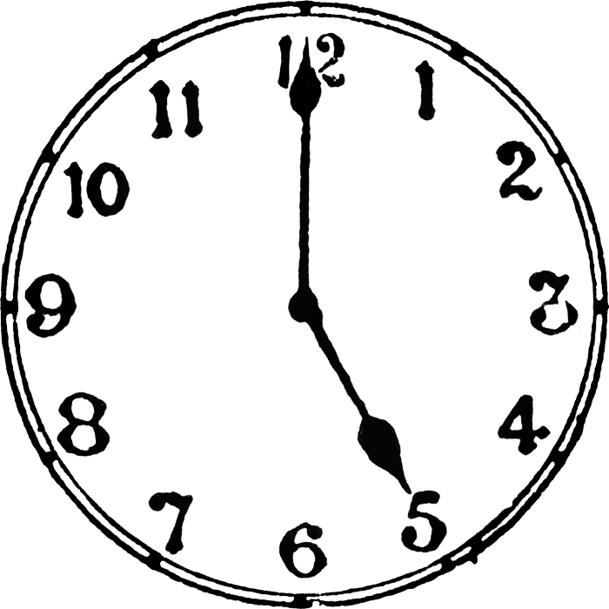
Quelle heure est-il ?
Il est cinq heures.
Notes:
It’s five o’clock.

Slide 9
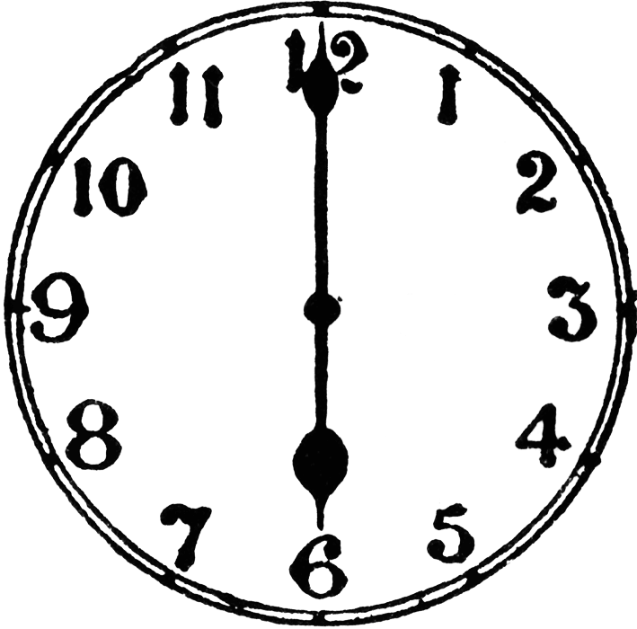
Quelle heure est-il ?
Il est six heures.
Notes:
It’s six o’clock.

Slide 10
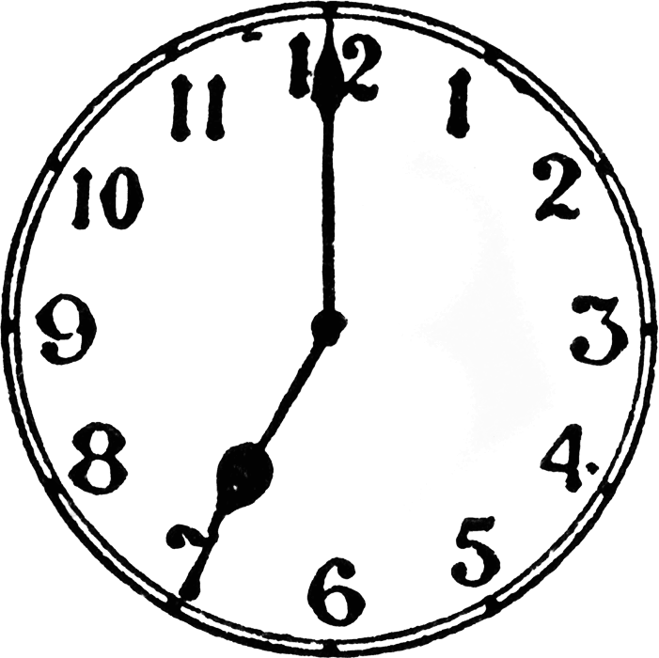
Quelle heure est-il ?
Il est sept heures.
Notes:
It’s seven o’clock.

Slide 11
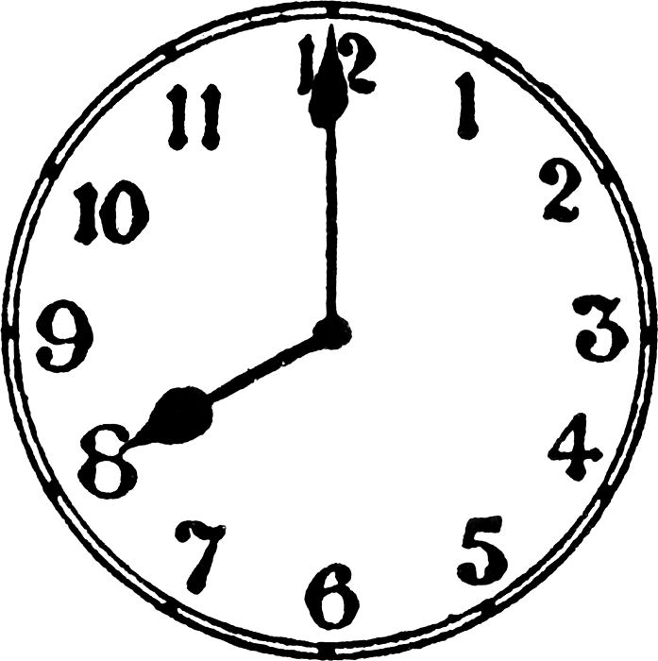
Quelle heure est-il ?
Il est huit heures.
Notes:
It’s eight o’clock.

Slide 12
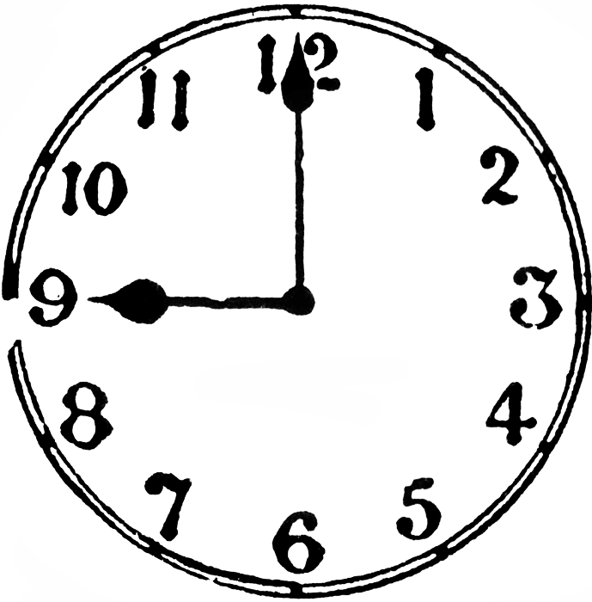
Quelle heure est-il ?
Il est neuf heures.
Notes:
It’s nine o’clock.

Slide 13
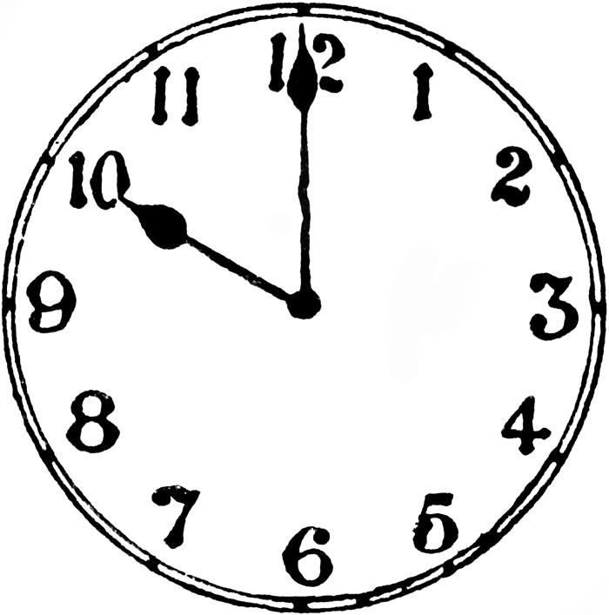
Quelle heure est-il ?
Il est dix heures.
Notes:
It’s ten o’clock.

Slide 14
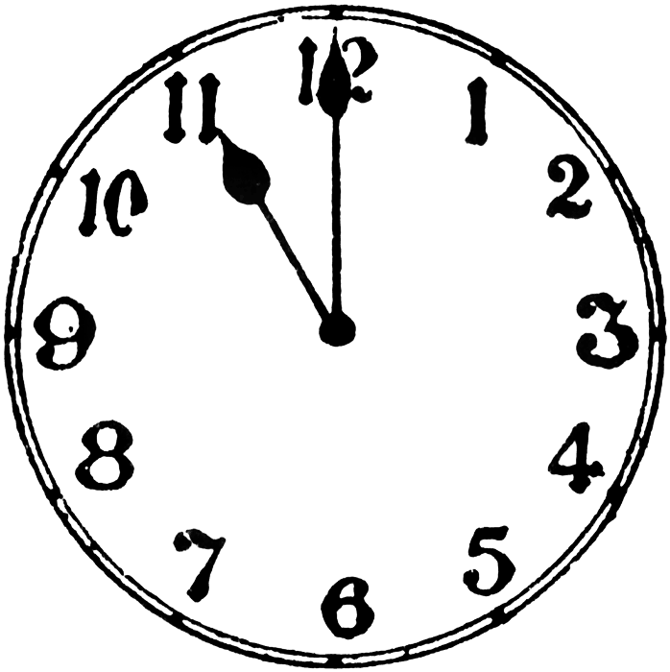
Quelle heure est-il ?
Il est onze heures.
Notes:
It’s eleven o’clock.

Slide 15
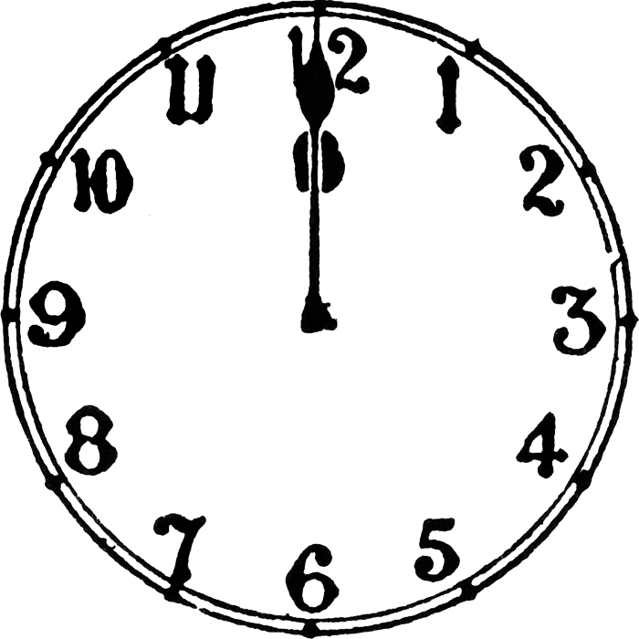
Quelle heure est-il ?
Il est midi.

Slide 16

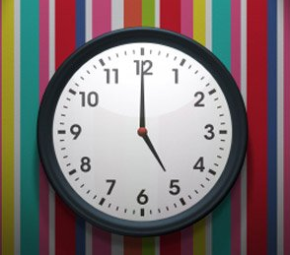
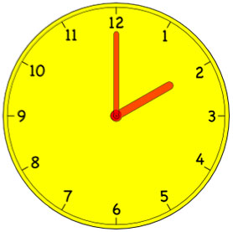
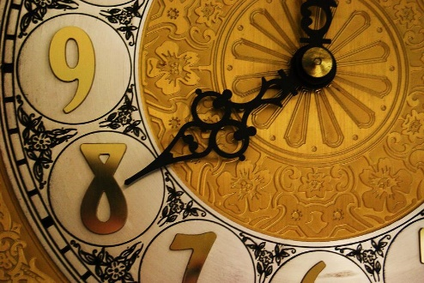
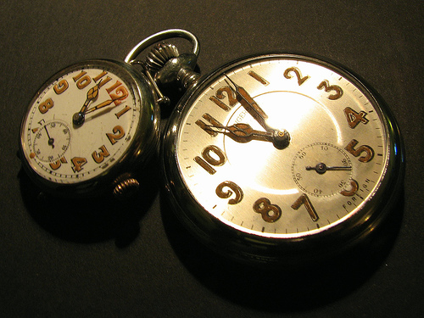
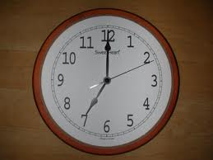
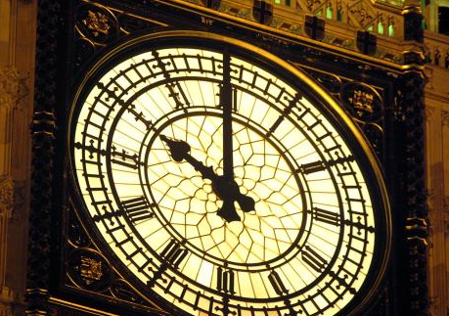
Quelle heure est-il ?
1.
2.
3.
4.
5.
6.
Notes:
Partner work: Pupils must say out loud to a partner what time it is as the Countdown clock ticks away (click on the COUNTDOWN icon to activate). You may have to click it again as it’s only 30 seconds long – depends how fast the class are!
The answers are not on the slide, but they are straightforward as they are just the ‘on the hour’ times.
When they feed back they should do it in pairs with question and answer.
Qué hora es?
Son las dos
Etc…

Slide 17




Quelle heure est-il ?
Il est midi.
Il est midi et quart.
Il est midi et demie.
Il est une heure moins le quart.
Notes:
It’s twelve o’clock. It’s a quarter past twelve.
It’s half past twelve. It’s a quarter to one.

Slide 18
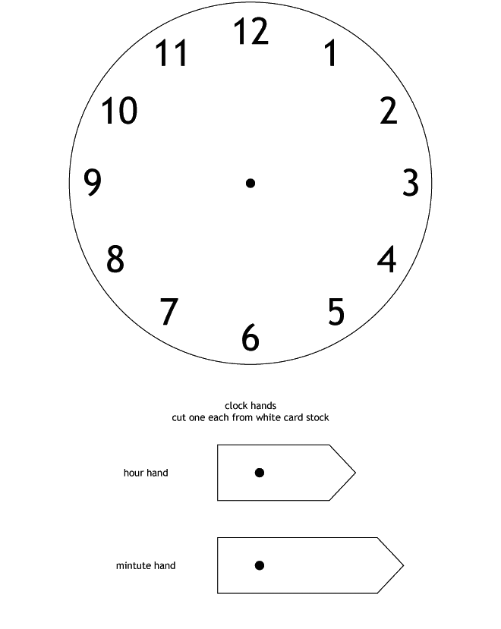
Notes:
Photocopy these for pupils to make their own clock. Pupils will need a butterfly clip to attach the hands so that they can adjust the time according to what they hear on the next slide.

Slide 19
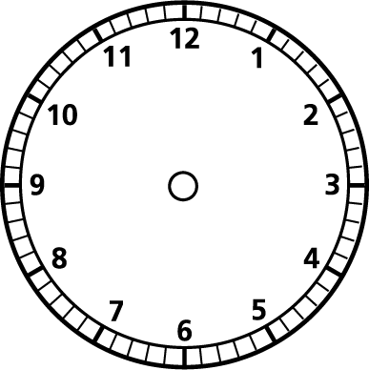
Quelle heure est-il ?
Travaille avec un ami / une amie.
Exemple:
Personne A - Quelle heure est-il ?
Personne B – Il est neuf heures.
Personne A -
Notes:
Encourage pupils to practise the quarter and half-past times.

