Slide 1

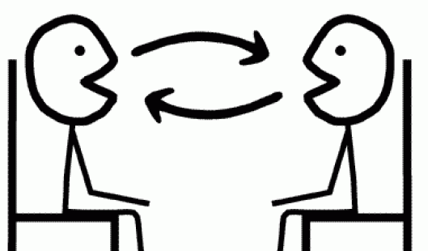
Révision!
Notes:
This lesson is about consolidating all the language learnt so far about music, likes, dislikes and reasons and bringing it together so that pupils end up being confident in have a short exchange of up to a max. of 6 questions and answers.
We are going to begin with some game activities to rehearse the language they have met, develop fluency, memory, pronunciation and confidence in speaking.

Slide 2
La musique
Opinions
la musique pop
J’adore
la musique classique
J’aime
la musique traditionnelle
Je n’aime pas
le jazz
le saxophone
Je déteste
le clavier
le piano
la trompette
la guitare électrique
le violon
la flûte
la batterie
Bien!
Génial!
Affreux.
Parfait!
Formidable!
Rapide!
Notes:
Slide to elicit / practise pronunciation first.

Slide 3
Opinions
La musique
J’adore
J’aime
Je n’aime pas
Je déteste
la musique pop
la musique classique
la musique traditionnelle
le jazz
le saxophone
le clavier
le piano
la trompette
la guitare éléctrique
le violon
la flûte
la batterie
Bien!
Génial!
Affreux.
Parfait!
Formidable!
Rapide!
Notes:
Inverse Bingo
Pupils write 3 opinion sentences on a piece of paper, choosing one from the left and one option from the right.
They all stand up. The teacher reads out combinations at random and pupils cross them off if they match theirs. When all three of their phrases have been said, they have to sit down.
The winner is the last pupil standing.
This slide can also be used for a version of Mastermind. The teacher writes a phrase on a miniwhiteboard. Pupils try to match her phrase by saying different options, until they get it right.

Slide 4
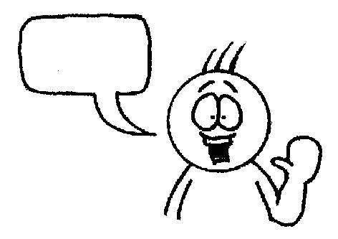
aime
adore
aime beaucoup
bruyant.
dynamique.
rapide.
J’
le rock parce que c’est
reggae
folk
jazz
Je n’aime pas le
parce que c’est tranquille.
du saxophone
du piano
de la trompette
de la flûte.
de la batterie.
de la guitare.
Je ne sais pas jouer
mais je joue
Taylor Swift.
Ed Sheeran.
Sam Smith.
Mon chanteur favori est
Notes:
Telepathy
Telepathy is brilliant for a) memory and b) speaking (repetition with a reason!) It’s a competitive game in pairs. Each chooses and option for each sentence in their head. One starts reading out loud, trying to anticipate the other’s choices. Each time they make a choice, the partner either nods or shakes his/her head. If the choice is wrong, play passes to the partner who starts the same process. If it is the right choice, the student gets to continue. The aim is to get to the end first. Answers don’t change, so this is also a great memory developer.

Slide 5
1 Quel type de musique aimes-tu ?
C’est bruyant.
Oui, je joue de la flûte.
2 Tu aimes le Hip Hop?
Non, je n’aime pas ça.
3 Pourquoi?
Non, je ne sais pas jouer de la guitare.
4 Tu sais jouer de la guitare?
J’aime beaucoup la pop.
5 Tu joues d’un instrument?
Je préfère la musique pop.
6 Tu préfères la musique pop ou le rock?
Notes:
Question and answer slide.
Step 1: Elicit the matching answers
Step 2: In pairs, practise Q & A but those answering have to change something about the answer – could be a change of word OR could be adding something extra.
Step 3: Move to the next slide where there are words missing from the questions. Elicit the questions again from pupils.

Slide 6
1 _____ type de musique ______-tu?
2 Tu ____ le ___ Hop?
3 P_______?
4 Tu sais_____de la ______?
5 Tu______ d’un instrument?
6 Tu _______la musique ___ ou le rock?
Oui, je joue de la flûte.
C’est bruyant.
Non, je n’aime pas ça.
Non, je ne sais pas jouer de la guitare.
J’aime beaucoup la pop.
Je préfère la musique pop.
Notes:
Step 3: Here there are words missing from the questions. Elicit the questions again from pupils. Roll back to the previous slide if pupils need support.

Slide 7


Nous allons jouer aux dominos.
Réponse
Question
C’est un domino.
Qu’est-ce que c’est?
Notes:
Pupils will need a set of the accompanying resource – 33_dominoes, one between two.
They first need to match all the Qs to the As. Then they can try practising the conversation in pairs, turning over as many dominoes as they can, to encourage them to produce their speaking from memory.

Slide 8
Salut ! Je suis Jean et j’habite en France.
Quel type de ______ aimes-tu? Tu ______ la musique pop? J’aime beaucoup la pop _______ c’est dynamique.
Tu sais________ du piano? Non mais je joue du _________. Quel chanteur __________-tu ? Tu préfères Justin Bieber ou _____________?
Je __________ Katie Perry.
Au revoir !
Paul
Salut! Ça va ? Je suis Sophie et je viens du Québec.
Tu aimes le ______?
Je ______ le rap parce que c’est __________.
Tu ______ d’un __________ ? Je joue du piano et du _______.
Et toi, ____ joues d’un instrument? Tu _____________ One Direction ou Little Mix?
Je _________ Little Mix.
A bientôt!
Sophie
Bien!
Génial!
Affreux.
Parfait!
Formidable!
Rapide!
Notes:
Gap-fill race
This will eventually be a fast and furious team game but initially I would suggest working through with the class, text by text, eliciting the missing words.
Pupils often approach this sort of activity quite unanalytically at first, calling out any words that come into their heads from the topic!
Encourage them to think logically, to look at the surrounding words and puzzle out in their heads what the missing idea is.
They may need some prompting to do this, initially, but they will improve with prompting and questioning.
They need to pay attention to clues – there may be some gaps where more than one answer is possible i.e. je sais jouer de la ______ but it must be an instrument that is feminine.
After you have elicited all the answers and written them up, pupils should read the email texts, sentence by sentence, in pairs, with the partner translating into English (not writing answers down, just orally).
Then warn them that they are going to play a game and give them 30 seconds to look at all the answers on the board, before wiping off all the words.
Then play the game as per the instructions below.
Divide the class into two teams. Give the first member of each team a pen. Each person has to fill in one word and pass the pen to someone else in their team.
The winning team is the one that fills in all the gaps correctly, first.
Involve all pupils in using the TL during the task by prompting them to encourage their teams (see prompts on sample slide).
The teacher keeps track of both texts and wipes off any incorrect answers to ensure that students re-consider their answers if they have got it wrong.

