Slide 1
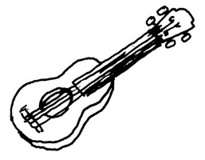
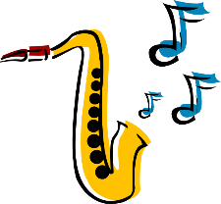
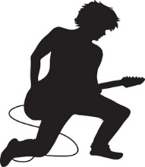
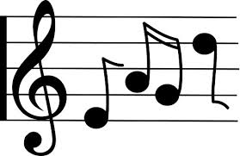






2
3
6
2
4
2
1
7
3
1
2
1
6
4
2
3
1
3
7
1
9
2
5
9
Notes:
Points
This is a variation on treasure hunt. Pupils volunteer a sentence, producing co-ordinates e.g. J’adore la musique classique. is the first square. Click on the blue square and it reveals the number of points that square is worth to the team. Keep playing, taking turns, until all the squares are revealed. There is a point scored behind each one, but it is not the same each time, so the suspense is there till the end.
Have two volunteers at the front, one to keep score for each team.

Slide 2

Aimes-tu
la musique française?
Pourquoi?
Notes:
Two questions to set the scene for the lesson.
Click on the text to hear the audio.

Slide 3
Aimes-tu la musique française ?
Quel numéro préfères-tu?
Je préfère …
1
2
3
4
5
Notes:
Aimes-tu la musique française ? = Do you like French music? Pupils are invited to give their opinions about each musical extract to allow them to practise the language they are learning.
Elicit the two opinion phrases first. Then click on the pink sound file icons to hear the audio.
Do some whole class question and answer – Aimes-tu numéro un? etc…
Introduce the question – what number do you prefer?
Quel numéro préfères-tu? = What number do you prefer? Je préfère número … = I prefer number …
Click again to see the second question about preference and how to begin the answer.

Slide 4
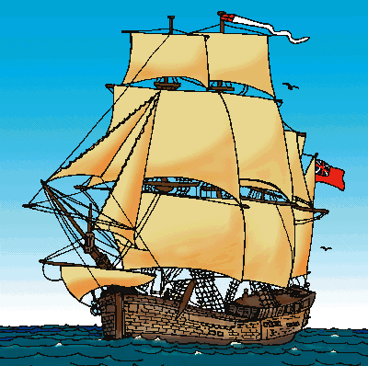


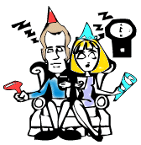

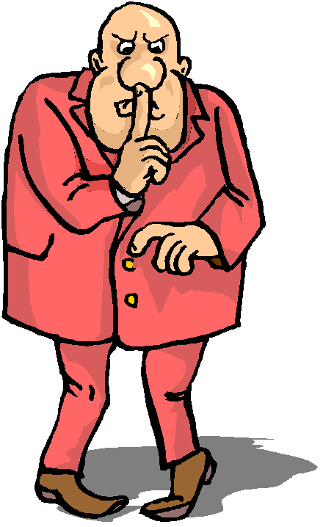
amusante
traditionnelle
bruyante
ennuyeuse
moderne
tranquille
Notes:
Before asking pupils to give reasons, bring back the most useful adjectives for describing music preferences from the those learnt in the previous lesson.
Bring them up one by one and then elicit the meanings ‘Comment dit-on en anglais?’ using the pictures if necessary to support.

Slide 5
Aimes-tu la musique française?
Pourquoi?
Pourquoi (pas)?
Oui, j’aime la musique française
parce que c’est__________.
1
Non, je n’aime pas la musique française
parce que c’est__________.
2
3
Quel numéro aimes-tu ?
Pourquoi?
4
J’aime numéro …
parce que je pense que c’est__________.
5
Je n’aime pas numéro …
parce que je pense que c’est __________.
Notes:
Aimes-tu la musique française? = Do you like French music?
Pupils have just practised the feminine form of the adjectives, in anticipation of describing ‘la musique française’.
Quel numéro aimes-tu? = What number do you like? ¿Pourquoi? = Why?
Before doing questions 2 and 3, which need the masculine form of the adjective, go to Slide 5 to elicit these, before returning to this slide to give reasons using masculine forms of the adjectives.
J’aime le numéro X… parce que je pense que c’est…… = I like number … because I think it is…
(The adjective pupils choose to use must be in the masculine form as it is describing a blue/masculine noun [número]).
Click again to see the second and third question. Pupils should give a reason using ‘parce que’ and c’est…’

Slide 6
amusante
traditionnelle
bruyante
amusant
traditionnel
bruyant
ennuyeuse
moderne
tranquille
ennuyeux
moderne
tranquille
Notes:
Elicit the masculine forms of the adjectives for each of the feminine forms.
Drill these.

Slide 7





Quel type de musique aimes-tu ?
J’adore le Hip Hop et le reggae.
Pourquoi?
Parce que le Hip Hop est bruyant et le reggae est amusant.
Quel type de musique n’aimes-tu pas?
I don’t like folk music and I hate jazz music.
Je n’aime pas le folk et je déteste le jazz.
Pourquoi pas?
Because folk music is traditional and jazz music is boring.
Parce que le folk est traditionnel et le jazz est ennuyeux.
Notes:
Try to elicit with the whole class the French for the first two sentences, picture by picture. Then reveal the sentences.
Then ask them to try to translate the next two sentences from French into English, and take their answers.

