Slide 1
Quelle est la date aujourd’hui?
mardi,
le vingt-sept septembre
jour = ?
mois = ?
date = ?
aujourd’hui = ?
Notes:
Pupils were introduced to this routine in the summer term of Y3 and in Y4 but may need reminding.
This will help remind them of the days of the week, keep working the numbers and help them remember some essential vocabulary e.g. day / month etc.
This slide can be adapted obviously to fit the day of the week / month.

Slide 2

Comment?
Qui?
Pourquoi?
Que?
Combien?
Où?
Quel/s/ Quelle/s?
Quand?
Notes:
Revise the key question words with gestures.

Slide 3




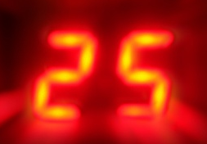
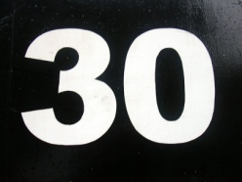
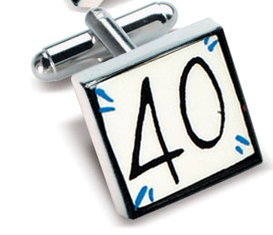
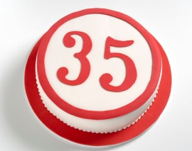
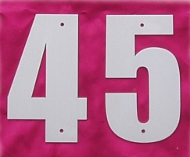

cinq | dix | quinze | vingt | vingt-cinq
trente | trente- cinq | quarante | quarante- cinq | cinquante
Notes:
Pupils have learnt numbers 1-31 but the last 4 x numbers in this sequence are new.
Read them through with pupils aloud 2 – 3 times.

Slide 4
cinq |  | quinze |  | vingt- cinq
 | trente-cinq |  | quarante-cinq
Notes:
Read through with pupils, eliciting from memory the numbers where only the digits are shown.

Slide 5
 | dix |  | vingt
trente |  | quarante |  | cinquante
Notes:
Read through with pupils, eliciting from memory the numbers where only the digits are shown.

Slide 6

50
5
15
10
Notes:
Individual pupils volunteer to read a line (they can have a few minutes to practise in pairs first).

Slide 7
5 x 2 =
10
20
5 x 4 =
25
5 x 5 =
15
5 x 3 =
5 x 7 =
35
Notes:
Further practice

Slide 8

Notes:
https://www.youtube.com/watch?time_continue=49&v=dL16JhlPixo
Click to play the video

Slide 9
5x1=
5x3=
5x9=
5x8=
5x6=
5x5=
5x10=
5x7=
5x4=
5x2=

Slide 10
5x1=
5x6=
5x2=
5x7=
5x3=
5x8=
5x4=
5x9=
5x5=
5x10=

