Slide 1







pTouché!
Bataille navale
X Manqué!
!
Je joue
Tu joues
Il/elle joue
Nous jouons
Vous jouez
Ils jouent
Notes:
Batalla naval (battleships)
Pupils form sentences to try to find the 5 x hidden battleships.
They can do this in two teams until all 5 are found.
Click in the middle of the purple rectangle indicated by the phrase given and it will disappear. Pupils say ‘touché’ when they get a ship and ‘manqué when they miss.
There is a black/white slide of the game at the end of this lesson, so pupils can play again, but in pairs.

Slide 2
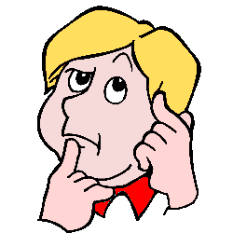
Pourquoi? (Why?)
parce que…(because)
Pourquoi aimes –tu ...?
Pourquoi tu n’aimes pas…?
Parce que je pense que c’est…
(Because I think it’s …)
Notes:
Pourquoi aimes-tu / Pourquoi tu n’aimes pas? = Why do you (not) like it?
Pupils are now encouraged to consider reasons why they might like or not like something.
Pupils should repeat the phrases to become familiar with them.
Click on the phrases to hear them pronounced.

Slide 3
Here are some useful words for giving reasons. Use your detective skills and work out the missing French and English word meanings.
anglais | français | anglais | français
serious |  |  | amusant
modern |  | traditional
pretty |  |  | laid
quiet |  |  | bruyant
boring |  | exciting | émouvant
international |  | these 4 words don’t have opposites listed, but they are like the English words. See if you can find them all.
touristy
famous
amazing
international | joli | moderne | fun | joli | tranquille | impressionnant
ugly | célèbre | ennuyeux | sérieux | touristique | noisy | traditionel
Notes:
Give pupils the sheet to see what they can work out themselves.

Slide 4
Here are some useful words for giving reasons. Use your detective skills and work out the missing French and English word meanings.
anglais | français | anglais | français
serious | sérieux | fun | amusant
modern | moderne | traditional | traditionnel
pretty | joli | ugly | laid
quiet | tranquille | noisy | bruyant
boring | ennuyeux | exciting | émouvant
international | International | These 4 words don’t have opposites listed, but they are like the English words. See if you can find them all.
touristy | touristique
famous | célèbre
amazing | impressionnant
international | joli | moderne | fun | joli | tranquille | impressionnant
ugly | célèbre | ennuyeux | sérieux | touristique | noisy | émouvant
Notes:
Show them the answers and allow them to complete any they missed.

Slide 5
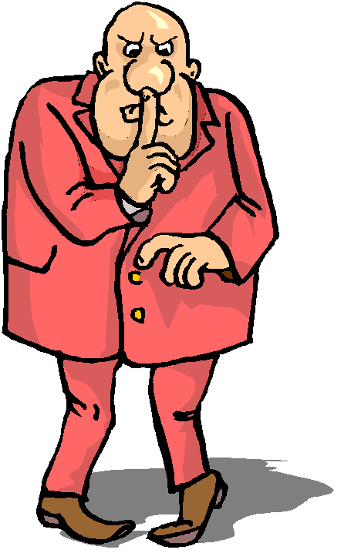
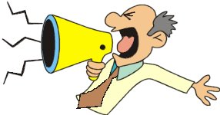
Comment dit-on en anglais ?
tranquille
tranquille
bruyant
bruyante
Notes:
All adjectives are shown in masc/fem forms. Where those forms are exactly the same, they are positioned side by side.
Blue = masculine, red = feminine; tranquille = quiet, bruyant(e) = noisy
Make pupils pronounce these words in both masculine and feminine forms several times. It would be really useful to have an action that you, as teacher, do to trigger pupil memory of the word. Realise this may be challenging …
The next mouse click brings up the question Comment dit-on en anglais ? (How do you say that in English?) to make sure that pupils know the meanings of all the words. Click on words to hear audio.

Slide 6

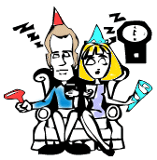
Comment dit-on en anglais ?
émouvant
ennuyeux
émouvante
ennuyeuse
Notes:
Blue = masculine, red = feminine; émouvant = exciting, ennuyeux = boring
Instructions as per previous.

Slide 7


Comment dit-on en anglais ?
amusant
sérieux
amusante
sérieuse
Notes:
Blue = masculine, red = feminine; amusant = fun(ny), serieux = serious
Instructions as per previous.

Slide 8
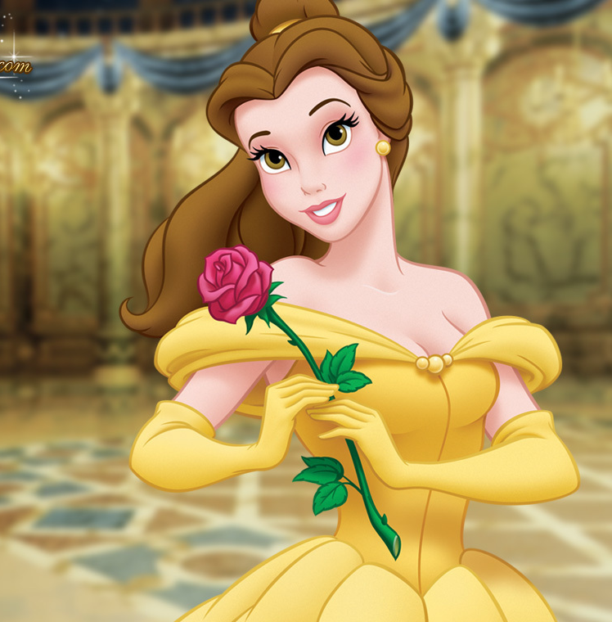
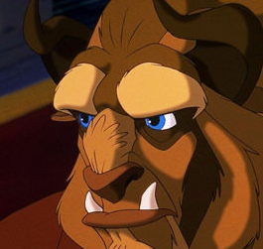
Comment dit-on en anglais ?
joli
laid
jolie
laide
Notes:
Blue = masculine, red = feminine; joli = pretty, laid = ugly
Instructions as per previous.

Slide 9
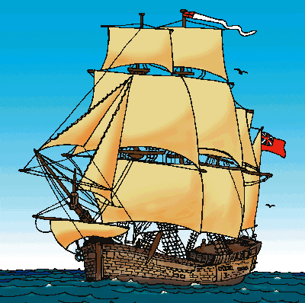
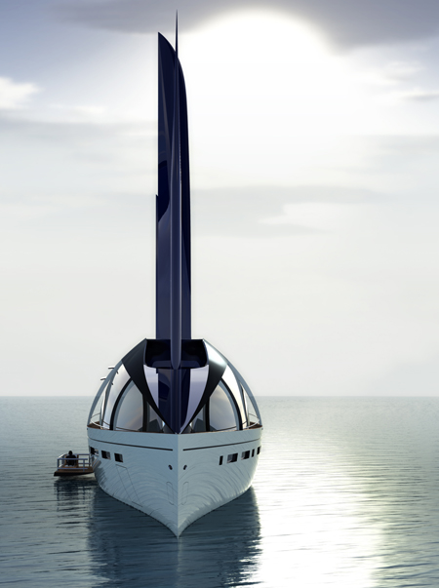
Comment dit-on en anglais ?
traditionnel
moderne
moderne
traditionnelle
Notes:
Blue = masculine, red = feminine; traditionnel = traditional, moderne = modern
Instructions as per previous. Remind pupils of cognates ☺

Slide 10
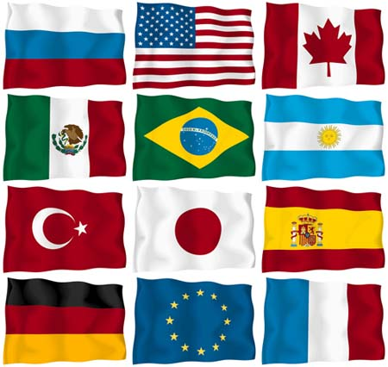
Comment dit-on en anglais ?
international
internationale
Notes:
Blue = masculine, red = feminine; international = international
Instructions as per previous.

Slide 11
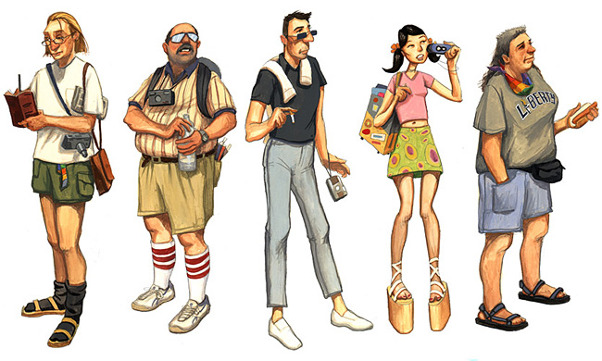
Comment dit-on en anglais ?
touristique
touristique
Notes:
Blue = masculine, red = feminine; touristique = touristy
Instructions as per previous.

Slide 12
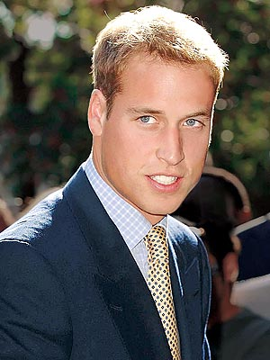
Comment dit-on en anglais ?
célèbre
célèbre
Notes:
Blue = masculine, red = feminine; célèbre= famous
Instructions as per previous.

Slide 13

Comment dit-on en anglais ?
impressionnant
impressionnante
Notes:
Blue = masculine, red = feminine; impresionante = striking/impressive
Instructions as per previous. Pupils will note that there is no difference in masculine & feminine forms for this word (because it doesn’t end in an –o in masculine there is no change.)

Slide 14





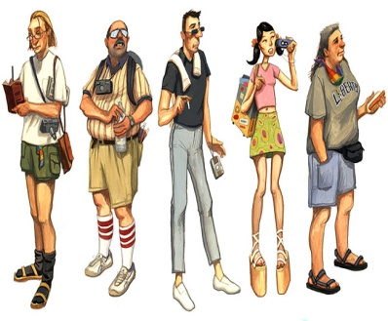
Notes:
Print out sheet, cut up into individual cards and give a set to each pair/pupil. Pupils then put the cards in the order (activities on next 2 slides) they are read out in. Run through the meanings first to check the pupils are on board with this activity.

Slide 15
1
Notes:
Display this slide on FREEZE whilst you use the next slide to give the listening task.

Slide 16

Notes:
Click to hear them in this order. Pupils should put their picture cards in the order they hear them said. NB: The screen is on FREEZE so pupils cannot see:
The audio is as follows:
impressionant
sérieux
célèbre
amusant
traditionnel
moderne
joli
ennuyeux
bruyant
émouvant
touristique
tranquille
laid
international
Then click again to reveal the picture order so that pupils can check they have it right.

Slide 17
2
Notes:
Display this slide on FREEZE whilst you use the next slide to give the listening task.

Slide 18
Notes:
Click on the pictures to hear the order. Pupils should put their picture cards in the order they hear them said.
joli
touristique
célèbre
amusant
moderne
traditionnel
impressionnant
laid
bruyant
tranquille
sérieux
émouvant
ennuyeux
international
Then click again to reveal the picture order so that pupils can check they have it right.

Slide 19
3
Notes:
Display this slide on FREEZE whilst you use the next slide to give the listening task.

Slide 20
Notes:
3rd round of audio.
Clcik to bring up the audio (and picture) one by one. Then UNFREEZE the board so pupils can check their answers.
traditionnel
bruyant
émouvant
impressionnant
tranquille
ennuyeux
amusant
sérieux
touristique
laid
célèbre
moderne
joli
international
Then click again to reveal the picture order so that pupils can check they have it right.
You may want to repeat this activity with your own order…

Slide 21
4
Notes:
Display this slide on FREEZE whilst you use the next slide to give the listening task.

Slide 22
Notes:
4th round ANSWERS
Same instructions as previously.
impressionnant
moderne
émouvant
laid
tranquille
ennuyeux
amusant
traditionnel
touristique
sérieux
international
bruyant
célèbre
Then click again to reveal the picture order so that pupils can check they have it right.
You may want to repeat this activity with your own order…

Slide 23
Pourquoi? (Why?)
parce que…(because)
Pourquoi aimes –tu ...?
Pourquoi tu n’aimes pas…?
Parce que je pense que c’est…
(Because I think it’s …)
Notes:
Pourquoi aimes-tu / Pourquoi tu n’aimes pas? = Why do you (not) like it?
Pupils are now encouraged to consider reasons why they might like or not like something.
Pupils should repeat the phrases to become familiar with them.
Click on the phrases to hear them pronounced.

Slide 24
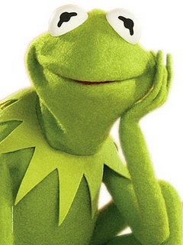
Aimes-tu…
Gustave la grenouille?
Pourquoi ?
Pourquoi (pas)?
J’aime…
Je n’aime pas…
J’adore…
Je déteste …
Parce que je pense que c’est …
Notes:
Pourquoi tu aimes Gustave la grenouille? Pourquoi (pas)?
Do you like Kermit the Frog? Why (not)?
Pupils are encouraged to give opinions using the language they have covered in lessons 1 & 2, and any other language they can recycle from previous lessons.

Slide 25
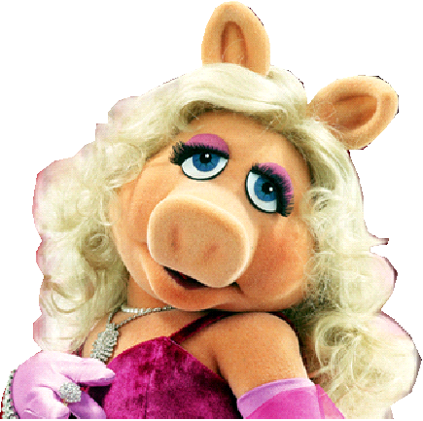
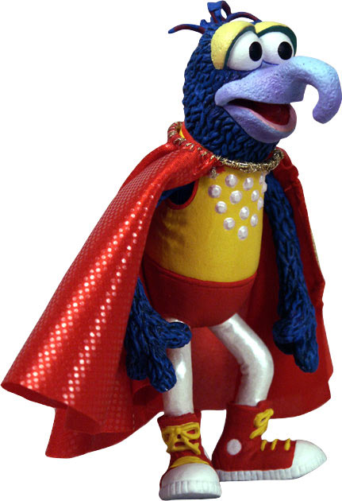
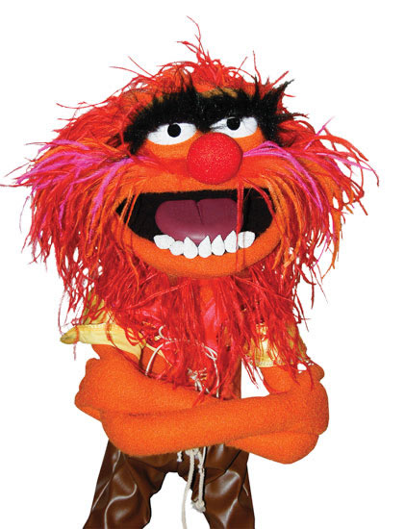
Aimes-tu…?
Pourquoi ?
Pourquoi (pas)?
1
2
Gonzo
Piggy
3
Animal
Notes:
Pourquoi aimes-tu?
Why do you like?
Pupils are encouraged to give opinions using the language they have covered in lessons 1 & 2, and any other language they can recycle from previous lessons.
Characters are revealed on mouse-clicks. Encourage pupils to use feminine singular (red) adjectives for Piggy and masculine singular (blue) adjectives for Gonzo & Animal.

Slide 26
Met un adjectif approprié dans le blanc !
Je n’aime pas mon collège parce que c’est__________.
J’adore les fêtes parce qu’elles sont __________.
Je préfère le football parce que c’est____________.
Mon animal favori est un chat parce que les chats sont _______.
La fille n’est pas bruyante, elle est __________.
Mon anniversaire est très __________.
J’adore les papillons parce qu’ils sont __________.
Pocoyo est très __________.
J’adore les aventures parce qu’elles sont ____________.
J’aime la photo parcque c’est__________.
amusant
émouvant
tranquille
jolis
amusantes
ennuyeux
jolie
bruyant
émouvantes
jolis
Notes:
Met un adjectif approprié dans le blanc !
Write appropriate adjectives in the spaces. Choose from the list at the bottom of the slide.
The rules for adjectival agreement are the same as for the colours. –o, -a, -os, -as. Alternatively if the adjective doesn’t end in –o in the masculine singular it will be the same for the feminine singular and add –es for masculine & feminine plural. The idea is that pupils will use some of the adjectives they have just been introduced to and have practised.
I don’t like school because it’s … (adjective must be masculine singular and fit in terms of meaning).
I like parties because they are … (feminine plural)
I prefer football because it’s … (feminine singular).
My favourite animal is a cat because cats are … (masculine plural).
The girl isn’t noisy, she’s … (feminine singular).
My birthday party is very … (feminine singular).
I love butterflies because they are … (feminine plural).
Pocoyó is very … (masculine singular).
I love adventures because they are … (feminine plural).
I like the photo because it’s … (feminine singular).
Answers appear on mouse-clicks and fly to spaces.

Slide 27
Met un adjectif approprié dans le blanc !
Je n’aime pas mon collège parce que c’est__________.
J’adore les fêtes parce qu’elles sont __________.
Je préfère le football parce que c’est____________.
Mon animal favori est un chat parce que les chats sont _______.
La fille n’est pas bruyante, elle est __________.
Mon anniversaire est très __________.
J’adore les papillons parce qu’ils sont __________.
Pocoyo est très __________.
J’adore les aventures parce qu’elles sont ____________.
J’aime la photo parcque c’est__________.
amusant
émouvant
tranquille
joli
amusant
ennuyeux
joli
bruyant
émouvant
joli
Notes:
Version for printing out

Slide 28

pTouché!
Bataille navale
X Manqué!
Je joue
Tu joues
Il joue
Nous jouons
Vous jouez
Ils jouent
Notes:
Batalla naval (battleships)
Pupils form sentences to try to find the 5 x hidden battleships.
They can do this in two teams until all 5 are found.
Click in the middle of the purple rectangle indicated by the phrase given and it will disappear. Pupils say ‘tocado’ when they get a ship and ‘agua’ when there is only water there.
There is a black/white slide of the game at the end of this lesson, so pupils can play again, but in pairs.

