Slide 1
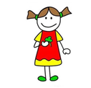
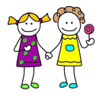
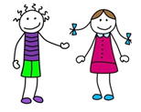
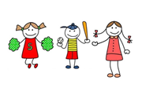
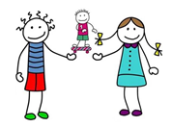
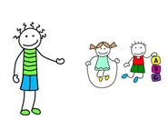
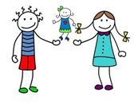
je joue
(one person) | (more than one person)
nous jouons
tu joues
vous jouez
il joue
ils/elles jouent
elle joue
Notes:
These are designed to be made into sets of cards for pupils to play snap with. This set (which has accompanying pictures) might be easier to start with but then pupils could graduate to using the set with words only. I have left one space blank so that pupils can start to predict what might snap with another card – if the pupil can produce the matching snap themselves then they win the pair.
Pupils can cut these up themselves, or make as many sets as they like, but they will need to have a set in Spanish and another in English to produce matching pairs!

Slide 2
(one person) | (more than one person)
I play
we play
you play
you play
he plays
they play
she plays

Slide 3
(one person) | (more than one person)
je joue
nous jouons
tu joues
vous jouez
il joue
ils/elles jouent
elle joue
Notes:
These are designed to be made into sets of cards for pupils to play snap with. This set (which has accompanying pictures) might be easier to start with but then pupils could graduate to using the set with words only. I have left one space blank so that pupils can start to predict what might snap with another card – if the pupil can produce the matching snap themselves then they win the pair.
Pupils can cut these up themselves, or make as many sets as they like, but they will need to have a set in Spanish and another in English to produce matching pairs!

Slide 4
(one person) | (more than one person)
Je joue
Nous jouons
Tu joues
Vous jouez
Il joue
Ils/elles jouent
Elle joue

