Slide 1
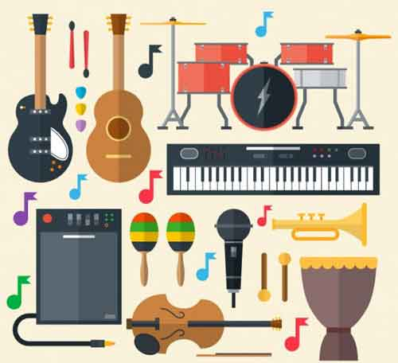

jouer du/de la – to play (instruments)
jouer au – to play (sports)

Slide 2
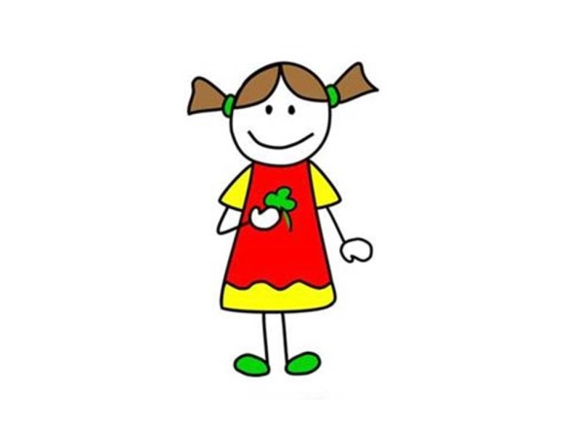
je
[I]
je joue
[I play]
Notes:
Click on ‘je’ and ‘je joue’ to hear it.
NB: This is the 2nd full ER verb paradigm pupils have been introduced to – they met ‘manger’ with foods in the autumn term.
Encourage pupils to point to the person being referred to in order to make this a physical memory activity.
I have included the English here to make it perfectly clear what the pictures stand for, in case there is any ambiguity.
Encourage pupils here to repeat aloud ‘je’ and point at themselves with one finger. (One finger should be used for singular forms and two for plural.)

Slide 3
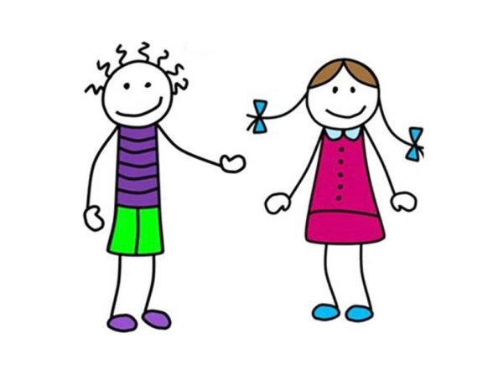
tu
[you, one person]
tu joues
[you play]
Notes:
Encourage pupils here to repeat aloud ‘tu’ and ‘tu joues’and point directly at one other person (looking at them) with one finger.

Slide 4
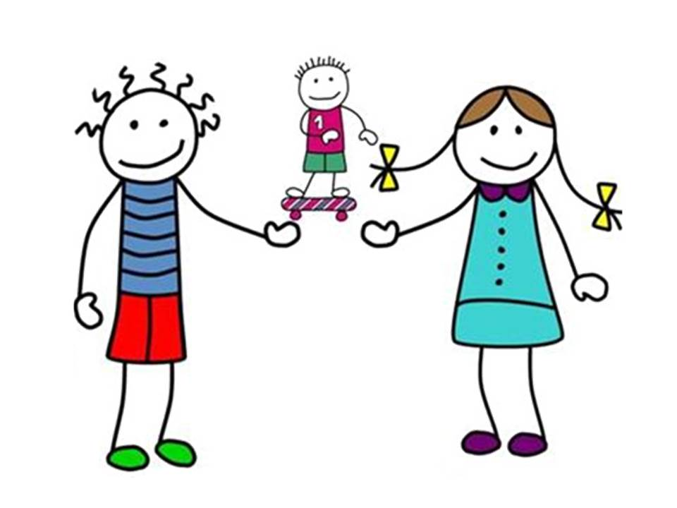
il
[he]
il joue
[he plays]

Slide 5
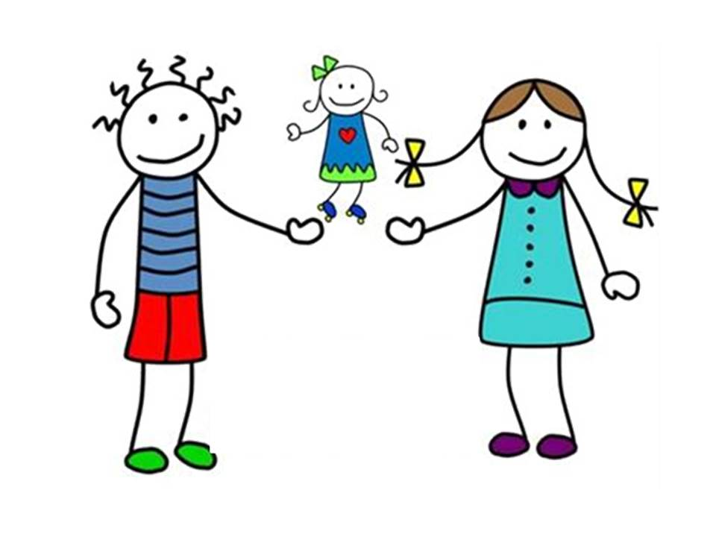
elle
[she]
elle joue
[she plays]

Slide 6
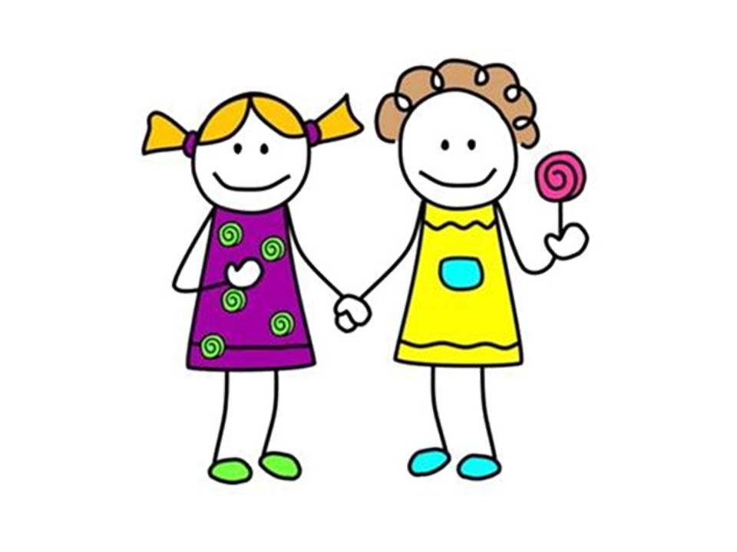
nous
[we]
nous jouons
[we play]
Notes:
Encourage pupils here to repeat aloud ‘nous’ and ‘nous jouons’ and point two fingers (one finger on each hand) at themselves.

Slide 7
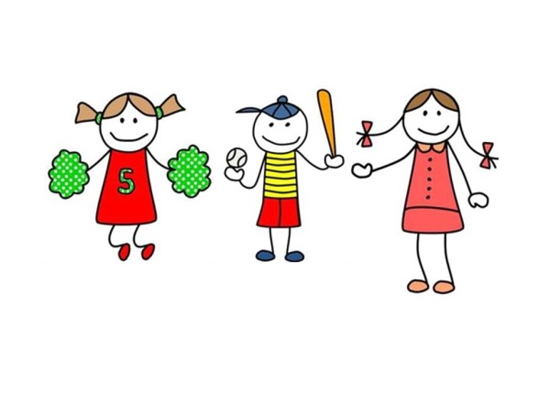
vous
[you, more than one person]
vous jouez
[you (all) play]
Notes:
Encourage pupils here to repeat aloud ‘vous’ and ‘vous jouez’ and point two fingers (one finger on each hand) directly at other people.

Slide 8
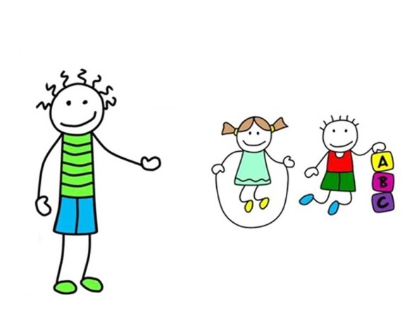
ils
[they]
ils jouent
[they play]
Notes:
Encourage pupils here to repeat aloud ils jouent’ and point two fingers (one finger on each hand) away at other people.

Slide 9
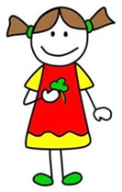
elles
[they (all girls)]
elles jouent
[they play]
Notes:
Encourage pupils here to repeat aloud ils jouent’ and point two fingers (one finger on each hand) away at other people.

Slide 10

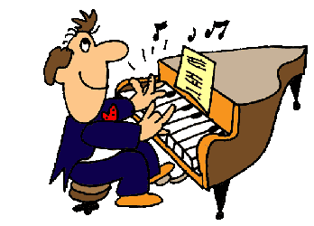
I
Je joue
play
e.g.
Je joue du piano.
Notes:
Here I have tried to make it obvious what information each part of the verb is conveying and why therefore it will be so important to get the ending of the verb right.

Slide 11
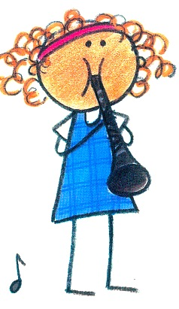
you
Tu joues
play
e.g.
Tu joues de la clarinette ?
Notes:
Here I have tried to make it obvious what information each part of the verb is conveying and why therefore it will be so important to get the ending of the verb right.

Slide 12
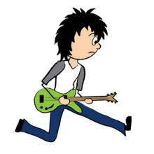
he / she
Il/elle joue
plays
e.g.
Il joue de la guitare.
Notes:
Here I have tried to make it obvious what information each part of the verb is conveying and why therefore it will be so important to get the ending of the verb right.

Slide 13
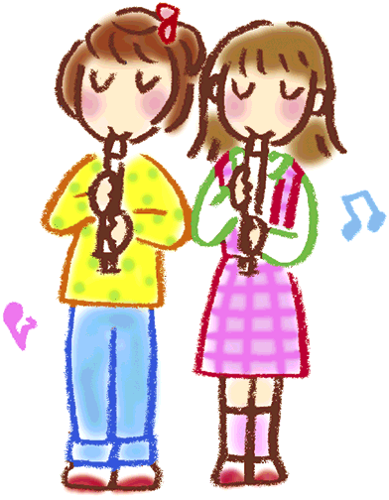
we
Nous jouons
play
e.g.
Nous jouons de la flûte.
Notes:
Here I have tried to make it obvious what information each part of the verb is conveying and why therefore it will be so important to get the ending of the verb right.

Slide 14
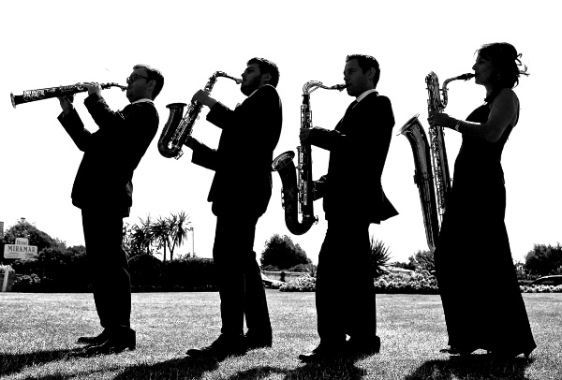
you (more than one)
vous jouez
play
e.g.
Vous jouez du saxophone?
Notes:
Here I have tried to make it obvious what information each part of the verb is conveying and why therefore it will be so important to get the ending of the verb right.

Slide 15

they
Ils jouent
play
e.g.
Ils jouent de la trompette.
Notes:
Here I have tried to make it obvious what information each part of the verb is conveying and why therefore it will be so important to get the ending of the verb right.

Slide 16


Je joue
I play
Notes:
Here pupils should be encouraged to see these two items rather like two matching cards in a card game of Snap!
Pupils are shown here what snaps together so that they can later play a game of snap and match up the correct French and English by calling ‘Snap’.

Slide 17
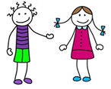
Tu joues
you play
(one person)
Notes:
Here pupils should be encouraged to see these two items rather like two matching cards in a card game of Snap!
Pupils are shown here what snaps together so that they can later play a game of snap and match up the correct French and English by calling ‘Snap’.

Slide 18
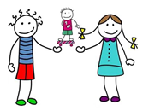
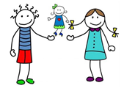
Il joue
he plays
Elle joue
she plays
Notes:
Here pupils should be encouraged to see these two items rather like two matching cards in a card game of Snap!
Pupils are shown here what snaps together so that they can later play a game of snap and match up the correct French and English by calling ‘Snap’.

Slide 19
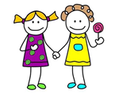
Nous jouons
we play
Notes:
Here pupils should be encouraged to see these two items rather like two matching cards in a card game of Snap!
Pupils are shown here what snaps together so that they can later play a game of snap and match up the correct French and English by calling ‘Snap’.

Slide 20
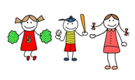
Vous jouez
you play
(more than one person)
Notes:
Here pupils should be encouraged to see these two items rather like two matching cards in a card game of Snap!
Pupils are shown here what snaps together so that they can later play a game of snap and match up the correct French and English by calling ‘Snap’.

Slide 21
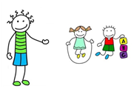
Ils jouent
they play
Notes:
Here pupils should be encouraged to see these two items rather like two matching cards in a card game of Snap!
Pupils are shown here what snaps together so that they can later play a game of snap and match up the correct French and English by calling ‘Snap’.

Slide 22

SNAP?
Tu joues
she plays
Notes:
Play this as a game against the class. Perhaps give them a count of 3 to then call out whether it is snap or not. A point to the class every time they get it right, and a point to you every time someone calls out ‘Snap!’ incorrectly.

Slide 23
SNAP?
Nous jouons
we play
Notes:
Play this as a game against the class. Perhaps give them a count of 3 to then call out whether it is snap or not. A point to the class every time they get it right, and a point to you every time someone calls out ‘Snap!’ incorrectly.

Slide 24
SNAP?
Ils jouent
they play
Notes:
Play this as a game against the class. Perhaps give them a count of 3 to then call out whether it is snap or not. A point to the class every time they get it right, and a point to you every time someone calls out ‘Snap!’ incorrectly.

Slide 25
SNAP?
je joue
you play
(one person)
Notes:
Play this as a game against the class. Perhaps give them a count of 3 to then call out whether it is snap or not. A point to the class every time they get it right, and a point to you every time someone calls out ‘Snap!’ incorrectly.

Slide 26
SNAP?
Je joue
he plays
Notes:
Play this as a game against the class. Perhaps give them a count of 3 to then call out whether it is snap or not. A point to the class every time they get it right, and a point to you every time someone calls out ‘Snap!’ incorrectly.

Slide 27
SNAP?
Je joue
I play
Notes:
Play this as a game against the class. Perhaps give them a count of 3 to then call out whether it is snap or not. A point to the class every time they get it right, and a point to you every time someone calls out ‘Snap!’ incorrectly.

Slide 28
SNAP?
Elle joue
she plays
Notes:
Play this as a game against the class. Perhaps give them a count of 3 to then call out whether it is snap or not. A point to the class every time they get it right, and a point to you every time someone calls out ‘Snap!’ incorrectly.

Slide 29
SNAP?
Nous jouons
we play
Notes:
Play this as a game against the class. Perhaps give them a count of 3 to then call out whether it is snap or not. A point to the class every time they get it right, and a point to you every time someone calls out ‘Snap!’ incorrectly.

Slide 30
SNAP?
Vous jouez
you play
(more than one person)
Notes:
Play this as a game against the class. Perhaps give them a count of 3 to then call out whether it is snap or not. A point to the class every time they get it right, and a point to you every time someone calls out ‘Snap!’ incorrectly.

Slide 31
SNAP?
Tu joues
you play
(one person)
Notes:
Play this as a game against the class. Perhaps give them a count of 3 to then call out whether it is snap or not. A point to the class every time they get it right, and a point to you every time someone calls out ‘Snap!’ incorrectly.

Slide 32
SNAP?
Ils jouent
you play
(more than one person)
Notes:
Play this as a game against the class. Perhaps give them a count of 3 to then call out whether it is snap or not. A point to the class every time they get it right, and a point to you every time someone calls out ‘Snap!’ incorrectly.

Slide 33
SNAP?
Ils jouent
they play
Notes:
Play this as a game against the class. Perhaps give them a count of 3 to then call out whether it is snap or not. A point to the class every time they get it right, and a point to you every time someone calls out ‘Snap!’ incorrectly.

Slide 34
SNAP?
Je joue
I play
Notes:
Play this as a game against the class. Perhaps give them a count of 3 to then call out whether it is snap or not. A point to the class every time they get it right, and a point to you every time someone calls out ‘Snap!’ incorrectly.

Slide 35
SNAP?
Tu joues
you play
(one person)

Slide 36
SNAP?
Elle joue
she plays
Notes:
Play this as a game against the class. Perhaps give them a count of 3 to then call out whether it is snap or not. A point to the class every time they get it right, and a point to you every time someone calls out ‘Snap!’ incorrectly.

Slide 37
jouer: to play
(singular)
(plural)
Je joue
Nous jouons
I play
we play
Tu joues
Vous jouez
you play (1)
you play (2+)
Il/elle joue
Ils/elles jouent
he/she plays
they play
Notes:
Here is the full verb pattern.
Now pupils can play snap with cards of their own (see accompanying resource).

Slide 38

Remplissez les blancs?
Salut ! Je m’appelle Sophie et j’ai dix ans. _____ de la guitare et j’aime la musique pop. Mon frère Paul préfère le rap et _____ de la batterie. Mes amies Sylvie et Simon aiment la musique classique et_________ du violon.
Je joue I play
Tu joues you play (sg.)
Il/elle joue he / she plays
Nous jouons we play
Vous jouez you play (pl.)
Ils/elles jouent they play
Je joue
Il joue
ils jouent
Notes:
Pupils need to use their reading skills to work out which part of ‘jouer’ fits in the three gaps.
Give pupils a few moments to puzzle this out – this is challenging but brighter pupils in the group will enjoy the task.
Then work through with the whole class, drawing out how they can work out from the surrounding words which part of the verb fits.
Click on the verb box to hear the whole verb paradigm.
Click on the text box to hear the whole Sophie text.
This slide is taken from ALL Connect KS2 Writing module.

