Slide 1

Tu aimes la musique?

Slide 2
Numéro | Exemple | Type de musique | Ton opinion
1
reggae
2
hip hop
3
musique classique
4
folk
5
rock
6
jazz
7
pop
8
musique traditionnelle
hip hop | reggae | classique | folk
jazz | rock | traditionnelle | pop
Notes:
There are 30 secs of each type of music to play to the students.
Click on the audio buttons to hear each one.
As they listen they should identify the type of music they think it is, and also write in their own opinion (J’aime etc…)
The types of music are animated to appear one by one. Teachers may want to feed back after each excerpt, asking:
C’est quel type de musique? C’est …
Tu aimes la musique reggae?
NB: When you click on the numbers, you hear the question ‘Tu aimes (le reggae)? etc…
If you use the noun ‘la musique’ in front of each type it keeps the gender / definite article the same (la) which is one way to do it.
On the other hand, the types that are essentially an English word (reggae, hip hop, rock, jazz, pop) can all just be ‘le + word’
le jazz, le rock etc… This is what I’ve done when you click on the words after they have appeared in the answer column.

Slide 3



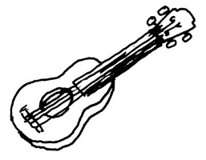




C’est quel type de musique ?
A
B
C
D
E
F
G
H
Tu aimes?
Notes:
Click on each picture to hear the audio for each type of music.
Slide to practise the new words.

Slide 4



J’aime!
Je n’aime pas!
Tu es fou!
Tu es fou!
Qu’en penses-tu?
Tu es folle!
Tu es folle!
Moi aussi!
Moi non plus!
Me, too!
Me, neither!
C’est génial!
C’est moche!
Notes:
A talk routine for giving and asking for opinions.
Pupils will need to practise these first, just like any another language, especially the me too, me neither.
When they are confident with having the same opinion as the person who starts (I like → me, too. I don’t like → me, neither.) introduce them to the either of giving an alternative opinion, using ‘Tu es fou/folle?’(are you mad?) followed by the alternative ‘j’aime’ or ‘Je n’aime pas’.
They should practise in pairs, talking about the different types of music.
OR, use the following slide with different musical acts they may know! (Labelled for teachers, more than anything else!)

Slide 5
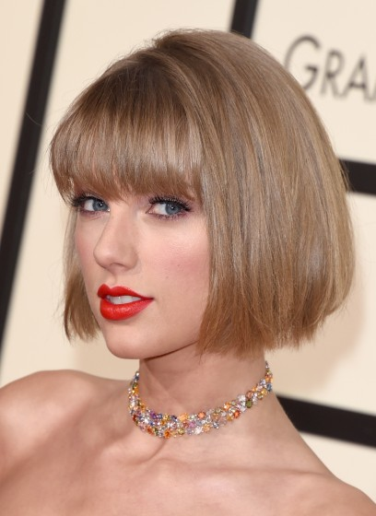
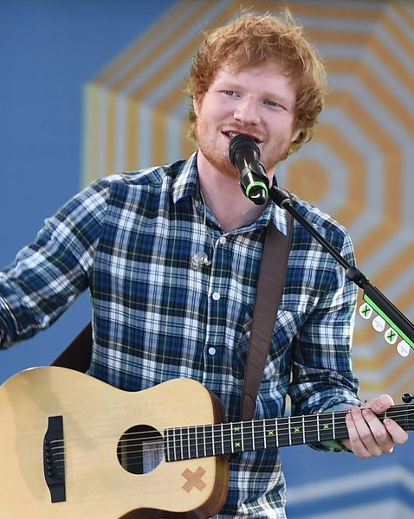

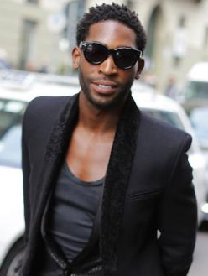
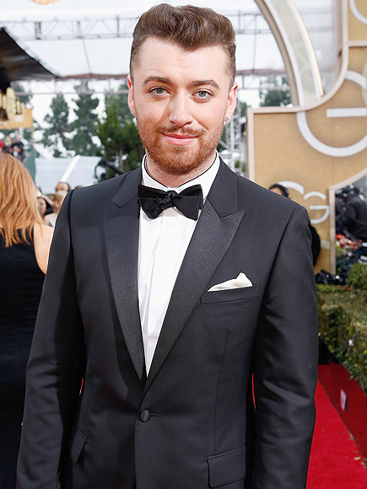

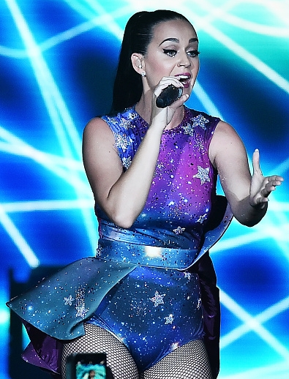
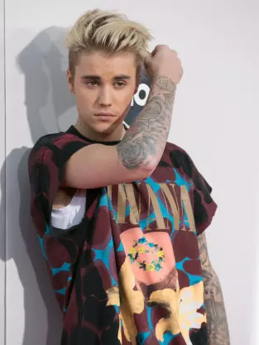
Taylor Swift
Ed Sheeran
One Direction
Tinie Tempah
Sam Smith
Little Mix
Katie Perry
Justin Bieber

Slide 6
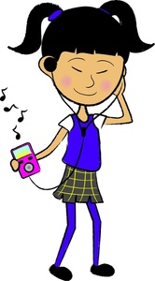
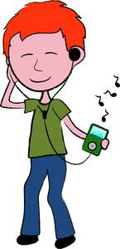
Écris tes opinions.
Quels groupes et chanteurs aimes-tu?
Ed Sheeran
J’adore__________ et aussi j’aime________ mais je n’aime pas _________ et je déteste______________.
Katie Perry
Little Mix
Justin Bieber
Notes:
Pupils conclude the lesson by writing a summary of their likes and dislikes – if they don’t like pop music at all, they can write instead about the types of music they like and dislike.
They could then practise giving their opinions orally, doing look, cover, say and check until they can speak confidently, and from memory.
Click on the text to hear it with gaps.

