Slide 1



Tu aimes…?
Notes:
Pupils should now form their own questions and work in pairs to seeking and giving opinions.

Slide 2
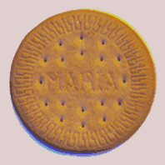




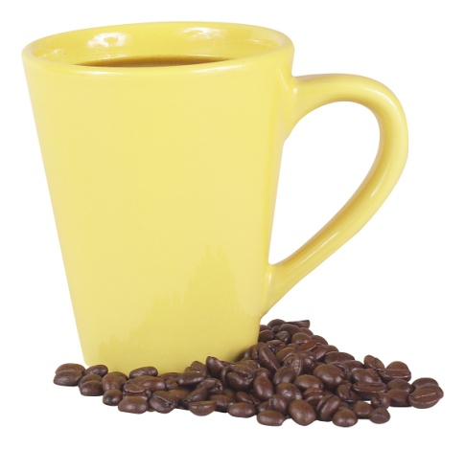


Tu aimes…?
le coco
les biscuits
les sandales
les lapins
le café
le foot

Slide 3


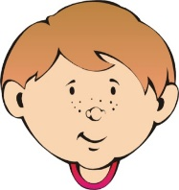



Tu aimes…?
les garçons
les filles
les hamburgers
le français
le fromage
la glace

Slide 4




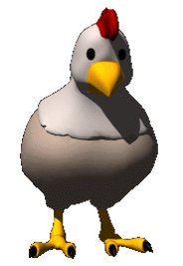

Tu aimes…?
les éléphants
le soleil
le lait
la natation
les poules
les poissons

Slide 5
Tu aimes …?
Notes:
Pupils should now form their own questions and work in pairs to seeking and giving opinions.

Slide 6
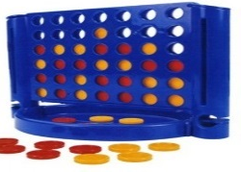
















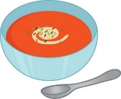


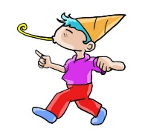


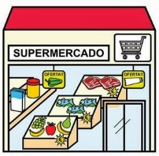






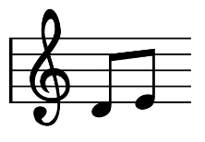






Connecte 4
 | a | b | c | d | e | f
6
5
4
3
2 |  |  |  |  | l
1
le soleil
le fromage
les chats
le février
le rose
la neige
les hamburgers
les araignées
les saucisses
les poissons
les grenouilles
l’eau
les livres
les gâteaux
le café
le tennis
les pommes
la soupe
le ski
les fêtes
Noël
les poules
les supermarchés
les sports
les bonbons
les orages
les Simpson
la musique
le lait
la gymnastique
la glace
le football
la salade
les souris
le yaourt
le rouge
Notes:
NB: all of the pictures have sound if you click on them.
Connect 4
Pupils in two teams. They give a full sentence with the opinion + article + noun. E.g. j’aime la glace.
They nominate their square by giving coordinates in SFrench e.g. Un-a
Must build up from bottom of grid – aim is to get four in a row before the other team.
The teacher can put a O or X over the correctly named square.
In this version the focus is only on recalling the correct opinion verb and pronouncing correctly.
In the version that follows, emphasis is also on recalling the nouns and articles correctly.

Slide 7
Connecte 4
 | a | b | c | d | e | f
6
5
4
3
2 |  |  |  |  | l
1
l_ s_____
l_ f______
l__ c____
l_ f_______
l_ r___
l_ n____
l__ h_________
l__ a_______
l__ s________
l__ p_______
l__ g____________
l’e__
l__ l_____
l__ g_______
l_ c___
l_ t_____
l__ p_____
l_ s____
l_ s__
l__ f____
l_ N___
l_ p_____
l__ s____________
l__ s____
l__ b______
l__ o_____
l__ S______
l_ m______
l_ l___
l_ g_______
l_ g____
l_ f_______
l_ s_____
l__ s_____
l_ y______
l_ r____
Notes:
NB: all of the pictures have sound if you click on them.

Slide 8
Connecte 4
 | a | b | c | d | e | f
6
5
4
3
2 |  |  |  |  | l
1
Notes:
NB: all of the pictures have sound if you click on them.

