Slide 1

Les opinions
Notes:
Les opinions = Opinions. In this lesson pupils will learn to understand and give their own opinions about singular items.

Slide 2


J’aime…
Je n’aime pas…
J’adore…
Je déteste…
Notes:
J’aime= I like, Je n’aime pas = I don’t like, J’adore = I love, Je déteste = I hate
The picture appears first on mouse click and then the opinion.
Allow pupils to repeat the French several times so that they become familiar with it.

Slide 3
Notes:
Mouse click to see icons flash one by one – they disappear immediately afterwards so pupils have to pay attention to be able to volunteer the French for each picture shown. Elicit the 4 phrases from the previous slide.
The first four appear with audio and thereafter pupils volunteer the correct phrase.

Slide 4
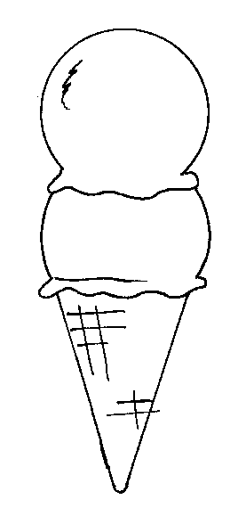



Tu aimes?
1
2
1
2
le cirque
la glace
3
3
4
4
Je n’aime pas le collège et je déteste le cirque mais j’aime le fromage et j’adore la glace.
le fromage
le collège
Notes:
Tu aimes…? = Do you like? (Click on word beneath pictures 1-4 to hear pronunciation if need be.)
Click on the pink button to hear the audio. Pupils must then draw the appropriate icon (smiling faces etc.) beside the appropriate number.
Answers appear on mouse clicks.
Audio = ‘Je n’aime pas le collège et je déteste le cirque mais j’aime le fromage et j’adore la glace..’ Play the clip 2 or 3 (or 4!) times before revealing answers.
Pupils will get them all if they listen enough times. Try to reassure them at the start that they might need 4 goes – 1 x answer per time.
This activity really gets pupils used to listening to longer stretches of speech and being resilient to extract the meaning. (Really able pupils can try transcribing on subsequent hearings if they get all the answers first time).

Slide 5





Tu aimes?
1
2
1
2
le zoo
le jus
3
3
4
4
1. j’adore le zoo.
2. Je n’aime pas le jus.
3. Je déteste la pizza.
la pizza
la science
4. j’aime la science.
Notes:
Tu aimes? = Do you like?
The opinion icons are now shown and pupils must say/write in French the opinion shown about each picture/word 1-4. Written answers appear on further mouse clicks and there is audio attached to both the opinion icons and the sentences.

Slide 6



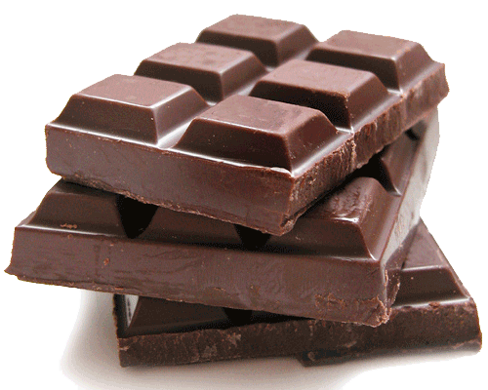


Tu aimes?
le soleil
le thé
le lait
le chocolat
la France
la natation
Notes:
Tu aimes?= Do you like?
Teacher should now invite pupils to give their own opinions on the six items shown. Simply combine the question with the vocabulary item listed, e.g. ¿Tu aimes….? etc. Teacher can ask questions and then pupils can work in pairs asking each other & giving answers. Click on the written word for a reminder on pronunciation if need be.

Slide 7
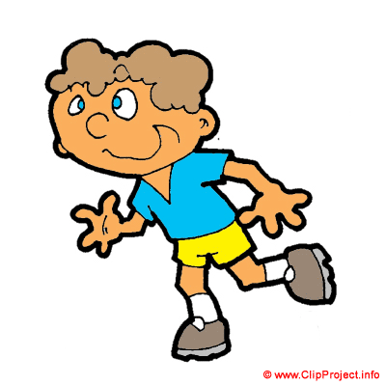
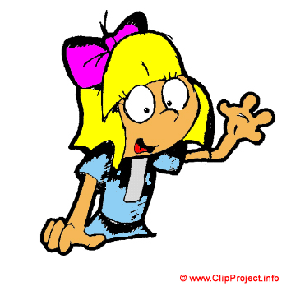
Que pense le garçon ?
Je n’aime pas la ________ et je déteste la ________ mais j’aime le________ et j’adore la ________ .
Que pense la fille ?
Je n’aime pas le______mais j’aime la ________ et j’adore le ________.
Notes:
Using the short listening exercise as a template pupils are now asked to fill in their own variables for what these two people might say that they like/dislike. They will need to pay attention to the number & gender of the words they choose as it is made clear (with use of colour-coding & el/la (singular)) which gender they should be.
et = and, mais = but.

Slide 8
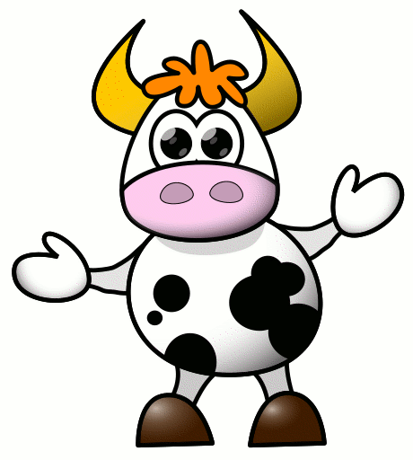
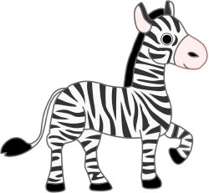
J’aime la vache.
J’aime les vaches.
Je n’aime pas le zèbre.
Je n’aime pas les zèbres.
Notes:
Plurals – revisit le/la/les

Slide 9
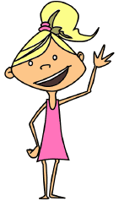
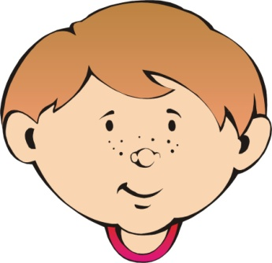

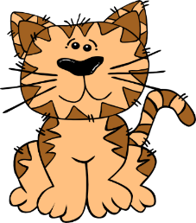
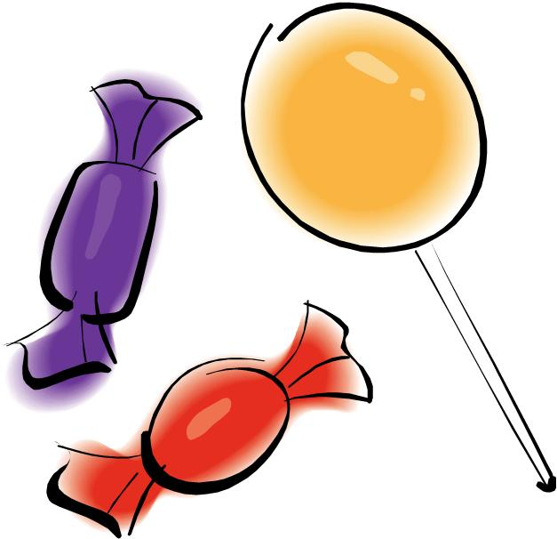

Tu aimes les…?
garçons
filles
bananes
chats
bonbons
fêtes
Notes:
Do you like = Tu aimes les…?
Pupils give their opinions

Slide 10



Tu aimes le / la / les…?
Notes:
Pupils should now form their own questions and work in pairs to seek and give opinions.

