Slide 1
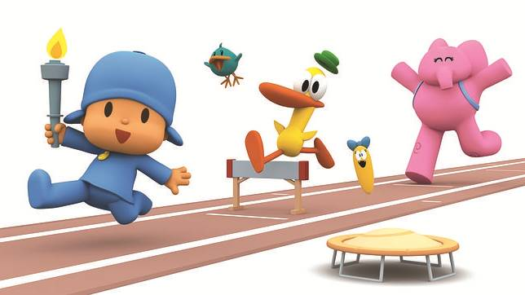
Maintenant nous allons analyser les formes du verbe ‘faire’ et utiliser ce verbe.
Pocoyo fait du sport.
Pato et Elly font du sport aussi.
Notes:
Today we are going to recognise and use appropriate forms of the verb ‘faire’.
‘Pocoyó does sport’. ‘Pocoyó and Pato (Duck) and Elly do sport’.

Slide 2
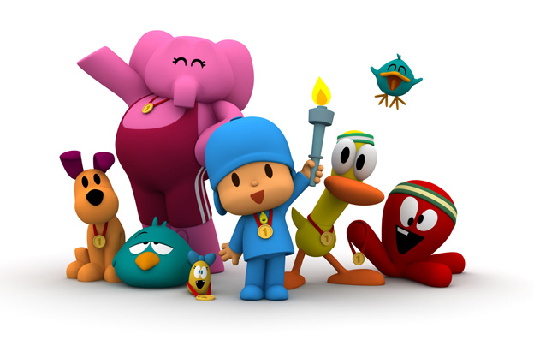
Quel sport fais-tu, Pocoyo?
Je fais beaucoup de sports
Par exemple…
Quel sport fais-tu, Pocoyo?
Notes:
Which sports does Pocoyo do?
Which sports do you do Pocoyo?
I do lots of sports. For example…

Slide 3
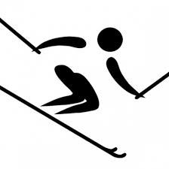











A
B
C
D
E
F
G
H
I
J
K
L
Notes:
Sports are l’athletisme, la natation, le ski, le cyclisme l’equitation, la voile la gymnastique l’escrime le judo l’halterophilie le tir a l’arc la boxe
Ask pupils to volunteer which letter the sports are as you choose which ones to say out loud. This should be a straightforward task for all to participate in.

Slide 4
Notes:
Print out this sheet and provide one each for pupils who can then can cut it up along the lines into 12 picture cards so that pupils can complete physical listening activity and, later, sentence-building activities.

Slide 5
1
Notes:
Card sort activity: Read out the sports. Pupils must order their own cards in the same order as the one dictated. Get pupils to feedback correct order answers in Spanish and click to reveal the correct order one-by-one.

Slide 6
2
Notes:
Card sort activity (part 2: different order): read them out in a different order. Pupils must put their cards in the same order as dictated. Then click to reveal the correct order and check pupils’ answers. Ask for volunteers to read out sports vocabulary as answers in the right order.

Slide 7
3
Notes:
Card sort activity (part 3: different order) Read out the sports in a different order. Pupils must put their cards in the same order. Then click to reveal the correct order. Teacher might then read their own order out, or ask a pupil or two to read the sports out in an order of their choice.

Slide 8
Notes:
Pupils should recall the appropriate vocabulary as the sports appear on clicks.
You may want to revisit the previous slides and get a pupil to call out the sports in the appropriate order (allowing the pupil to see the correct order without projecting this on a projector screen) so that they can take some control.

Slide 9
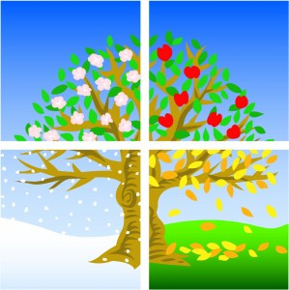
Les saisons
au printemps
en été
en hiver
en automne
Notes:
A revision of the seasons (introduced to pupils in Yr4 autumn lesson 5) so that these can be incorporated to add interest to pupils’ writing about sports used with ‘faire’.

Slide 10
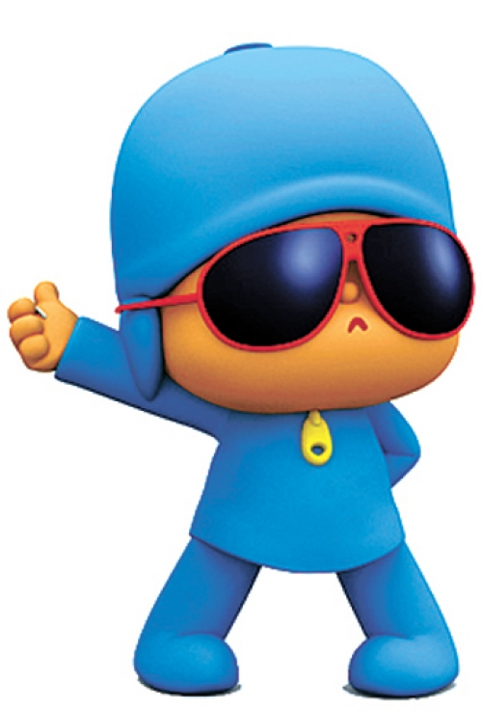
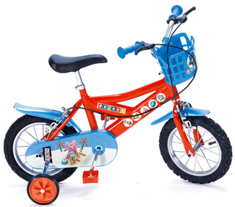
Au printemps Pocoyo fait du cyclisme deux fois par semaine.
Notes:
A text description will appear on the first click, disappear on the second and reappear on the third.
This is to encourage pupils to take longer sentences on board and attempt to reproduce them in full from memory.

Slide 11
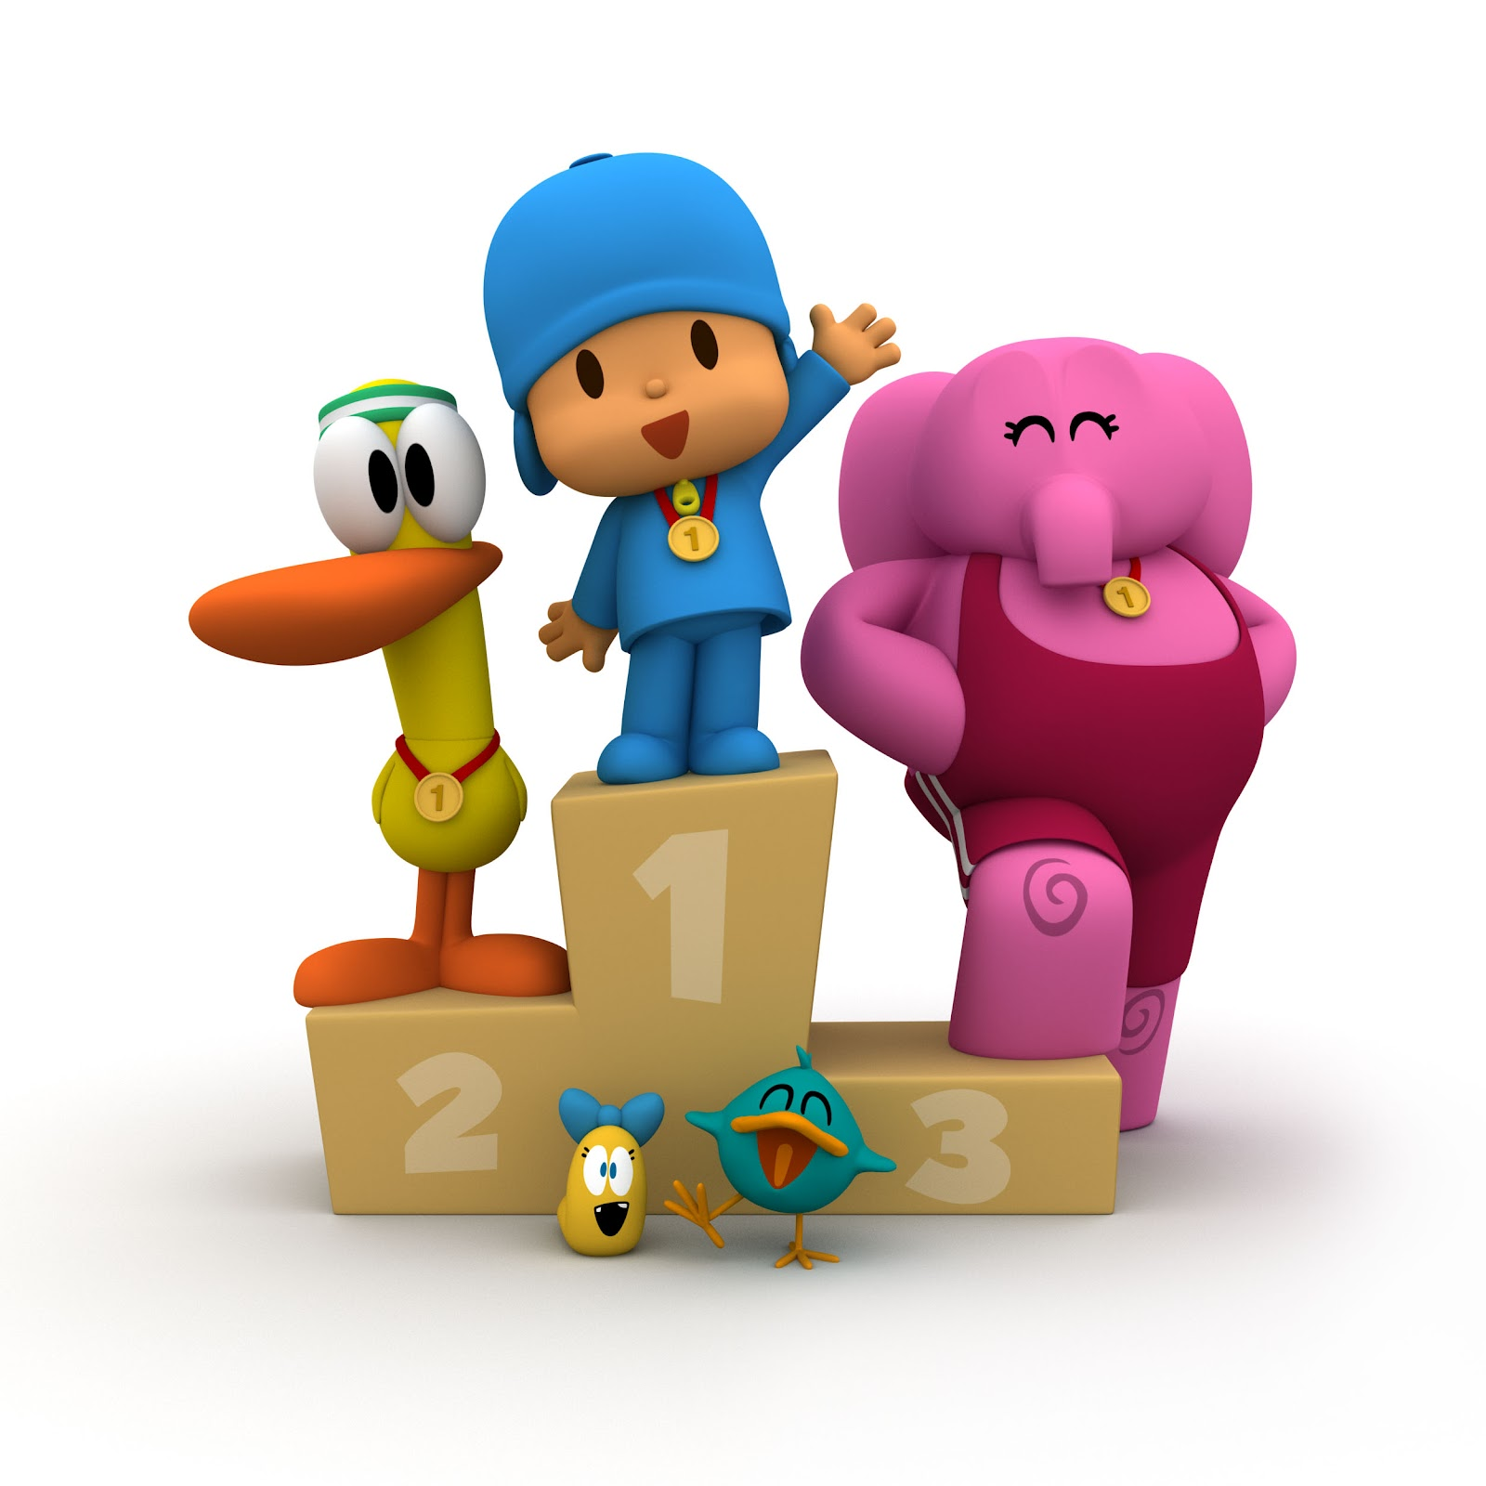
En été Pato, Elly et Pocoyo font de l’athlétisme le samedi.
Notes:
A text description will appear on the first click, disappear on the second and reappear on the third.
This is to encourage pupils to take longer sentences on board and attempt to reproduce them in full from memory.

Slide 12
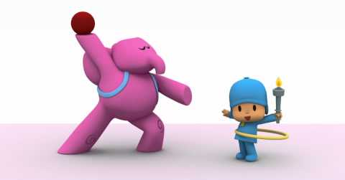
En automne Elly et Pocoyo font de la gymnastique parfois.
Notes:
A text description will appear on the first click, disappear on the second and reappear on the third.
This is to encourage pupils to take longer sentences on board and attempt to reproduce them in full from memory.

Slide 13

En hiver Pato et Pocoyo font du ski
tous les jours.
Notes:
A text description will appear on the first click, disappear on the second and reappear on the third.
This is to encourage pupils to take longer sentences on board and attempt to reproduce them in full from memory.

Slide 14
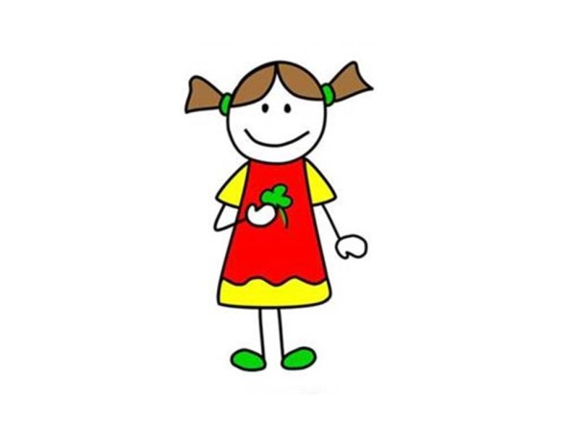

1 x week
Quelle phrase est correcte?
a. Je fais de la natation une fois par mois.
b. Je fais de l’athlétisme une fois par mois.
c. Je fais de l’athlétisme une fois par semaine.
d. Je fais de la natation une fois par semaine.
Notes:
Which of the sentences is the correct one?
Pupils must look at the pictures and choose the sentences which matches in terms of meaning and grammar.

Slide 15
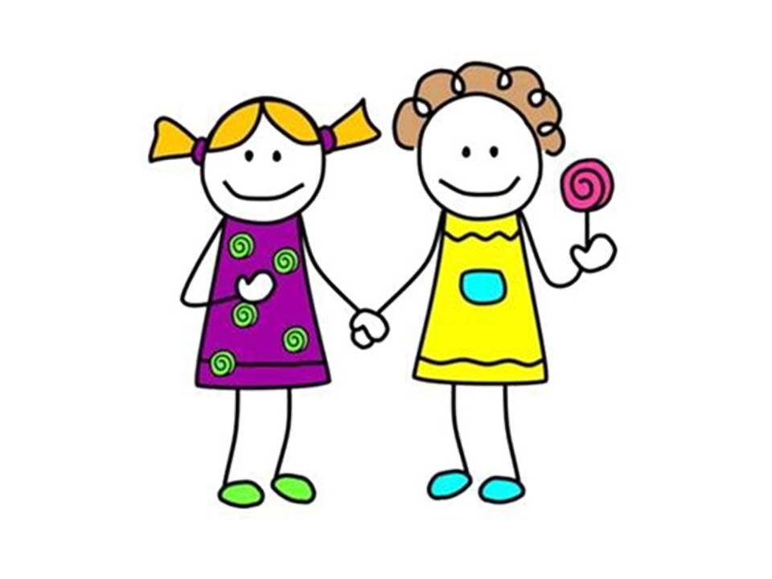
every day
Quelle phrase est la phrase correcte?
a. Je fais de la natation le mardi.
b. Nous faisons du ski chaque jour.
c. Nous faisons du cyclisme tous les jours.
d. Nous faisons de la natation tous les jours.

Slide 16
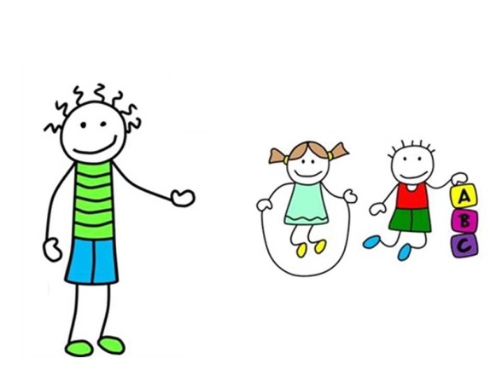
never
Quelle phrase est la phrase correcte?
a. Je ne fais pas de ski.
b. Ils ne font jamais de ski.
c. Il fait du ski.
d. Nous ne faisons jamais de ski.

Slide 17
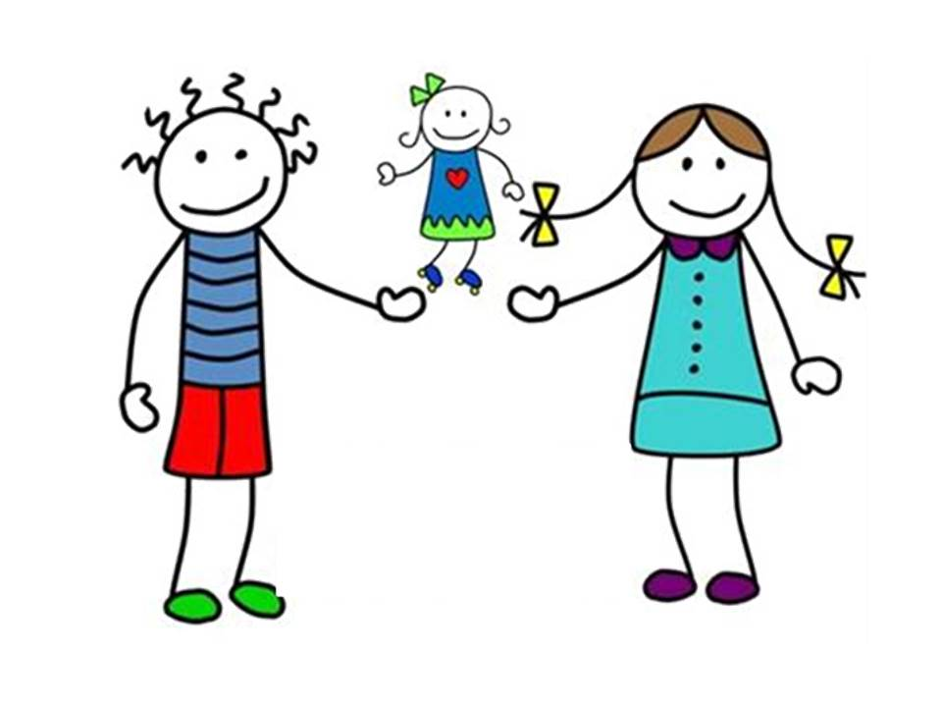

sometimes
Quelle phrase est la phrase correcte?
a. Je fais du cyclisme deux fois par semaine.
b. il fait du cyclisme deux fois par semaine.
c. Ils font du cyclisme parfois.
d. Je fais du cyclisme parfois.

Slide 18
Je fais du sport parce que j’adore le sport et je suis très sportif.
J’ai un cheval blanc et au printemps je fais de l’équitation quatre fois par semaine. Aussi, je fais de l’escrime une fois par semaine.
En été, mon amie Anna et moi faisons de la natation tous les jours et nous faisons du tir à l’arc trois fois par mois. Je ne fais jamais d’athlétisme parce que je n’aime pas ça.
En automne mes amis font du cyclisme le dimanche. Je ne fais pas de cyclisme en hiver parce que je fais du judo le dimanche. Le judo, c’est fantastique!
En hiver parfois je fais du ski mais ma maman ne fait pas de ski parce qu’elle pense que c’est trop difficile.
Et toi ? Quels sports fais-tu ?
Notes:
Texts are revealed one by one to avoid overwhelming pupils. Leave this displayed whilst pupils write about which sports they do using the template on the next slide.

Slide 19
Write about which sports you (and others) do (or don’t do) in which seasons and how often you do them. For the time being try to use only the sports which are used with the verb ‘faire’. You will deal with the sports which are used with ‘jouer’ in another lesson.
Au printemps…
En hiver…
En autômne…
En hiver…
Notes:
Print this slide for pupils to write on.

