Slide 1
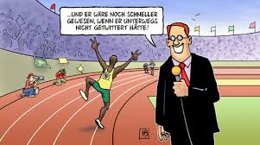
Maintenant nous allons apprendre les formes du verbe ‘faire’.
Usain Bolt fait de l’athlètisme.
Notes:
Today we are going to repeat and learn the different forms of the verb ‘faire’.
Usain Bolt does athletics.
(Notice the ending is now ‘t’ , il fait, not ‘s’ as for je fais

Slide 2
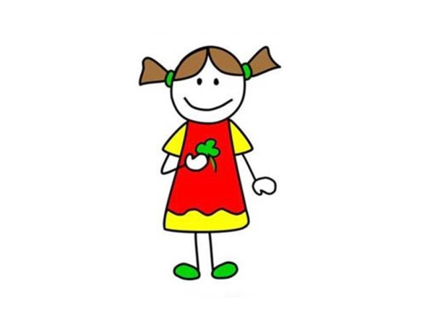

je fais
Notes:
Encourage pupils to point to the person being referred to in order to make this a physical memory activity.
I have included the English here to make it perfectly clear what the pictures stand for, in case there is any ambiguity.
Encourage pupils here to repeat aloud ‘je fais ’ and point at themselves with one finger. (One finger should be used for singular forms and two for plural.)

Slide 3
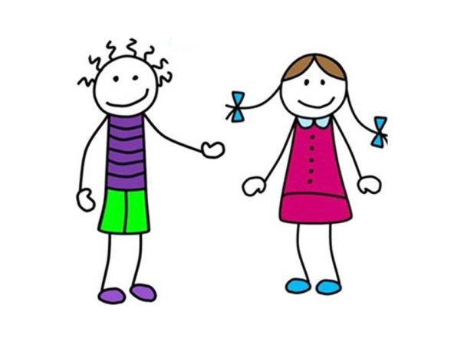

tu fais
Notes:
Encourage pupils here to repeat aloud ‘tu fais and point directly at one other person (looking at them) with one finger.
Explain informal ‘ you’

Slide 4
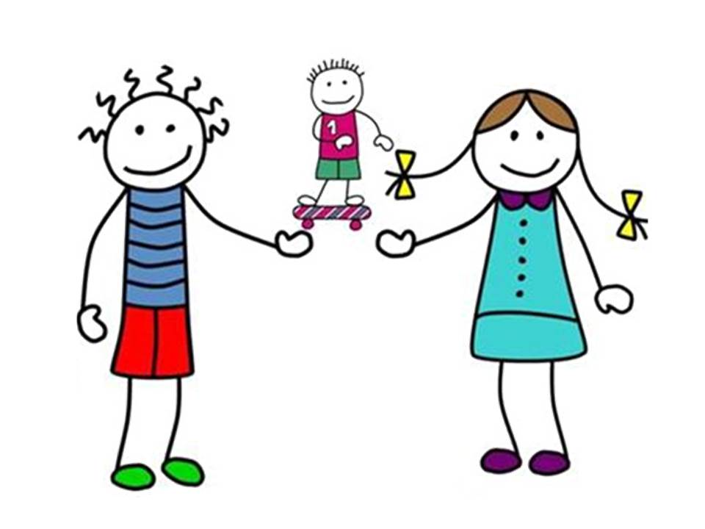

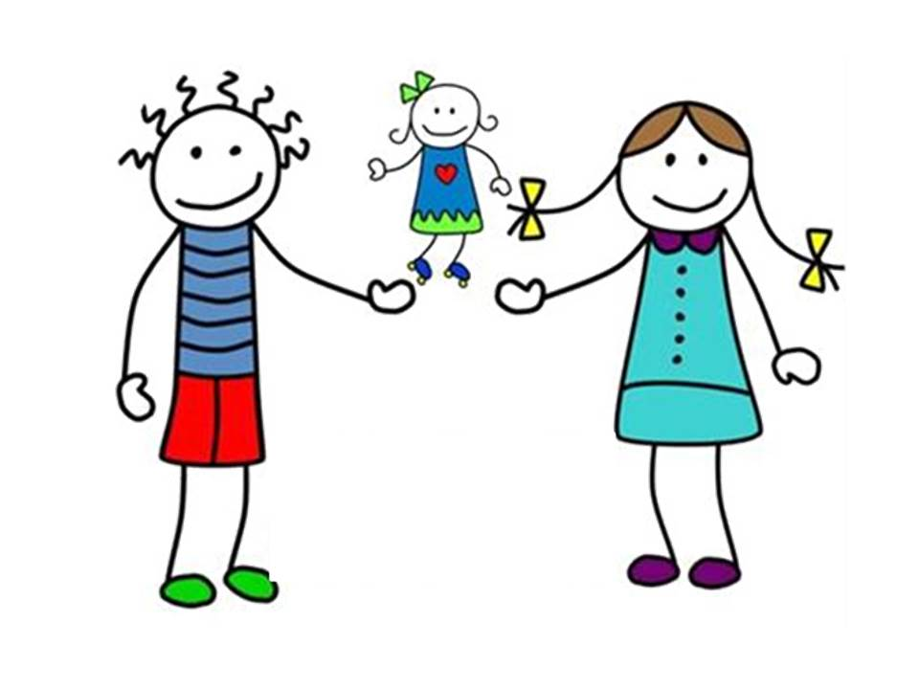

il /elle fait
Notes:
Encourage pupils here to repeat aloud ‘il fait’ and point away first at a boy (with one finger) and then ‘elle fait’ again but point away at a girl (with one finger).

Slide 5
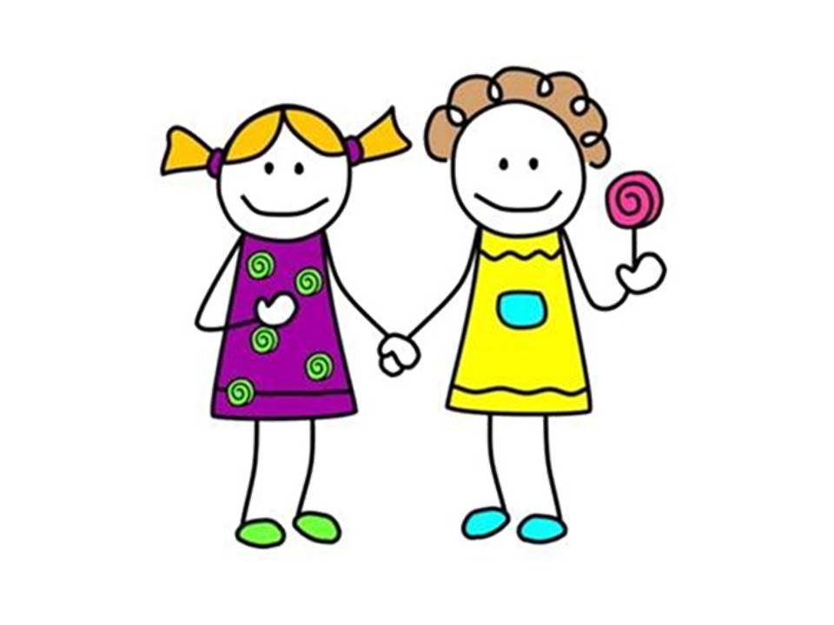

Nous faisons
Notes:
Encourage pupils here to repeat aloud ‘nous faisons’ and point two fingers (one finger on each hand) at themselves.

Slide 6
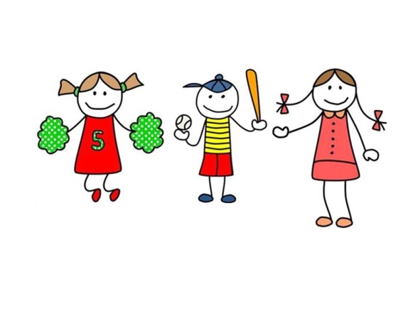
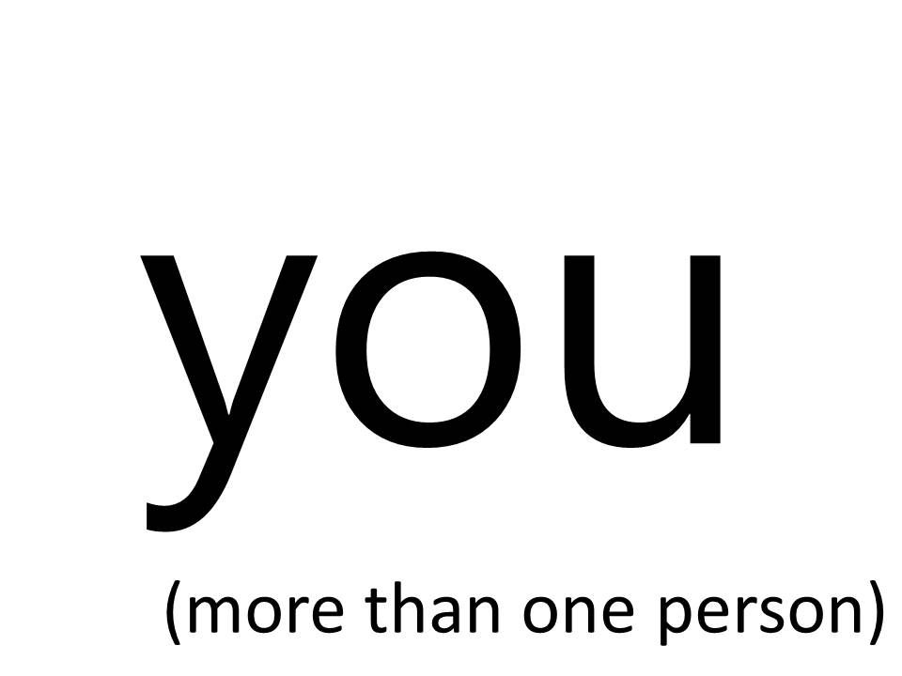
Vous faites
Notes:
Encourage pupils here to repeat aloud ‘vous faites’ and point two fingers (one finger on each hand) directly at other people.
Explain formal ‘ you’ rules with a salute

Slide 7
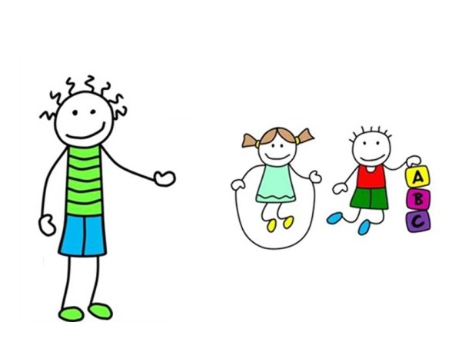

Ils/elles font
Notes:
Encourage pupils here to repeat aloud ‘ils/ells font’ and point two fingers (one finger on each hand) away at other people.

Slide 8

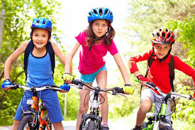
I
do
e.g.
Je fais du cyclisme.
Notes:
Here I have tried to make it obvious what information each part of the verb is conveying and why therefore it will be so important to get the ending of the verb right.

Slide 9
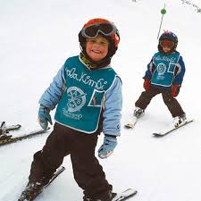
You (1/informal
do
e.g.
Tu fais du ski ?
Notes:
Here I have tried to make it obvious what information each part of the verb is conveying and why therefore it will be so important to get the ending of the verb right.

Slide 10
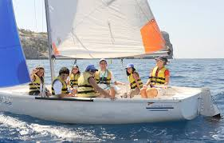
he/she
does
e.g.
Il/elle fait de la voile
Notes:
Here I have tried to make it obvious what information each part of the verb is conveying and why therefore it will be so important to get the ending of the verb right.

Slide 11
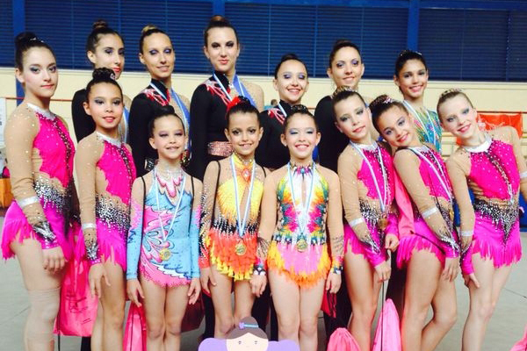
we
do
e.g.
Nous faisons de la gymnastique
Notes:
Here I have tried to make it obvious what information each part of the verb is conveying and why therefore it will be so important to get the ending of the verb right.

Slide 12
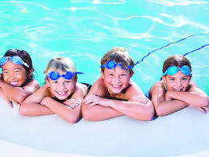
you (2+/formal)
do
e.g.
Vous faites de la natation
Notes:
Here I have tried to make it obvious what information each part of the verb is conveying and why therefore it will be so important to get the ending of the verb right.

Slide 13
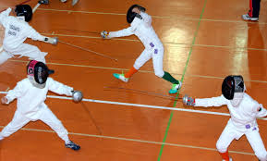
they
do
e.g.
Ils/elles font de l’escrime.
Notes:
Here I have tried to make it obvious what information each part of the verb is conveying and why therefore it will be so important to get the ending of the verb right.

Slide 14
faire: to do (sports)
(singular)
(plural)
Je fais
Nous faisons
I do
we do
Tu fais
Vous faites
you do (1 /informal)
you do (2+/ formal)
Il/elle fait
Ils/elles font
he/she does
they do
Notes:
Here is the full verb pattern.
Now pupils can play snap with cards of their own (see accompanying resource).

Slide 15

Faire – to do
Je fais, tu fais
Je fais, tu fais
Il, elle fait
Il, elle fait
Nous faisons, vous faites
Nous faisons, vous faites
Ils elles font
Ils elles font
Merci, Mademoiselle Matrat ☺ ☺
https://www.youtube.com/watch?v=-1RvCib-0Zg&t=6s
Notes:
Sing to the tune of Frere Jacques

