Slide 1
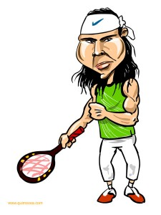
Maintenant, nous allons utiliser les mots
pour donner une opinion sur les sports.
J’adore le tennis et toi, tu aimes le tennis ?
Notes:
Today we are going to practise vocabulary about sports and give our opinions of these sports.
Rafa Nadal: I love tennis! And you, do you like tennis?

Slide 2
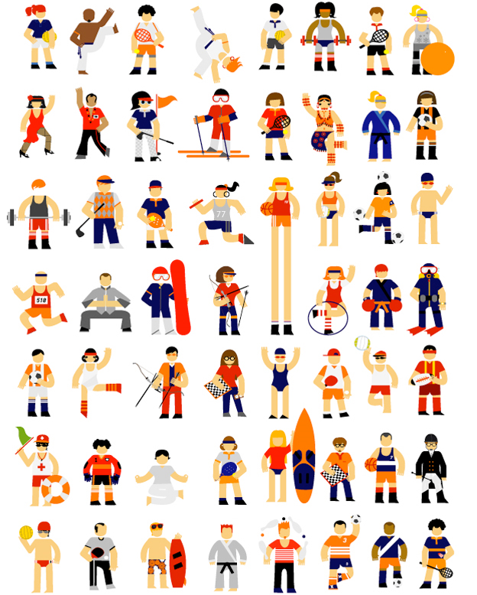
Combien de sports y a -t-il dans la photo?
Il y a huit sports dans la photo.
Notes:
(An opportunity to practise question words & numbers further.)
How many sports are there in this photo? There are 8 sports in this photo.

Slide 3
Combien de sports y a -t-il dans la photo?
Il y a seize sports dans la photo.
Notes:
How many sports are there in this photo? There are 16 sports in this photo.

Slide 4
Combien de sports y a -t-il dans la photo?
Il y a trente et un sports dans la photo.
Notes:
How many sports are there in this photo? There are 31 sports in this photo.

Slide 5
Combien de sports y a -t-il ?
Il y a quarante-sept sports dans la photo.
Notes:
How many sports are there in this photo? There are 47 sports in this photo.

Slide 6
Combien de sports y a -t-il dans la photo?
Il y a cinquante-cinq sports dans la photo.
Notes:
How many sports are there in this photo? There are 55 sports in this photo.

Slide 7
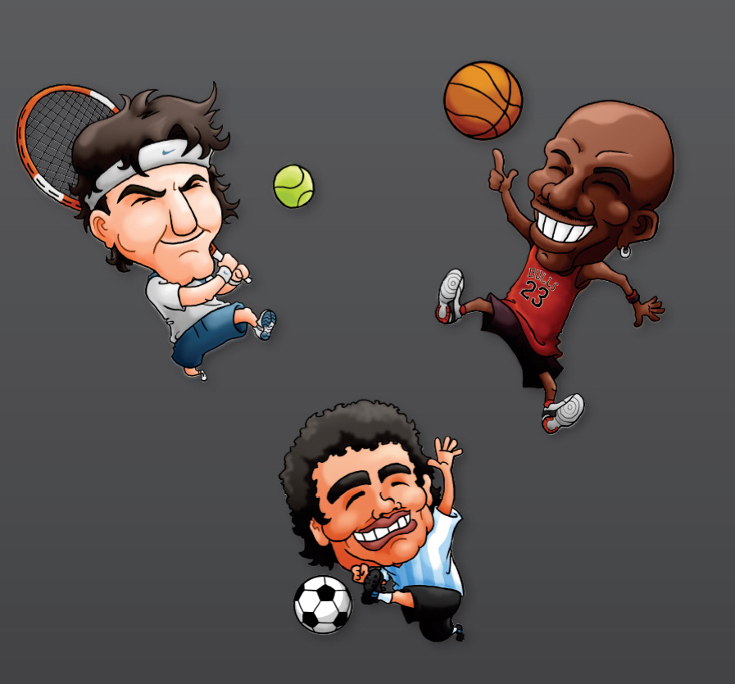
sports
ballon
au
Notes:
Ball sports

Slide 8
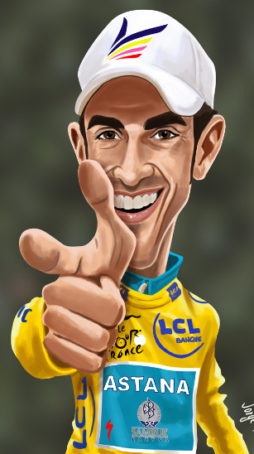
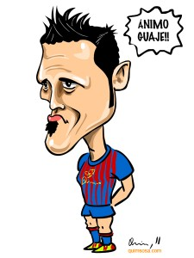
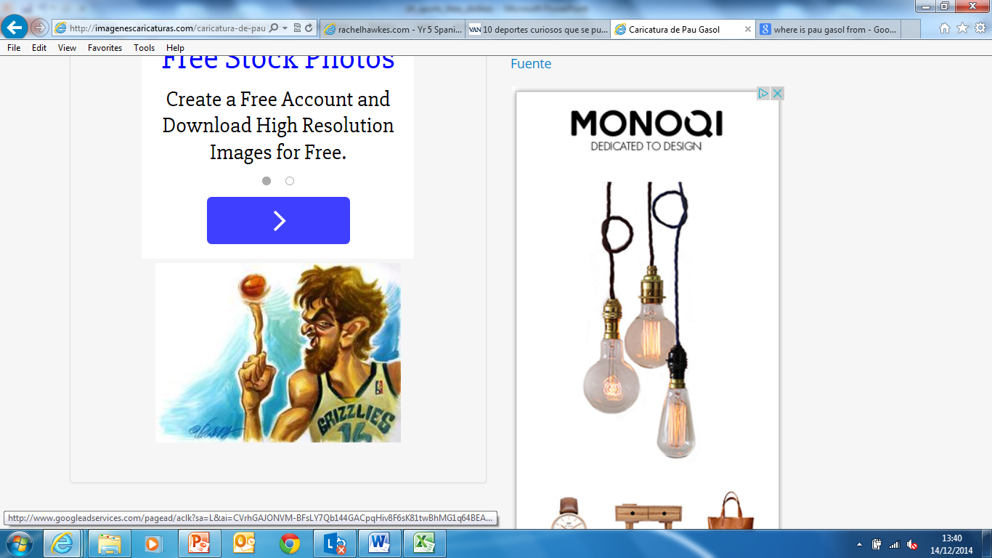
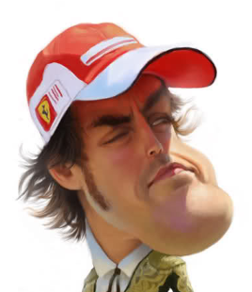
Combien de sports sont les sports au ballon?
Deux sports sont les sports au ballon
Notes:
How many of these sports are ball sports? Two sports are ball sports.
(Not asking yet for the names of these sports.)

Slide 9
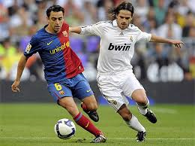
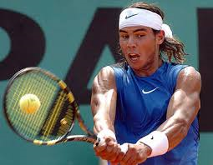
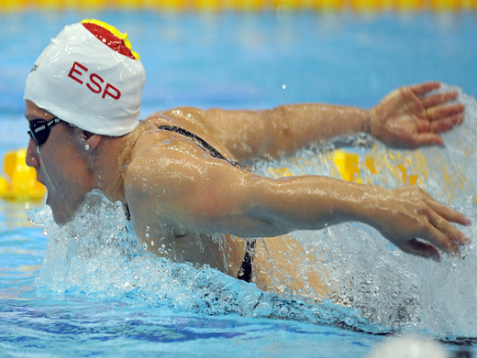
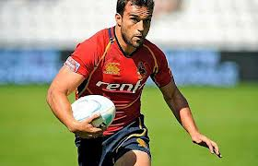
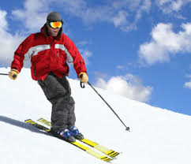
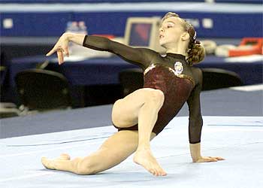
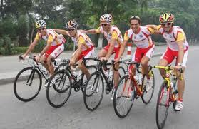
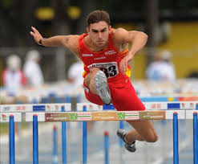
les sports
Notes:
(The main sports to be focused on in the pupil survey are introduced formally and the genders emphasised with coloured backgrounds.)
Le football, le tennis, le rugby, le ski, le cyclisme, l’atlétisme, la natation, la gymnastique
Get pupils to repeat pronunciation.

Slide 10

C’est quel sport?
Notes:
Which sport is it? It’s …
(The photos of the sports spin in and then fade away to put a little concentration pressure on the pupils. Pupils are also asked to produce the definite article le/la with the appropriate noun in their answer as they will need to use this later.)

Slide 11
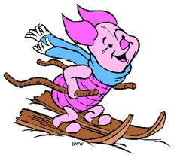
10
22
33
44
55
16
27
38
13
39
41
52
Notes:
(Pupils choose a square which teacher clicks on to reveal part of the photo underneath. Pupil then gets one guess at which sport the photo is of.)
[This photo is of piglet skiing = le skí]

Slide 12
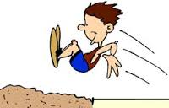
10
22
33
44
55
16
27
38
13
39
41
52
Notes:
(Pupils choose a square which teacher clicks on to reveal part of the photo underneath. Pupil then gets one guess at which sport the photo is of.)
[This photo is of a boy doing long jump = l’atlétisme]

Slide 13
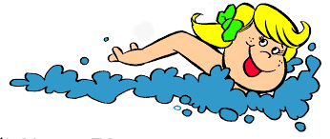
10
22
33
44
55
16
27
38
13
39
41
52
Notes:
(Pupils choose a square which teacher clicks on to reveal part of the photo underneath. Pupil then gets one guess at which sport the photo is of.)
[This photo is of a girl swimming = la natation]

Slide 14



Quelle est ton opinion des sports?
Que penses-tu de la gymnastique?
J’adore (la gymnastique).
Quelle est ton opinion de la natation ?
J’aime (la natation).
Que penses-tu de l’athlétisme?
Je n’aime pas (l ‘athlétisme).
Que penses-tu du ski?
Je déteste le ski!
Notes:
Introduction of key questions pupils will need to reproduce in the survey.
Small grammar point = using ‘de’ followed by ‘le’ → du (pupils have encountered this when talking about foods they eat)
Revision of opinions j’adore, j’aime, Je n’aime pas, Je déteste
[The sheet for the survey is a separate resource as it is portrait rather than landscape.]

Slide 15


Que penses –tu des sports?

