Slide 1
Organisez les sports olympiques en ordre alphabétique!
1. le volley
4.l’athlètisme
2. le football
7. le badminton
3. la gymnastique
8. la boxe
4. l’athlètisme
5. le cyclisme
5. le cyclisme
2.le football
6. le tennis
3. la gymnastique
7.le badminton
6. le tennis
8. la boxe
1. le volley
Notes:
Organise these Olympic sports in alphabetical order. Answers appear on the right hand side with the important letters highlighted in yellow.

Slide 2
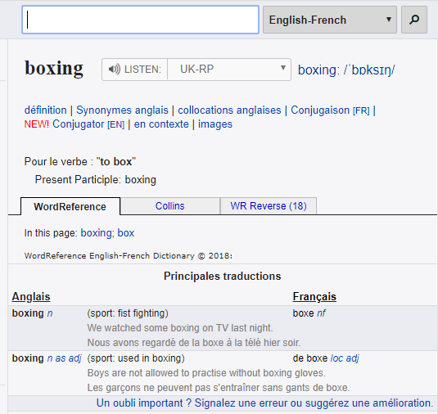
Nous allons utiliser un dictionnaire ou un dictionnaire en ligne.
Notes:
Use word reference to show pupils how to use it
It’s possible to use a traditional dictionary or an online dictionary.

Slide 3
Un dictionnaire en ligne est gratuit et rapide.
Notes:
The online dictionary is free and fast.

Slide 4
Trouvez les sports en ligne!
boxing
martial arts
basketball
badminton
handball
cycling
skiing
fencing
horse riding
Notes:
Look for these sports in an dictionary!
Teachers may choose to ask pupils to do this on computers using an online dictionary or using a paper dictionary. Hopefully the translations will still be the same!
There is an accompanying word document that can be copied for pupils so that they can write straight onto it.
I realised that there are a lot of sports in this list so maybe it would be an idea to put pupils into groups (divide & conquer) or to get pupils to look up their favourite 10 sports from the list. Translations follow on the next 3 slides.

Slide 5
Can you add 5 more sports of your own
Trouvez les sports en ligne!
boxing
martial arts
basketball
badminton
handball
cycling
skiing
fencing
horse riding
la boxe (n/f/sg)
les arts martiaux (n/f/pl)
le basket (n/m/sg)
le badminton (n/m/sg)
le handball (n/m/sg)
le cyclisme (n/m/sg)
le ski (n/m/sg)
l’escrime (n/f/sg)
l’équitation (n/f/sg)
Notes:
Look for these sports in an dictionary!
Teachers may choose to ask pupils to do this on computers using an online dictionary or using a paper dictionary. Hopefully the translations will still be the same!
There is an accompanying word document that can be copied for pupils so that they can write straight onto it.
I realised that there are a lot of sports in this list so maybe it would be an idea to put pupils into groups (divide & conquer) or to get pupils to look up their favourite 10 sports from the list. Translations follow on the next 3 slides.

