Slide 1

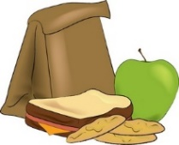
Date: (E.g. 10/11 – 16/11) | Au petit déjeuner… | Au déjeuner … | Au dîner…
lundi
mardi
mercredi
jeudi
vendredi
samedi
dimanche
Notes:
In the week following lesson 12 pupils should keep a food diary, writing down in French what they have for breakfast, lunch and dinner each day.
They should use a dictionary to look up words they don’t know.

