Slide 1
Quelle est la date aujourd’hui?
mardi,
le vingt-sept septembre
jour = ?
mois = ?
date = ?
aujourd’hui = ?
Notes:
Pupils were introduced to this routine in the summer term of Y3 and in Y4 but may need reminding.
This will help remind them of the days of the week, keep working the numbers and help them remember some essential vocabulary e.g. day / month etc.
This slide can be adapted obviously to fit the day of the week / month.

Slide 2
Write the following words in your book in alphabetical order.
soupe
biscuit
poisson
viande
spaghettis
cerise
salade
carotte
poulet
Notes:
Words are deliberately chosen to be mostly new vocabulary, with a few cognates that can be guessed if you know the theme is food.
Both genders and gendered plurals also included.
Several words with the same starting letter to remind pupils to look to the 2nd and subsequent letters for ordering.

Slide 3
biscuit
carotte
cerise
poisson
poulet
salade
soupe
spaghettis
viande
Notes:
Answer slide
Ask pupils to pronounce the words, using the phonics they know.
Check through their pronunciation, reminding them of the phonics key words where necessary e.g. Zanahoria (zumo) and galletas / pollo (llave)

Slide 4
Words I know
Words I can guess
Words I need to look up
Organise the words into the three categories.
viande | biscuits | poulet
salade | cerises | soupe
spaghettis | poisson | carotte
Notes:
Obviously the pupils may have different answers here, depending on their own level of knowledge. Make sure they realise this and respond individually.
In the interests of the next part of the lesson the next slide suggests some words that could be guessed, and some that might need looking up in a dictionary.

Slide 5
Words I can guess
Words I know
Words I need to look up
salade
spaghettis
viande
poulet
soupe
poisson
carotte
cerise
biscuit
Organise the words into the three categories.
viande | biscuits | poulet
salade | gâteau | soupe
spaguettis | poisson | carotte
Notes:
One strategy for guessing the meaning of words is to look for similarity to written English words e.g. ‘salad’ in ‘salade’.
Another strategy is to say the word aloud and try to spot any similarity to spoken English words e.g. ‘spaghettis’ sounds very much like ‘spaghetti’
Another strategy is to think about the overall theme / topic if you know it e.g. food in this case and see if any similar words occur e.g. soup / soupe
See if pupils agree that the other words could not be guessed so easily so would need looking up in a dictionary, if you did not already know them.

Slide 6

A réfléchir!
Why do you need to know the alphabet to use a dictionary?
How many different types of words can you think of? What are they?
What type of words has ‘gender’?
How do you find out the gender of a word from the dictionary? What does it say next to the word?
Notes:
Ask pupils each question and give them some thinking / discussion time in pairs. Then take answers.

Slide 7
Attention!
1- adj | 1. g | a- noun/ masculine/singular
2- n/f/sg | 2 | b- transitive verb
3- n/m/pl | 3 | c- noun/ feminine
4- n/m/sg | 4 | d- noun/feminine/singular
5- vb | 5 | e- noun/masculine
6- adv | 6 | f- noun/masculine/plural
7- n/f/pl | 7 | g- adjective
8- nm | 8 | h- noun / feminine / plural
9- nf | 9 | i- adverb
10- vt | 10 | j- verb
Notes:
Give pupils hand out of this slide and in pairs they can match up the abbreviations or as a whole class activity.
This is NOT the time to explain what a verb is, I don’t think, but because the abbreviation is there, I have listed it here. For now just tell pupils it is a kind of verb, but the most important thing is for them to be able to spot the difference between verbs, adjectives, nouns and adverbs in a dictionary, because the different types of words behave differently and have different parts to them, i.e. articles for nouns, infinitive form for verbs.
Refer to the front of the dictionary for any other abbreviations possible (page viii – in Collins Spanish Dictionary & Grammar)

Slide 8
le jus
les oeufs
n/m/sg
n/m/pl
la pomme
les frites
n/f/sg
n/f/pl
Notes:
As we are concentrating on nouns in this lesson, this slide picks out the 4 x possibilities for nouns. Pupils need to realize that where words can be singular and plural e.g. egg (s) the word will be listed in the singular and it is up to them to add / subtract an ‘s’ depending on their needs. Chips, however, will be listed in the plural as that is how they most often occur.
This slide also reminds pupils of the 4 x definite articles, the words for ‘the’, which they will need for the next activity.

Slide 9
Look up the six food nouns in a dictionary. Complete the table with the gender code, the matching definite article (word for ‘the’) and the English meaning.
Ordre alphabétique | m/f | ‘the’ | English
biscuits | n/m/pl | les | biscuits
carotte
cerises
poisson
poulet
viande

Slide 10
Look up the six food nouns in a dictionary. Complete the table with the gender code, the matching definite article (word for ‘the’) and the English meaning.
Ordre alphabétique | m/f | ‘the’ | English
biscuits | n/m/pl | les | biscuits
carotte | n/f/sg | la | carrot
cerises | n/f/pl | les | cherries
poisson | n/m/sg | le | fish
poulet | n/m/sg | le | chicken
viande | n/f/sg | la | meat
Notes:
Answer slide

Slide 11


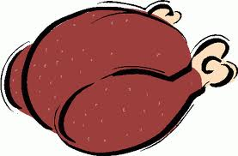



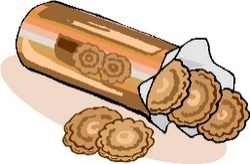

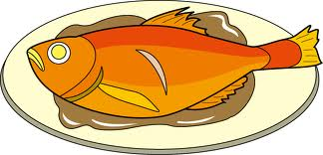
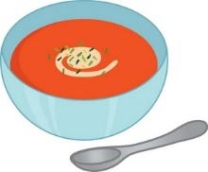
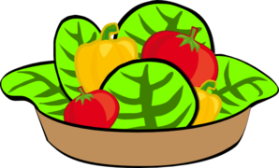
Complétez les phrases.
1
2
3
4
5
Notes:
1 J’adore le poulet et j’aime les carottes
2 J’adore les biscuits mais je n’aime pas les frites.
3 J’aime le poisson mais je n’aime pas la viande.
4 Je déteste le poulet mais et je n’aime pas la soupe
5 J’aime beacoup la viande mais je n’aime pas la salade.
NB: Attention!
Pupils will need reminding of a few things.
1 opinion words
2 you need the definite article (le/la.les) with opinions
Also, the picture of ‘talk to the hand’ is the symbol I’ve used for ‘mais’ = but. This symbol is new to pupils.

