Slide 1
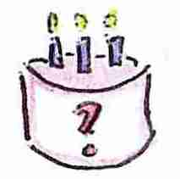
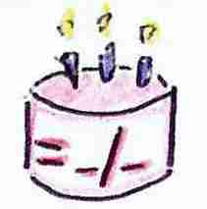
Quelle est la date de ton anniversaire?
Mon anniversaire est le ________ ___________

Slide 2
5/10
4/4
1/1
5/5
9/9
15/9
4/1
2/2
6/6
10/10
10/5
8/11
3/3
7/7
11/11
9/12
9/7
4/4
8/8
12/12
Notes:
Slide borrowed from TES resource contributed by Pura Vida – Gracias!
Play blockbusters to revise the dates.

Slide 3


Quelle est la date de ton anniversaire?
 | Nom | Age | Anniversaire
1.
2.
3.
4.
5.
Notes:
Pupils choose 5 other pupils and ask them their name / age and birthday and record the information in the table.
Those who finish early can count the candles on the birthday cake (23!) in French.

Slide 4
C’est mon
anniversaire!
Salut !
Je t’invite à mon anniversaire!
Date: ________________
Heure: _________________
Endroit : _________________
J’espère que tu pourras venir !
Notes:
Pupils design their own birthday party invitation in French. Their work could make a nice display.
https://www.bing.com/images/search?q=invitation+a+mon+fete+d%27anniversaire&FORM=HDRSC2 – It might be interesting to do a search online.
Enter ‘Je t’invite a mon anniversaire’ and choose images to see lots of example intviation
It is my birthday!
Hello!
I’m inviting you to my party
Date:
Time:
Place:
I hope you can come!

