Slide 1
Quelle est la date aujourd’hui?
mardi,
le dix-sept septembre
Jour = ?
Mois = ?
Date = ?
Aujourd’hui = ?
Notes:
Pupils were introduced to this routine in the summer term of Y3 but will need reminding.
This will help remind them of the days of the week, keep working the numbers and help them remember some essential vocabulary e.g. day / month etc. They don’t know the months yet formally, but they are about to learn them this term, so keeping the date routine like this each lesson this year will be very useful. This slide can be adapted obviously to fit the day of the week / month.

Slide 2
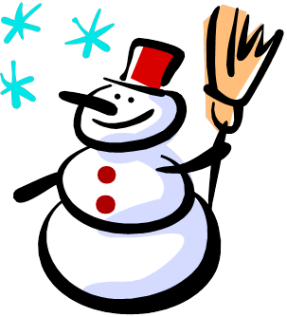
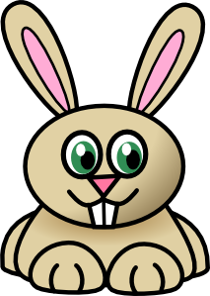
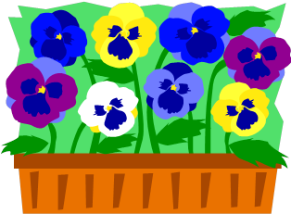
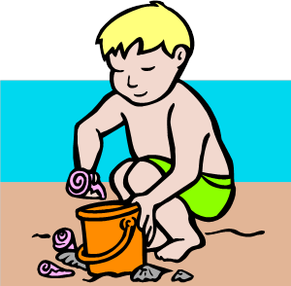
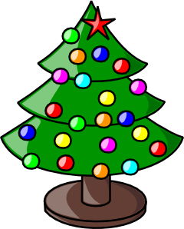
janvier
février
mars
avril
mai
juin
juillet
août
septembre
octobre
novembre
décembre
Notes:
Recap – on this slide text appears with AUDIO one by one

Slide 3
Les mois
1 | 2 | 3 | 4
5 | 6 | 7 | 8
9 | 10 | 11 | 12
Notes:
Recap – give alternatives – C’est juin ou avril etc..If they seem to be able to produce them already, elicit them straightaway. If reinforcement of pronunciation is needed, click on each picture to hear the month.
This slide also has numbers 1-12 so you can elicit by number – Qu’est-ce que c’est le numéro cinq? etc…

Slide 4
11 | 12 | 13 | 14
15 | 16 | 17 | 18
19 | 20 | 21 | 22
Notes:
Use the numbers 11-22 to elicit the months. This helps to practise the numbers too and the numbers 13 – 20 are particularly tricky for pupils to remember.
Click on the months to hear the audio, if needed.

Slide 5
Notes:
Sing the months to the tune of Michael Finnegan
(audio provided for scansion!)
janvier, février, mars, avril mai, juin, juillet, août
septembre, octobre, novembre, décembre
ce sont les mois de l’annéee

Slide 6
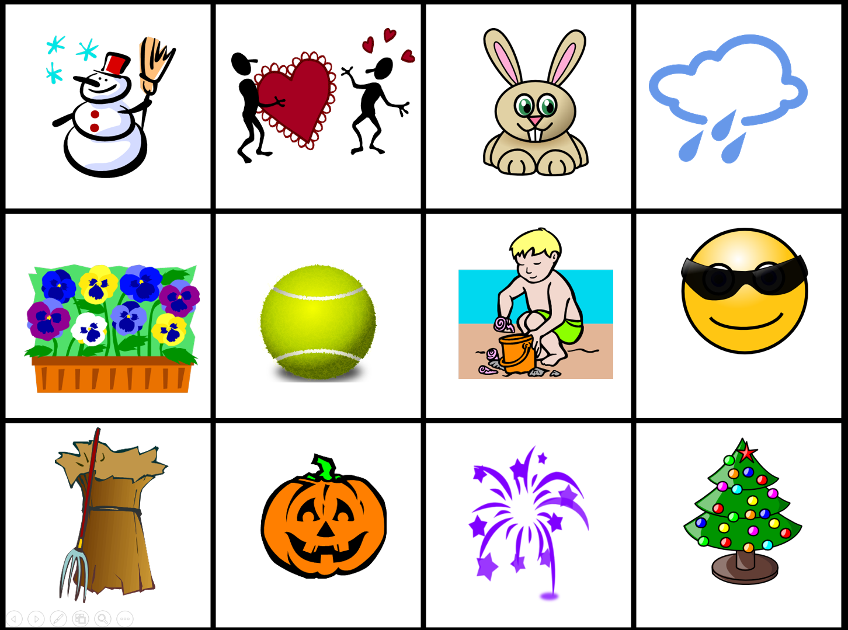
https://www.youtube.com/watch?v=qHFapUrSuVM
Notes:
A different piece of music to sing the months to.

Slide 7
https://quizlet.com/198768/flashcards
Notes:
This link is to an online activity for pupils to learn the months. It contains audio to assist with pronunciation, too.

Slide 8
Devoirs Every day next week (and the week after) one person from the class writes the full date in French on the board: e.g. Aujourd’hui, c’est le 12 novembre.

