Slide 1

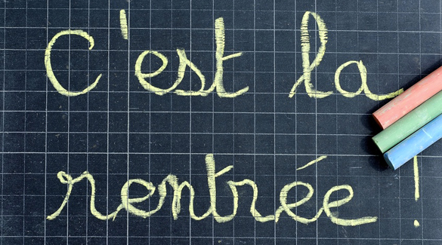
Quelle est la date aujourd’hui?
Aujourd’hui c’est mardi
19 septembre!
le mois = ?
la date = ?
le jour = ?
aujourd’hui = ?
Notes:
Pupils would have learnt the days of the week in Year 3. This will help remind them of the days of the week, keep working the numbers and help them remember some essential vocabulary e.g. day / month etc.
They don’t know the months yet formally, but they are about to learn them this term, so keeping the date routine like this each lesson this year will be very useful.
This slide can be adapted obviously to fit the day of the week / month.

Slide 2

C’est quel numéro?
6
1
1, 2, 3, 4, 5, __
15, 16, 17, 18, __
2, 4, 6, 8, __
3, 6, 9, 12, __
16, 16, 17, 17, 18, __
1, 2, 4, 8, __
19
2
3
10
15
4
18
5
6
16
Notes:
Click the red numbers to hear the whole sequence of numbers, including the final ‘answer’ number
Pupils should practise each sequence themselves, or calling out in pairs (i.e. verbal tennis style)

Slide 3
[
]
x3
[
]
x3
et
Notes:
Say it in rhythm first before trying to sing!
Chorus of yellow submarine (once) with the pictures in the right order! It does fit!
Rouge vert Rouge vert jaune jaune jaune (jaune jaune jaune, jaune jaune jaune )
Rouge vert Rouge vert jaune jaune jaune (jaune jaune jaune, jaune jaune jaune )
Violet, bleu blanc
Rose, orange et marron

Slide 4

De quelle couleur est le numéro
30
19
24
13
25
23
14
17
26
31
16
22
15
28
20
18
29
21
27
Notes:
‘What colour is number …?’ Teachers say a number. Pupils should then say what colour that particular number is. Teachers point at the correct number and confirm the colour.
Each number is linked to the audio and plays if/when clicked. Text question also has audio.

Slide 5


C’est quel numéro?
22
31
30
29
11
13
8
23
20
28
16
15
10
29
Notes:
Numbers appear one by one without audio, to allow teacher to elicit number from pupils. Then click on the number to hear the audio, to check.
Click title question to hear audio.

Slide 6
Mathématiques
1. dix-neuf plus deux =
vingt et un
2. quatorze plus trois =
dix-sept
3. dix-sept plus cinq =
vingt-deux
4. vingt -trois plus six =
vingt-neuf
5. dix-huit plus sept =
vingt-cinq
6. treize plus neuf =
vingt-deux
7. vingt plus dix =
trente
8. quinze plus douze =
vingt-sept
9. vingt-quatre plus sept =
trente et un
10. vingt et un plus huit =
vingt -neuf
Notes:
Maths for extension – sums appear in written form one by one. Answers then appear on next mouse click. This slide is all addition, and the next is all subtraction.
ANSWERS only have audio and they appear one by one on this slide, with the intention that the class is working at the same pace, perhaps on mini whiteboards, converting all the words into numbers?
E.g. 1. 19+2 = 21

Slide 7
Mathématiques
1. douze moins sept =
cinq
2. treize moins un =
douze
3. dix-sept moins cinq =
douze
4. vingt-trois moins six =
dix-sept
5. dix-huit moins six =
onze
6. trente et un moins neuf =
vingt -deux
7. vingt-neuf moins dix =
dix-neuf
8. trente moins quinze =
quinze
9. vingt-quatre moins six =
dix-huit
10. vingt et un moins huit =
treize
Notes:
These are animated so that all the Qs appear first and then the answers. This allows pupils to work at their own speed.
The teacher may prefer to set a time limit of 3 minutes for pupils to do as many as they can, not worrying if not all finish all of them.
Again, answers appear with audio.

Slide 8





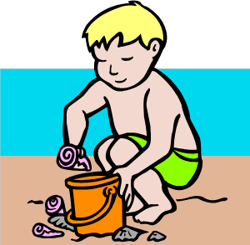

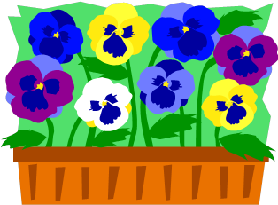




Les mois
1 | 2 | 3 | 4
5 | 6 | 7 | 8
9 | 10 | 11 | 12
Notes:
Present months with sounds and gestures first.
Pictures appear with audio. You can then click on them again to hear the audio again.
Spend time on this slide, rehearsing the names of the months several times, and agreeing gestures with pupils that cue the months.

Slide 9
janvier
février
mars
avril
mai
juin
juillet
août
septembre
octobre
novembre
décembre
Notes:
This time the text appears with AUDIO.

Slide 10
Mets les mois dans le bon ordre!
février
octobre
mars
avril
novembre
août
mai
décembre
juillet
juin
janvier
septembre
Notes:
Pupils have to re-order the months.
They appear out of order, one by one, with audio again, for extra reinforcement.

Slide 11
janvier
février
mars
avril
mai
juin
juillet
août
septembre
octobre
novembre
décembre
Notes:
This slide serves as an answer slide, and one more opportunity for pronouncing the months altogether.

Slide 12
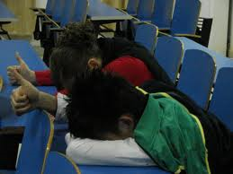

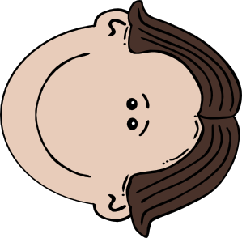
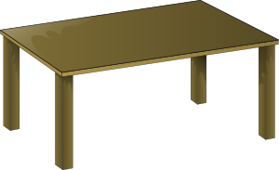
lundi – mardi – mercredi – jeudi – vendredi – samedi - dimanche
Tête sur la table pouce en l’air
Notes:
This is just to keep the days of the week fresh in memory.
Text pronounced on click.

