Slide 1

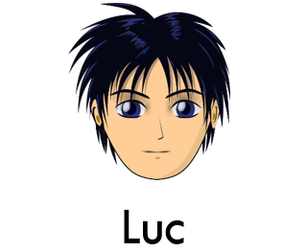



Qui est-ce?
Notes:
NB: This version of Guess Who has been created using copyright free images from www.clker.com
There are versions of the game available to download free from TES resources which use commercial images, which teachers can download, if they prefer.
Whilst I’ve tried to obtain as differentiated a range of faces as possible, I was limited to those I could find copyright free. Therefore the range of eye colour is limited, and the selection is far from representative of the diversity of population in any country! However, the variety of hair length, colour etc will be a useful stimulus for practice of this language, and the game should be fun!
Amazon also has some French versions of the game available:
Card version
https://www.amazon.co.uk/Shuffle-100202034-Est-Ce-language-version/dp/B00KGB3DSE/ref=sr_1_1?ie=UTF8&qid=1535351297&sr=8-1&keywords=qui+est+ce
Travel version
https://www.amazon.co.uk/Hasbro-CE-VOYAGE-QUI-EST/dp/B00R2D6DYU/ref=sr_1_2?ie=UTF8&qid=1535351297&sr=8-2&keywords=qui+est+ce

Slide 2
vocabulaire
C’est ?
une fille
un garçon
Tu as …?
les yeux bleus/ marron/ verts/ gris
les cheveux marron/ blond/ noir/ roux
les cheveux longs/mi-longs / courts
les cheveux raides/ bouclés/ ondulés
une couette (pony tail)
Tu portes …?
des lunettes (glasses)
Notes:
Les taches de rousseur = freckles
un chapeau (hat)
une casquette (cap)

Slide 3











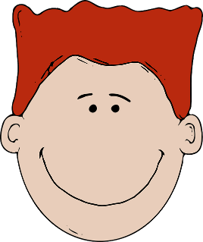


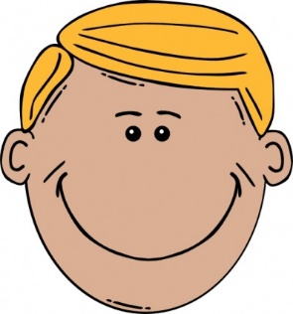

Martine
Lilou
Robert
Janine
Fabien
Luc
Giselle
Amandine
Éric
Georges
Nathalie
Jean-Paul
Cécile
Nicolas
Jacques
Sandrine
Notes:
This is the game board. To play this whole class, the teacher needs to take the PowerPoint out of presentation mode and remove the characters during the game in response to the pupils’ questions. Use Slide 4 for this.
When pupils are confident with the whole class version, they could play in pairs (car boot sales often have copies of this game and it is worth trying to get as many as possible!)

Slide 4
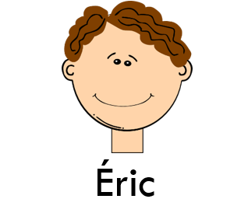



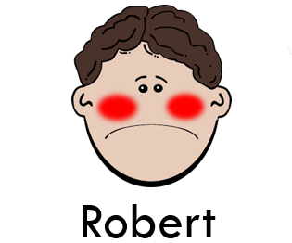



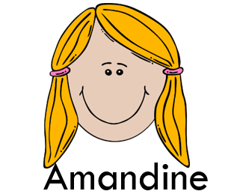


Notes:
This is the game board. To play this whole class, the teacher needs to take the PowerPoint out of presentation mode and remove the characters during the game in response to the pupils’ questions.
When pupils are confident with the whole class version, they could play in pairs (car boot sales often have copies of this game and it is worth trying to get as many as possible!)

