Slide 1
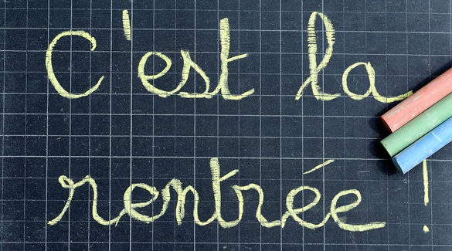
Quelle est la date aujourd’hui?
Aujourd’hui c’est mardi 12 septembre!
la date = ?
le mois = ?
le jour = ?
aujourd’hui = ?
Notes:
Pupils would have learnt the days of the week in Year 3. This will help remind them of the days of the week, keep working the numbers and help them remember some essential vocabulary e.g. day / month etc. They don’t know the months yet formally, but they are about to learn them this term, so keeping the date routine like this each lesson this year will be very useful. This slide can be adapted obviously to fit the day of the week / month.

Slide 2
Lundi gris, c’est reparti Mardi bleu ouvre les yeux Mercredi rose, on se repose Jeudi blanc, tout le monde est content
Vendredi vert saute à l’envers Samedi rouge, rien ne bouge Dimanche violet, fais ce qu’il te plaît
lundi
mardi
mercredi
jeudi
vendredi
samedi
dimanche
Notes:
Days of the week comptine
Lundi gris, c’est reparti Mardi bleu ouvre les yeux Mercredi rose, on se repose Jeudi blanc, tout le monde est content Vendredi vert saute à l’envers Samedi rouge, rien ne bouge Dimanche violet, fais ce qu’il te plaît

Slide 3
Il y a sept jours, il y a sept jours, il y a sept jours par semaine: lundi mardi mercredi jeudi vendredi samedi dimanche
Notes:
Oh my darling, Clementine.

Slide 4
1
2
3
4
5
6
7
10
8
9
Notes:
Click. As number appears, audio is heard.

Slide 5
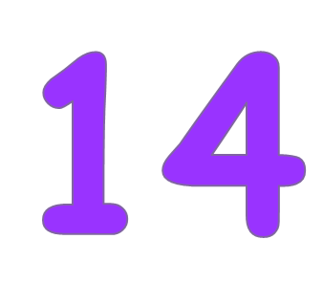
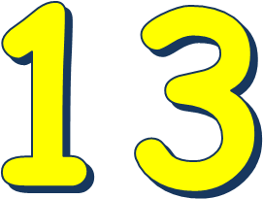
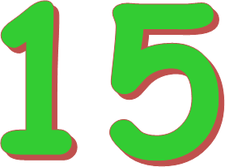
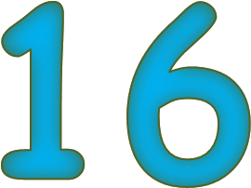
11
12
Notes:
Click. As number appears, audio is heard.

Slide 6
17
18
19
20
Notes:
Click. As number appears, audio is heard.

Slide 7
Notes:
Numbers 1-20.
This not inserted, it is linked from YouTube, so you need to be connected to the internet for it to play.

Slide 8
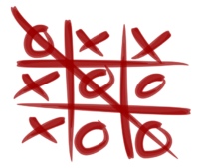
Le morpion

Slide 9
11
9
10
6
12
8
4
7
5
Notes:
Divide the class into two teams to play this version of noughts and crosses (le morpion).

Slide 10
7
1
6
4
10
12
8
5
11
Notes:
Divide the class into two teams to play this version of noughts and crosses (le morpion).

Slide 11
6
7
12
9
5
11
1
8
10
Notes:
Divide the class into two teams to play this version of noughts and crosses (le morpion).

Slide 12
Notes:
The children are only learning numbers to 31 but could watch and listen to the rest of the video to see the pattern.

Slide 13
13
dix-neuf
14
vingt-deux
15
treize
Relie les chiffres et les mots!
16
vingt et un
17
vingt
18
quatorze
19
dix-huit
20
dix-sept
21
quinze
22
seize
Notes:
Pupils should find the correct spelling of each number. Click to reveal the arrows linking number to word. These are the numbers 13-22. 23-31 is on the next slide.
Click on the number (digits) to hear the audio.

Slide 14
23
vingt-quatre
24
trente
25
vingt-six
Relie les chiffres et les mots!
26
vingt-sept
27
trente et un
28
vingt-trois
29
vingt-cinq
30
vingt-neuf
31
vingt-huit
Notes:
As before but for numbers 23-31.

Slide 15
Comptine des couleurs
L'arc en ciel est en fête Car il porte sur sa tête Un nœud de toutes les couleurs Comme celui de ma petite sœur Violet, indigo Bleu, vert, jaune, orange et rouge L'arc en ciel est en fête, Les couleurs sont sur sa tête.

