Slide 1
L’alphabet
A
B
C
D
E
F
G
H
I
J
K
L
M
N
O
P
Q
R
S
T
U
V
W
X
Y
Z
Notes:
Quick revision slide for the alphabet.
Letters laid out as for the second song in the previous lesson.
Take time to practise in particular the tricky letters: E I, G, J, R, W, Y

Slide 2
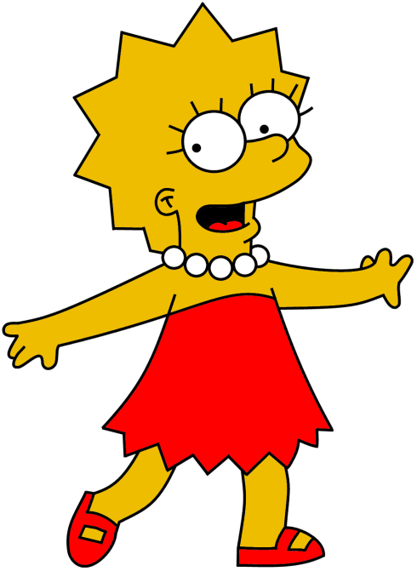
Comment t’appelles-tu ?
Comment ça s’écrit?
Notes:
Slide to recap spelling own names.

Slide 3
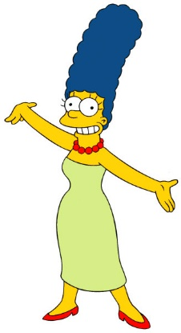
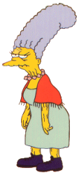

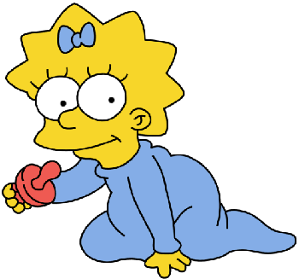

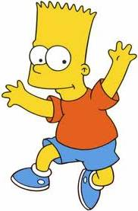
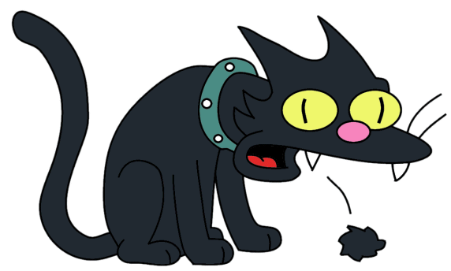
Comment ça écrit ?
H
B a r t
E
S n o w b a l l
1 |  | __ __ __ __ | 5 |  | __ __ __ __ __ __ __ __
2 |  | __ __ __ | 6 |  | __ __ __ __ __
3 |  | __ __ __ __ | 7 |  | __ __ __ __ __ __
4 |  | __ __ __ __ __ __ | 8 |  | __ __ __ __ __
C
A b e
G
H o m e r
F
L i s a
D
M a g g i e
B
J a c k i e
A
M a r g e
A | B | C | D
E | F | G | H
Notes:
1 B – A – R – T
2 A – B - E
3 L – I – S – A
4 J – A – C – K – I – E
5 S – N – O – W – B – A – L – L
6 H – O – M – E – R
7 M – A – G – G – I – E
8 M – A – R – G - E
Teacher spells out the name of each character 1 – 8.
First time pupils just have to recognise the letter
Second time pupils write in the letters to spell the names.

Slide 4





Comment ça s’écrit?
Eric Cantona
Zinedine Zidane
Edith Piaf
Vanessa Paradis
Lionel Messi
Notes:
Thank you to Elilala for the main content in the next 3 slides ☺
teacher led listening activity

Slide 5
Comment ça s’écrit?
la France
la Suisse
la Réunion
La Belgique
la Guadeloupe
le Québec
Notes:
Paired speaking practice

Slide 6
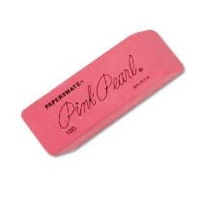

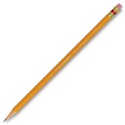
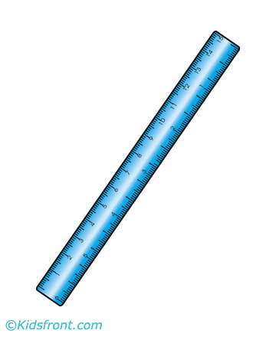
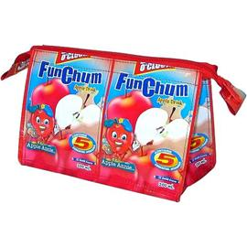
Comment ça s’écrit?
gomme
trousse
taille-crayon
règle
crayon
Notes:
Final benchmark activity listening

Slide 7



ma mère
mon père
Voici ma mère
Elle s’appelle Clara
Voici ma mère
Elle est très sympa
C’est ma mère...
C’est ma mère …
C’est ma mère.
Voici mon père
Il s’appelle Georges
Voici mon père
il adore le sport
C’est mon père...
C’est mon père...
C’est mon père.
Notes:
Song to practise members of the family. Click the audio. It should continue playing when you move across the slides.
NB: Please note that the pictures used in the following slides came with the 100 points game from Clare Seccombe’s brilliant lightbulb languages site.
I used them for the song so that pupils will be used to them and can go straight into the game.
© Light Bulb Languages 2015 CS http://www.lightbulblanguages.co.uk

Slide 8


ma grand-mère
mon grand-père
Voici ma grand-mère
Elle s’appelle Margot
Voici ma grand-mère
Elle aime le chocolat chaud
Ma grand-mère...
Ma grand-mère …
Ma grand-mère.
Voici mon grand-père
Il s’appelle Vincent
Voici mon grand-père
il est très intelligent
Mon grand-père...
Mon grand-père...
Mon grand-père.

Slide 9


ma soeur
mon frère
Voici ma soeur
Elle s’appelle Lisette
Voici ma soeur
elle joue de la trompette.
C’est ma soeur…
C’est ma soeur…
C’est ma soeur.
Voici mon frère,
Il s’appelle Alain.
Voici mon frère,
Il adore les chiens.
C’est mon frère…
C’est mon frère…
C’est mon frère.

Slide 10
ma mère
mon père
ma grand-mère
mon grand-père
ma soeur
mon frère

Slide 11




Notes:
Slap the board game (with divided board so two pupils play but they are not trying to hit the same picture as each other).
Use other pupils to score the points and call out the family members in French.
Play in two teams and rotate all 4 roles every three points.
In 6 minutes you can get through almost a whole class!

Slide 12
100
PUNTOS

Slide 13
ma mère
mon père
ma grand-mère
mon grand-père
ma soeur
mon frère

Slide 15



10
4
7
8
3
2

Slide 17
1
11
6
5
9
14

Slide 19
7
8
2
4
10
9

Slide 21
13
16
8
7
15
2

Slide 23
11
12
20
8
3
21

Slide 25
10
9
2
30
4
12

Slide 27
18
14
10
0
16
5

Slide 29
5
6
50
10
2
26

Slide 31
17
28
21
3
10
19

Slide 33
1
6
35
25
8
0

Slide 35
20
18
8
2
13
29

Slide 37
7
14
22
20
0
8

Slide 38
NOTES FOR THE TEACHER:
Students can work in groups or as a whole class.
The aim of the game is to score 100 points or more.
Groups take it in turns to say one of the family members.
Teacher reveals the next slide showing the family members.
The group scores the number of points shown next to the family member they have chosen.
If you get to slide 26 and nobody has reached 100 points, click on the return button. This will take you back to slide 3 and you can run through the slides again.
To make things more interesting you could give each team a wild card which will allow then to double their points on the next turn (see next slide).
© Light Bulb Languages 2015 CS http://www.lightbulblanguages.co.uk

Slide 39

x2
x2
x2
x2
x2
x2

