Slide 1
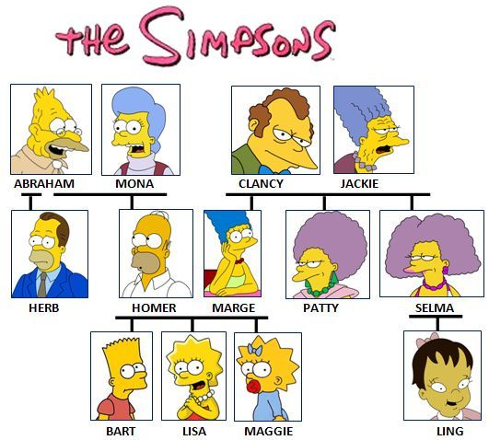
___________,comment ça s’écrit?
Notes:
Pupils have seen this slide once already but it makes a good recapping activity to start the lesson.
Comment il s’appelle? Comment elle s’appelle (What is he/she called?
Comment ca s’écrit? (How do you spell that?
Alphabet introduction
A - a, B - bay, C - say, D - dé, E - euh, F - eff, G - jay, H - aash, I - ee, J - gee, K - ka, L - ell, M - emm, N - enn, O - oh, P - pay, Q - koo, R - air, S - ss, T - tay, U - u, W - dooblé vay, X - eeks, Y - egrek, Z - zed

Slide 2

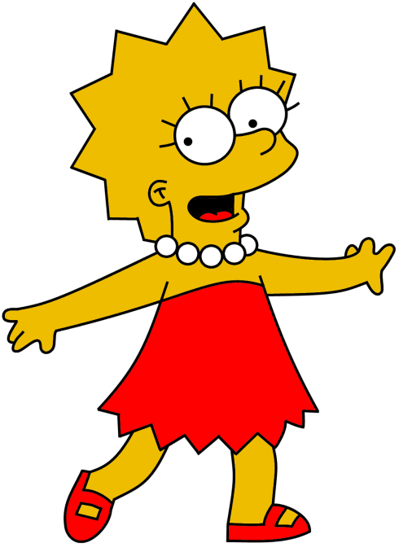
Ça s’écrit
H – O – M – E – R.
Homer
___________,comment ça s’écrit?
Notes:
H – ash
O - oh
M – em
E – euh
R - aire

Slide 3

Ça s’écrit
A – B - E.
___________,comment ça s’écrit?
Abe
Notes:
A - a, B - beuh, E – euh

Slide 4
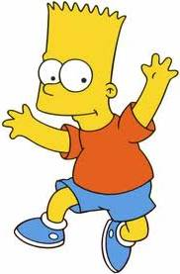
Ça s’écrit
B – A – R - T.
___________,comment ça s’écrit?
Bart
Notes:
B - beuh, A - a, R – aire, T - tay

Slide 5
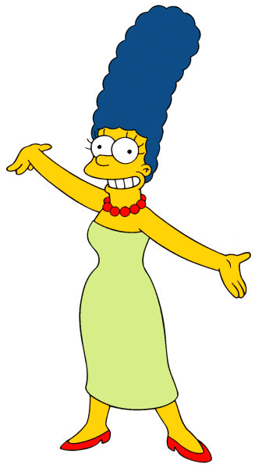
Ça s’écrit
M – A – R – G - E.
Marge
___________,comment ça s’écrit?
Notes:
M – em, A - a, R – aire, G – zshay, E – euh

Slide 6
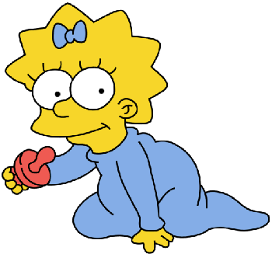
Ça s’écrit
M – A – G – G – I - E.
___________,comment ça s’écrit?
Maggie
Notes:
M – emm , A - ah, G – zshay G – zshay, I – ee, E – euh

Slide 7
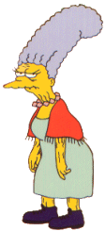
Ça s’écrit
J – A – C – K – I - E.
___________,comment ça s’écrit?
Jackie
Notes:
J - jee , A - ah, C – say, K – kah, I – ee, E – euh

Slide 8
Comment tu t’appelles?
Comment ça s’écrit?
Notes:
Prompts to ask pupils to give their name and to practise spelling their first name.
They will need some time to practise this – show them their previous slide or refer them to their study guides for the alphabet pronunciation guide there.

Slide 9

l’alphabet français
Notes:
https://www.youtube.com/watch?v=_LYy3P2okyw
Alphabet chant to music

Slide 10
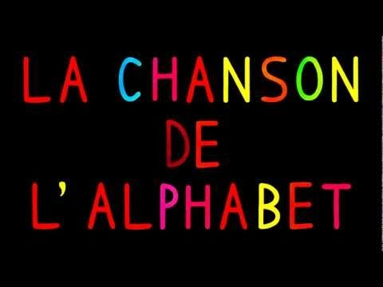
l’alphabet français
Notes:
https://www.youtube.com/watch?v=YkFXGlHCn_o
Alphabet song – for variety

