Slide 1
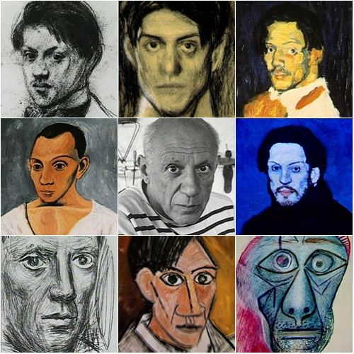
P____ P_______ -- 1881 - 1973
Pablo Picasso -- 1881 - 1973

Slide 2
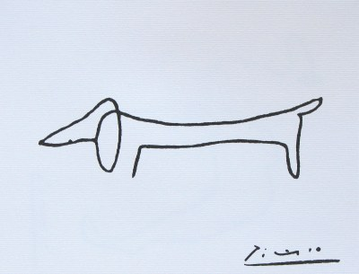
Qu’est-ce que c’est?
C’est un chien.
Notes:
Ask them to guess the artist and say what this drawing is in French (un chien).

Slide 3
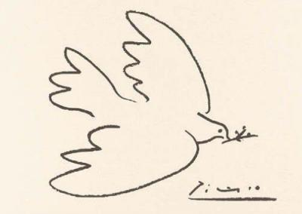
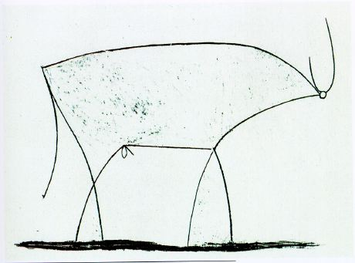
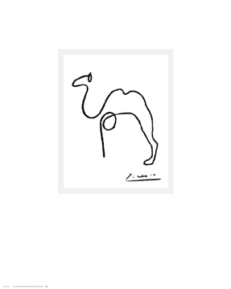
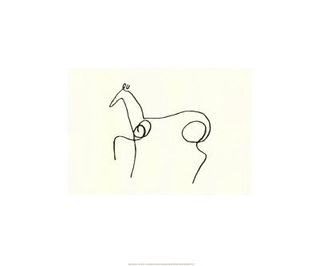
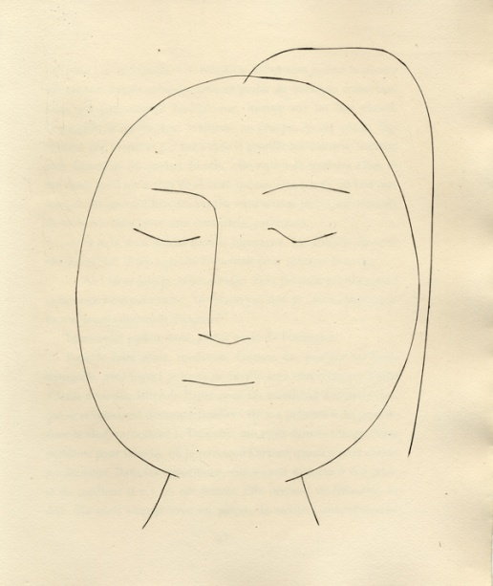
un taureau
un t_ _ _
un c_ _ _ _ _ _
un chameau
une colombe
una p_ _ _ _ _
une personne
una p_ _ _ _ _ _
un cheval
un c_ _ _ _ _ _
Notes:
These are Picasso line drawings that students need to label. They probably won’t be able to do these in French the first time around but can see the answers whole class and then try to recall the words when you take the answers away and leave the first letter only again.

Slide 4
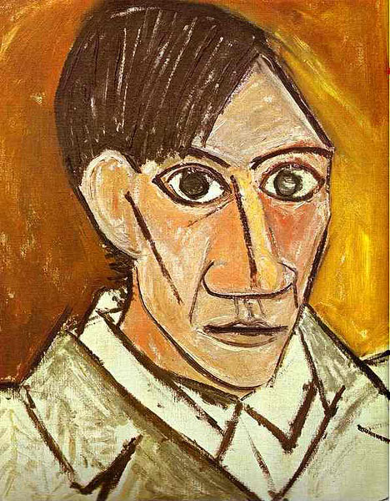
Que vois-tu?
Je vois…
un visage rond
un visage long
des yeux verts
des yeux marron
un grand nez
un petit nez
une petite bouche
une grande bouche
deux oreilles
une oreille
les cheveux marron
les cheveux noirs
Notes:
This is a self-portrait by Picasso.
Work with the class to describe the face.
Que vois-tu? What do you see?
Bring up the sentences and ask pupils to choose the correct option.
Je vois…
un visage long
deux yeux marron
un grand nez
une petite bouche
une oreille
les cheveux marron

Slide 5
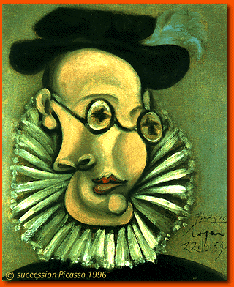
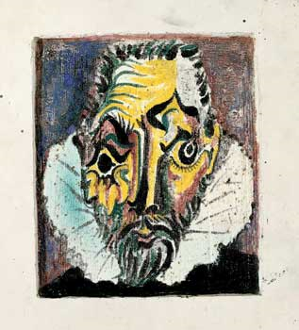
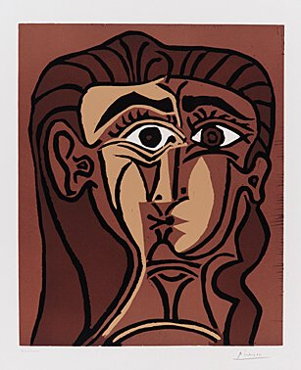
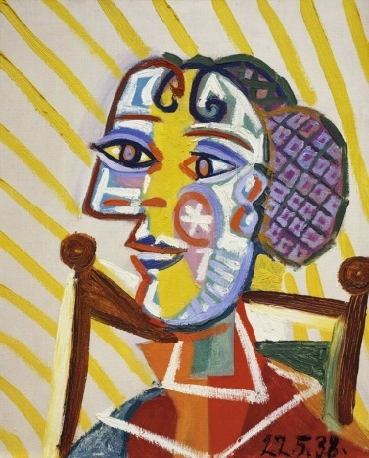
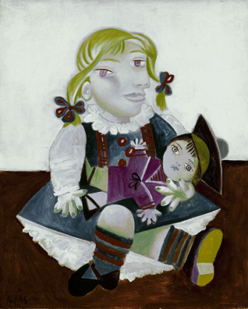
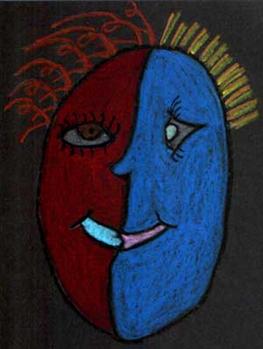
Notes:
Show the pupils these faces and ask them to tell you what they think of them.
Do they look real? Like in a photo? What is different about them?

Slide 6
Dessinez un cercle ou un ovale.
Dessinez un oeil .
3. Dessinez l’autre oeil en profil.
4. Ajoutez la bouche et le nez.
Dessinez chaque cheveu
individuellement
6. Soulignez chaque partie en noir.
7. Colorez chaque partie du visage.
Notes:
Creative task - the students are shown Picasso's painting, The Girl Before the Mirror. The students are directed to the faces in the painting and to see how Picasso changed the faces from natural looking faces to abstract faces. The teacher then demonstrates how to draw a ‘picasso-style abstract face’ as follows:
Draw a circle/oval for a face
Draw a profile down the face.
Draw the front view of an eye and a side view of an eye. You can place one eye in a different place.
Draw the mouth.
Make crazy hairstyles. Draw each hair.
Outline every single line with a black pastel.
Color all parts. Color each side a different color.

Slide 7
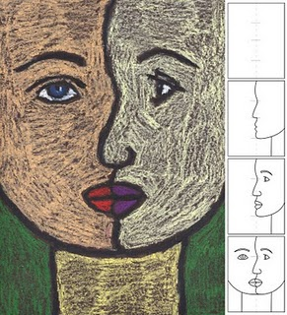
Notes:
This is an alternative way to demonstrate how to draw an abstract face.

Slide 8
Que vois-tu ? Je vois…
Notes:
Encourage pupils to swap their pictures and describe each others’ pictures.

