Slide 1
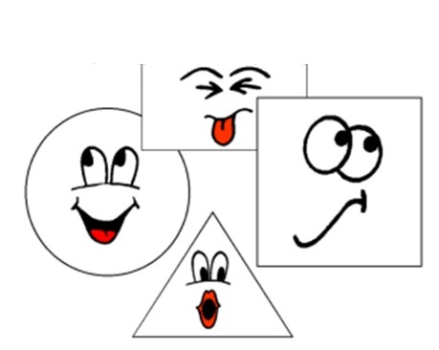
les formes et les couleurs

Slide 2
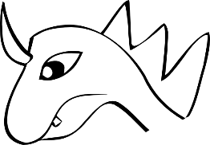
Notes:
Starter activity – ask pupils to name the shapes they can see in the picture.
trois triangles
un oeil
un rectangle
des lignes

Slide 3
droit
courbé
fine
épais
Notes:
droit (straight) courbé (curved), petit (small), grand (big), fine (thin), épais (thick)
It would be useful to practise recalling these using gestures.

Slide 4
grand
petit
Notes:
Practise these also using gestures.

Slide 5
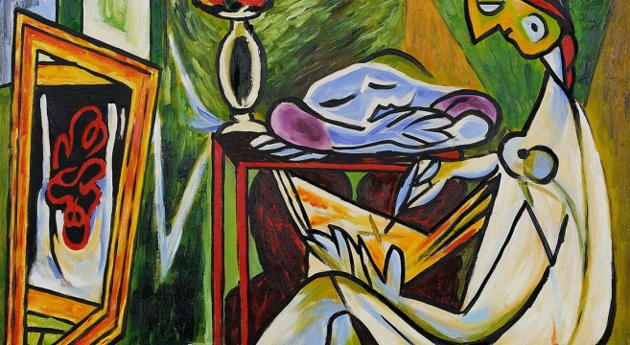
Matisse
1 Il y a un triangle vert.
2 Il y a un cercle bleu.
3 Il y a un demi-cercle bleu.
4 Il y a un ovale vert.
5 Il y a un rectangle marron.
6 Il y a deux lignes marron.
Notes:
Introduce the pupils to this painting by Matisse.
Read each sentence and ask pupils to volunteer to point out what you are describing.
5

Slide 6
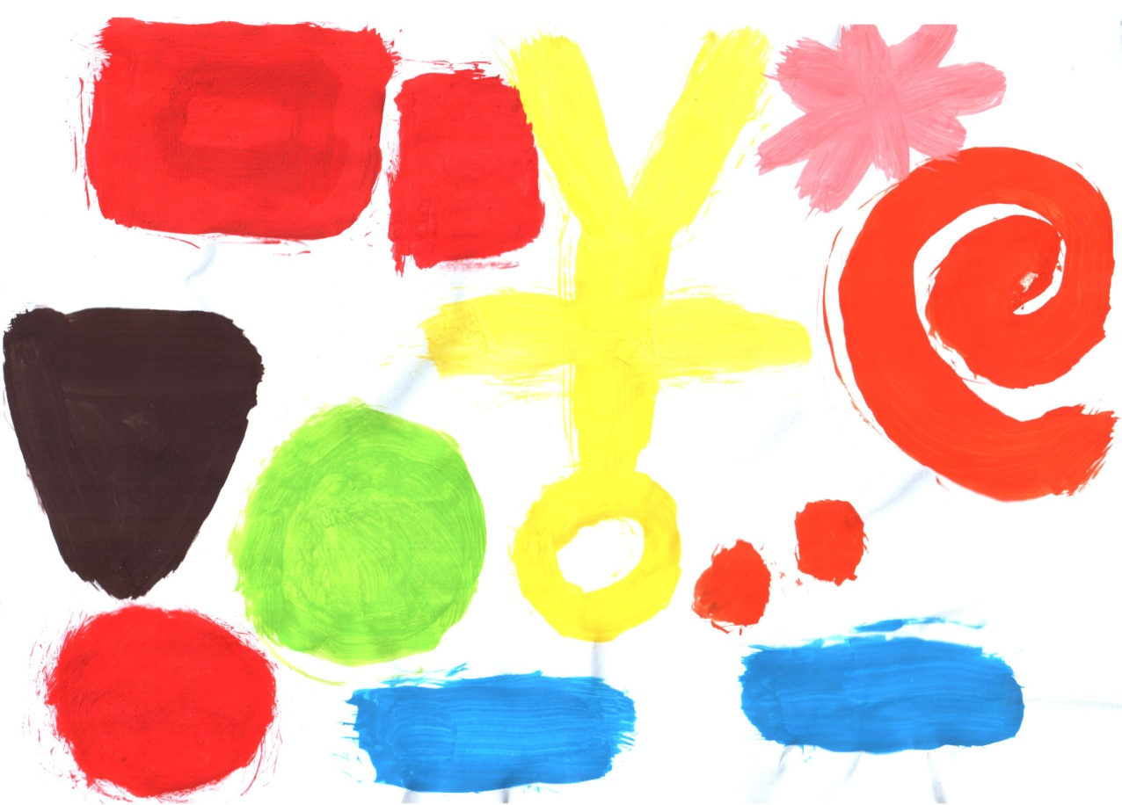
Il y a deux petits points oranges.
Il y a un cercle rouge.
Il y a une étoile rose.
Il y a un triangle marron foncé
Il y a deux rectangles bleus.
Aussi il y a deux rectangles oranges.
Il y a un cercle vert.
Il y a une spirale orange.
Il y a un homme jaune.
Notes:
This is a piece of Y7 work from last year with some sentences describing it. Present these sentences, reading each one aloud to the class as it appears and ask for volunteers to point out each shape that is being described.

Slide 7


Notes:
A slide to revise all of the vocabulary covered in this lesson. Shapes could be described as follows:
un cercle rouge
un triangle vert
une ligne courbée
un ovale blanc
un rectangle grand et orange
un petit oeil
un petit point violet
des lignes violettes
un petit oval blanc
un carré noir
It is not necessary for pupils to put two adjectives together – it is more likely in oral work that each pupil will just say one short phrase with either the size or the colour adjective.

