Slide 1

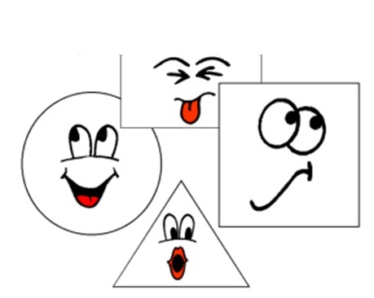
Les formes et les couleurs

Slide 2
Notes:
Say the colours (pupils already know these) and get pupils to show you with their hands which shape is the colour you are saying.
Start saying simple sentences for them to respond with the ‘true’ or ‘false’ gesture.
E.g. Le cercle est rouge. Vrai ou faux?
Le cercle est bleu.
Le triangle est bleu.
Le triangle est rouge.
Le triangle est jaune.
Le carré (trace the shape of a square with your fingers) est rouge. Vrai ou faux?
Etc…

Slide 3


 | un cercle |  | un point
 | un triangle |  | une ligne
 | un carré |  | une étoile
 | un rectangle |  | une spirale
 | un ovale |  | un oeil
Notes:
Click to make each shape appear and hear the audio. Replay each one several times, and invite pupils to make a gesture to correspond to the shape, as they say the word.

Slide 4
 | un cercle |  | un point
 | un triangle |  | une ligne
 | un carré |  | une étoile
 | un rectangle |  | une spirale
 | un ovale |  | un oeil
Notes:
Freeze the screen so pupils cannot see the shapes as they appear, with the audio.
Ask pupils to draw the shape they think each word they hear represents. They could do this on paper or mini whiteboards. Circulate to check pupils’ progress with this. Unfreeze the slide to show pupils the answers.
Then rewind the animations to the start of the slide, and practise saying the words again.

Slide 5
Nous allons mélanger les couleurs !
+
=
+
=
+
=
+
=
Notes:
Pupils know the colours already so this is revision.
The audio is a full sentence, as follows:
1) Rouge et jaune font orange.
The answer colour is animated by a second click, to allow pupils to see and then repeat the final colour, again. i.e. ‘Orange’.
2) Bleu et jaune font vert.
3) Rouge et blanc font rose.
4) Rouge et bleu font violet
font = (they) make
Pupils haven’t learnt any parts of this verb yet, but it is useful to draw their attention to it here.
Ask them what they think ‘font’ means..

Slide 6
et
et
x2
Des crayons pour créer un petit monde coloré
et
et
Notes:
Heads shoulders knees and toes

Slide 7
et
et
x2
Des crayons pour créer un petit monde coloré
et
et
x2

