Slide 1
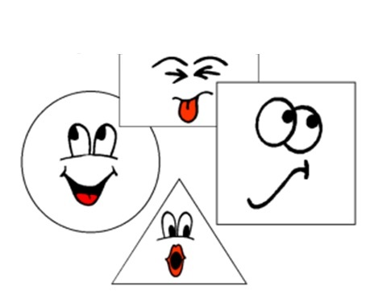
Les formes et les couleurs

Slide 2
Notes:
Say the colours (pupils already know these) and get pupils to show you with their hands which shape is the colour you are saying.
Start saying simple sentences for them to respond with the ‘true’ or ‘false’ gesture. E.g. Le cercle est rouge. Vrai ou faux? Le cercle est bleu. Le triangle est bleu. Le triangle est rouge. Le triangle est jaune. Le carré (trace the shape of a square with your fingers) est rouge. Vrai ou faux? Etc…

Slide 3
 | un cercle |  | un point
 | un triangle |  | une ligne
 | un carré |  | une étoile
 | un rectangle |  | une spirale
 | une ovale |  | un oeil
Notes:
Say the words for the shapes and ask students to draw the shape they think it represents. They know the first 3 shapes already, some are cognates. Then reveal the answers again and get them to practise saying the shapes in pairs.

Slide 4
 | un cercle |  | un point
 | un triangle |  | une ligne
 | un carré |  | une étoile
 | un rectangle |  | une spirale
 | une ovale |  | un oeil
Notes:
Say the words for the shapes and ask students to draw the shape they think it represents. They know the first 3 shapes already, some are cognates. Then reveal the answers again and get them to practise saying the shapes in pairs.

Slide 5
Nous allons mélanger les couleurs !
+
=
+
=
+
=
+
=
Notes:
Pupils know the colours already so this is revision. Teacher models the first sentence:
Rouge et jaune font orange.
Bleu et jaune font vert.
Rouge et blanc font rose. Rouge et bleu font violet

Slide 6
et
et
x2
Des crayons pour créer un petit monde coloré
et
et
Notes:
Heads shoulders knees and toes

Slide 7
et
et
x2
Des crayons pour créer un petit monde coloré
et
et
x2

