Slide 1








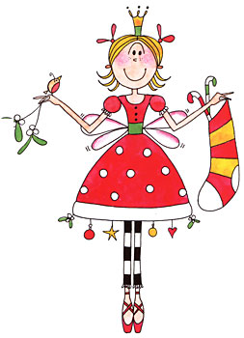
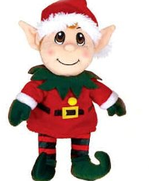
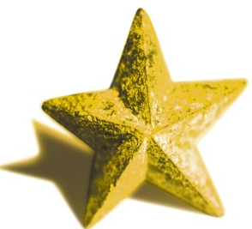
1
2
3
4
5
6
7
8
9
10
11
12
13
14
15
16
17
18
19
20
21
22
23
24
25
Notes:
Choose a number and click on it to see what is on the advent calendar. Click on individual Christmas character to hear what it is in French. Only numbers 1-25 used (similar to advent calendar). Pupils should practise pronunciation of the Christmas characters. There are 10 different ones which are re-used 2 or 3 times in this activity.

Slide 2
1
2
3
4
5
6
7
8
9
10
Choisis le numéro correct pour les mots.
9
a. Père Noel
2
f. un cadeau
6
b. un pingouin
3
g. une cloche
4
c. un renne
1
h. un sapin de Noel
10
d. une étoile
7
i. une fée
8
e. un elfe
5
j. un bonhomme de neige
Notes:
Find the correct number for each word. Here the Christmas vocabulary is written for pupils and they must recognise the word and match it to the picture. You can click on either the word or the picture to hear the vocabulary again.

Slide 3






Combien de sapins de Noël y a-t-il sur la photo?
Il y a sept sapins de Noël .
Notes:
There follows a series of slides asking questions about the things in this picture:
Pupils have to answer in French. Answers are revealed.
‘How many Christmas trees are there in the photo? There are 7 Christmas trees.’
All text has linked audio when clicked on (up to slide 8).

Slide 4
De quelle couleur sont les sapins de Noël ?
Ils sont verts.
Notes:
‘What colour are the Christmas trees? They are green.’

Slide 5
Combien d’étoiles y a-t-il sur la photo?
Il y a une étoile.
Notes:
‘How many stars are there in the photo? There is one.’

Slide 6
De quelle couleur est l’étoile ?
Elle est jaune .
Notes:
‘What colour is the star? It’s yellow.’

Slide 7
Combien de rennes y a-t-il sur la photo ?
Il y a quatre rennes.
Notes:
‘How many reindeer are in the photo? There are 4 reindeer.’

Slide 8
Comment s’appelle le renne au nez rouge ?
Il s’appelle Rodolphe .
Notes:
From this slide onwards, the there is no audio for each question
‘What is the reindeer with the red nose called? He’s called Rudolf.’

Slide 9
Combien de cloches y a-t-il sur la photo?
Il y a treize cloches.
Notes:
‘How many bells are in the photo? There are 13 bells.’

Slide 10
De quelle couleur sont les cloches ?
Elles sont jaunes.
Notes:
‘What colour are the bells? They are yellow.’

Slide 11
Combien de fées y a-t-il ?
Il y a neuf fées.
Notes:
‘How many fairies are there in the photo? There are 9 fairies.’

Slide 12
Combien d’hommes de neige y a-t-il ?
Il y a sept hommes de neige.
Notes:
How many snowmen are there in the photo? There are 7 snowmen.’

Slide 13
De quelle couleur sont les hommes de neige?
Ils sont blancs.
Notes:
‘What colour is a snowman usually? He’s white.’

Slide 14
De quelle couleur est un pingouin ?
Il est blanc et noir.
Notes:
‘What colour is a penguin? It’s black & white.’

Slide 15
Combien de cadeaux y a-t-il sur la photo?
Il y a douze cadeaux.
Notes:
‘How many presents are there in the photo? There are 12 presents.’

Slide 16
De quelle couleur sont les cadeaux dans la photo ?
Ils sont rouges et blancs.
Notes:
‘What colour are the presents? They are white and red.’

Slide 17
Combien d’elfes y a-t-il sur la photo?
Il y a deux elfes.
Notes:
‘How many elves are there in the photo? There are 2 elves.’

Slide 18


1
2
3
10
9
8
7
6
5
4
11
12
13
14
15
16
17
24
23
22
21
20
19
18
25
26
27
28
29
30
31
Notes:
Print out A4 sheets of paper/card so that pupils can play this game in pairs. Pupils can throw dice (saying out loud the number they have thrown) to move squares, pronouncing which number and Christmas character they have landed on. The winner is the first to reach 31.

