Slide 1
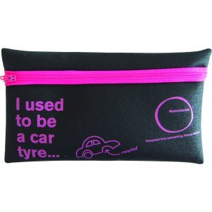
Qu’est-ce que c’est?
C’est ma trousse.
Notes:
What is it? It’s my pencil case.

Slide 2
Qu’est-ce que tu as dans ta trousse?
Notes:
What do you have in your pencil case?

Slide 3

J’ai…
un crayon
Notes:
J’ai
This is the first time that colour-coded nouns (masculine = blue, feminine = red, plura = green) have been presented with the indefinite article (a/some). The colour-coding is to help with internalising the gender, especially for visual learners but for everyone in general.
un = ‘a’ (masculine singular), une = ‘a’ (feminine singular)

Slide 4

J’ai…
un stylo
Notes:
un stylo= a pen

Slide 5

J’ai…
un usb
Notes:
= a pen drive/memory stick

Slide 6
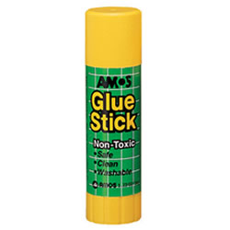
J’ai…
un bâton de colle
Notes:
un bâton de colle
= a glue stick

Slide 7
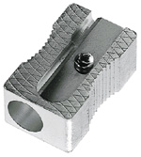
J’ai…
un taille-crayon
Notes:
un taille-crayon
= a sharpener

Slide 8
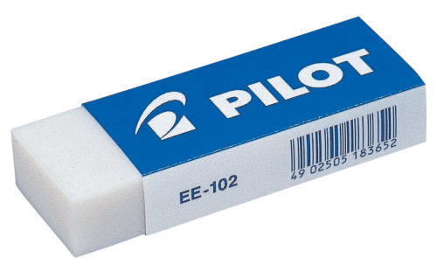
J’ai…
une gomme
Notes:
une gomme
= a rubber

Slide 9
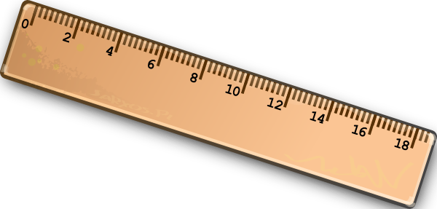
J’ai…
une règle
Notes:
une règle

Slide 10
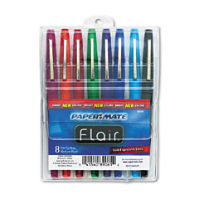
J’ai…
des feutres
Notes:
des feutres = some felt pens

Slide 11
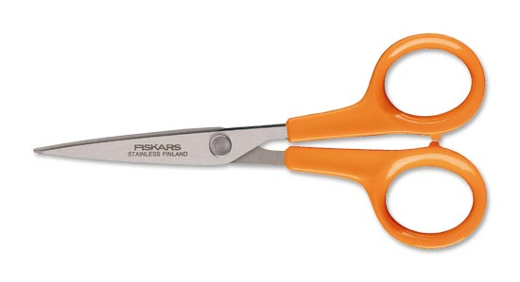
J’ai…
des ciseaux
Notes:
des ciseaux
= scissors

Slide 12
1 | 2 | 3
4 | 5 | 6
7 | 8 | 9
Notes:
A slide to see all items together. Teacher calls out the word and pupils identify the number. Teacher can say the number and a phrase e.g. Número dos – Tengo un sacapuntas and pupils respond ‘Es verdad – it’s true’ or ‘Es mentira – it’s false’.
The teacher can also play the repetition game using this slide. In this game, the teacher points to an item and says something. If the teacher names the item correctly the pupils repeat, if s/he says a different item, pupils remain silent. If they all remain silent for a wrong answer they get a point. If they start saying the word mistakenly the teacher gains a point. Play the first to 5 x points. This game can get very competitive!
Audio is heard if you click on the picture.

Slide 13
A l’envers
Notes:
A l’envers = upside down
In this activity pupils will see the vocabulary upside down and will have to volunteer the correct answer.

Slide 14
des ciseaux
des ciseaux
Notes:
Designed to encourage the pupils to pronounce the words with upside down prompts so that there is a little challenge but the activity is manageable for most. The words are still colour-coded to get pupils used to the gender categorisations. Click on the word (right way up) to hear pronunciation.

Slide 15
un stylo
un stylo

Slide 16
une règle
une règle

Slide 17
un bâton de colle
un bâton de colle

Slide 18
un taille-crayon
un taille-crayon

Slide 19
des feutres
des feutres

Slide 20
un usb
un usb

Slide 21
une gomme
une gomme

Slide 22
une trousse
une trousse

Slide 23
un crayon
un crayon

