Slide 1






Quel âge as-tu ?
9
6
8
7
5
Notes:
Slide giving a clue about the aim of the lesson.

Slide 2
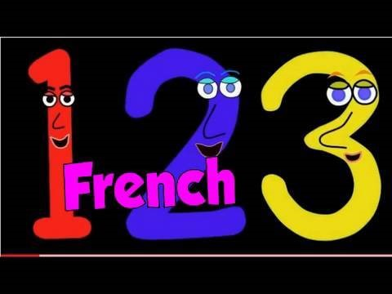
Nous allons chanter les numéros!
Notes:
Short song to revise the numbers.
https://www.youtube.com/watch?v=lsc3qLMaCu8

Slide 3
1
2
3
4
5
6
7
8
9
10
11
12
Notes:
A slide to revise numbers (and add the numbers 11 and 12 – onze et douze

Slide 4

Notes:
Hot-seating activity

Slide 5
4
10
3
8
1
9
6
5
2
7
Notes:
Hot-seating activity. One pupil accepts the challenge of calling out the numbers which appear before them on the whiteboard (numbers are timed to appear so teacher just has to click once to start the activity). The speed increases with each slide.
This can also be done chorally, with the whole class calling out the numbers (I usually prefer to do it this way, these days).

Slide 6
4
10
3
8
1
9
6
5
2
7

Slide 7
4
10
3
8
1
9
6
5
2
7

Slide 8
Nom:
1 | ☺ ☹
2 | ☺ ☹
3 | ☺ ☹
4 | ☺ ☹
5 | ☺ ☹
6 | ☺ ☹
7 | ☺ ☹
8 | ☺ ☹
9 | ☺ ☹
10 | ☺ ☹
Ton opinion:
Nom:
1 | ☺ ☹
2 | ☺ ☹
3 | ☺ ☹
4 | ☺ ☹
5 | ☺ ☹
6 | ☺ ☹
7 | ☺ ☹
8 | ☺ ☹
9 | ☺ ☹
10 | ☺ ☹
Ton opinion
Nom:
1 | ☺ ☹
2 | ☺ ☹
3 | ☺ ☹
4 | ☺ ☹
5 | ☺ ☹
6 | ☺ ☹
7 | ☺ ☹
8 | ☺ ☹
9 | ☺ ☹
10 | ☺ ☹
Ton opinion
Nom:
1 | ☺ ☹
2 | ☺ ☹
3 | ☺ ☹
4 | ☺ ☹
5 | ☺ ☹
6 | ☺ ☹
7 | ☺ ☹
8 | ☺ ☹
9 | ☺ ☹
10 | ☺ ☹
Ton opinion
Nom:
1 | ☺ ☹
2 | ☺ ☹
3 | ☺ ☹
4 | ☺ ☹
5 | ☺ ☹
6 | ☺ ☹
7 | ☺ ☹
8 | ☺ ☹
9 | ☺ ☹
10 | ☺ ☹
Ton opinion:
Nom:
1 | ☺ ☹
2 | ☺ ☹
3 | ☺ ☹
4 | ☺ ☹
5 | ☺ ☹
6 | ☺ ☹
7 | ☺ ☹
8 | ☺ ☹
9 | ☺ ☹
10 | ☺ ☹
Ton opinion
Nom:
1 | ☺ ☹
2 | ☺ ☹
3 | ☺ ☹
4 | ☺ ☹
5 | ☺ ☹
6 | ☺ ☹
7 | ☺ ☹
8 | ☺ ☹
9 | ☺ ☹
10 | ☺ ☹
Ton opinion:
Nom:
1 | ☺ ☹
2 | ☺ ☹
3 | ☺ ☹
4 | ☺ ☹
5 | ☺ ☹
6 | ☺ ☹
7 | ☺ ☹
8 | ☺ ☹
9 | ☺ ☹
10 | ☺ ☹
Ton opinion
Notes:
These hot-seating activity grids should keep the rest of the class involved whilst one pupil is in the hot-seat. The other pupils fill in a grid for each person in the hot-seat, recording whether they agree with the answer given and making a comment if they wish at the bottom. This could be something like ‘excellent’ or ‘assez bien’ etc. Make copies for your pupils or get them to write a grid out on paper.

Slide 9
1
2
3
4
5
6
7
8
9
10
11
12
Notes:
Revise the numbers 1-12 once more.

Slide 10
Quel âge as-tu ?
7
J’ai ans.
Et toi?
9
J’ai ans
Notes:
This slide models the question ‘How old are you?’ and the answer ‘I am…years old’, with the question ‘And you?’

Slide 11
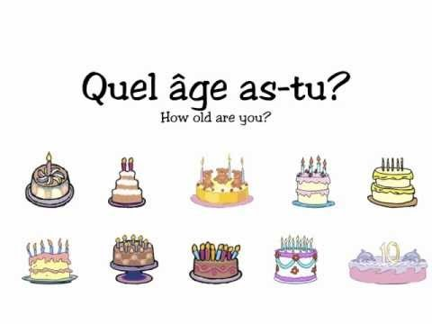
Notes:
Useful little rap to practise the Q and Answer
https://www.youtube.com/watch?v=4WksvcV6vU0

Slide 12
Quel âge as-tu ?
12
6
A | J’ai douze ans. |  | F | J’ai six ans.
B | J’ai huit ans. |  | G | J’ai neuf ans.
C | J’ai dix ans. |  | H | J’ai onze ans.
D | J’ai un an. |  | I | J’ai trois ans.
E | J’ai quatre ans. |  | J | J’ai deux ans.
8
9
10
11
1
3
4
2
Notes:
There is a similar exercise to this in the Year 3 study booklet for further practice.
Pupils read and write in the correct numbers.

Slide 13
Notes:
Do the 45 second rap again to prime for the speaking activity.
https://www.youtube.com/watch?v=4WksvcV6vU0

Slide 14
Quel âge as-tu ?
9
6
8
7
5
Notes:
Slide to practise Q&A

