Slide 1
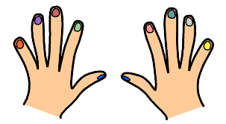

C’est quel numéro?
Notes:
Count the numbers with pupils.
They put their hands up like in the slide and repeat after the teacher.
Do this two or three times.

Slide 2
Tu as combien de doigts?
trois
huit
deux
neuf
quatre
sept
un
dix
cinq
six
Notes:
How many fingers are there? We’re going to practise…
More familiarisation with the written form of the numbers. Pronunciation on click.
Isolate and practise the dipthongs shown in pink

Slide 3
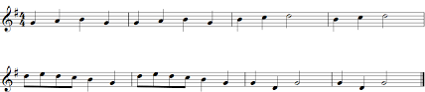
Un, deux, trois quatre
Un, deux, trois quatre
Ci-nq six
Ci-nq six
Se-pt hu-it ne-uf
Se-pt hu-it ne-uf
Dix dix dix!
Dix dix dix!
Notes:
Teacher sings: 1, 2, 3, 4,
Students repeat in song: 1, 2, 3, 4
T: 5, 6,
S: 5,6,
T:7, 8, 9
S: 7,8 ,9
T:10, 10, 10,
S 10, 10 , 10!

Slide 4
1, 2, 3, 4
1, 2, 3, 4
5-- , 6
5-- , 6
7-- ,8--, 9--
7-- ,8--, 9--
10, 10, 10
10, 10, 10
Notes:
Teacher sings: 1, 2, 3, 4,
Students repeat in song: 1, 2, 3, 4
T: 5, 6,
S: 5,6,
T:7, 8, 9
S: 7,8 ,9
T:10, 10, 10,
S 10, 10 , 10!

Slide 5










Notes:
(Click on each blue box, from left to right in order, and you will hear the number which matches the next picture that comes up).
Then click anywhere else on the screen to bring up the picture so pupils can check that they were holding up the right number of fingues.
The numbers are in the following order:
Trois
Dix
Six
Un
Huit
Cinq
Neuf
Sept
Quatre
Deux

Slide 6

Les mains
﻿Un, deux,
Un, deux, trois,
ça fait une main.
Un, deux, trois,
Quatre, cinq,
ça fait cinq doigts.
Six, sept, huit, neuf, dix,
ça fait deux mains
qui se disent : "bonjour".
Bonjour!
Notes:
Click on Text ‘Un deux’ and let it play through –you can click each image to come up at the right time, to support understanding, while the audio continues playing.

Slide 7
C’est quel numéro?
Notes:
Pupils should say which number of finger (according to previous slide) is being pointed at. The arrow only flashes once and then disappears so pupils have to stay focused to see which finger is being pointed at.
The instruction has audio, but here pupils need to just respond with the correct number, so there is no audio for each number on this slide.

Slide 8
deux
onze
cinq
quatre
trois
sept
six
dix
douze
neuf
un
huit

Slide 9





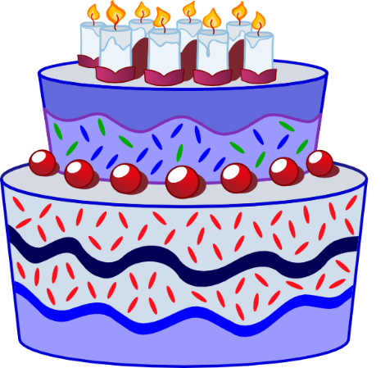

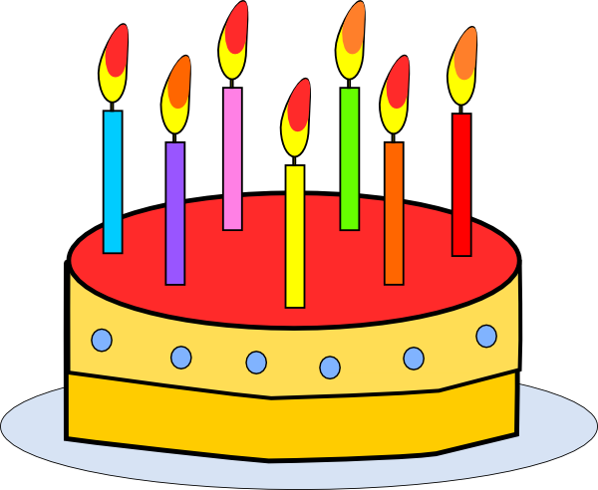





onze
douze
Notes:
Repeat the known numbers and introduce eleven and twelve
Click on the text box to hear numbers 11 and 12 pronounced.

Slide 10
onze
douze
Notes:
Cakes disappear one by one and pupils say the number

Slide 11


Il y a combien de chiens?
Il y a un chien.
Il y a deux chiens.
Très bien!

Slide 12



Il y a combien de chiens?
Il y a cinq chiens.
Très bien!

Slide 13


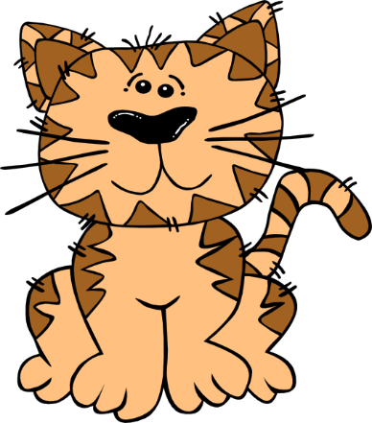

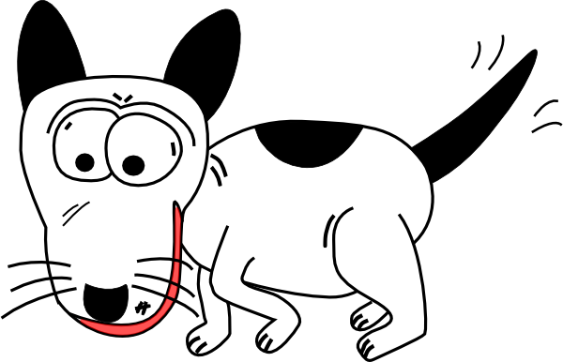
Il y a combien de chiens?
Il y a huit chiens...
et un chat.
Très bien!

Slide 14

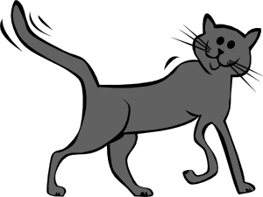
Il y a combien de chats?
Il y a trois chats.
pas mal!

Slide 15
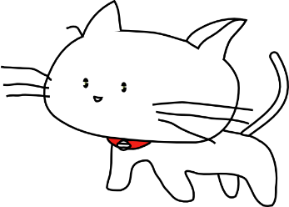

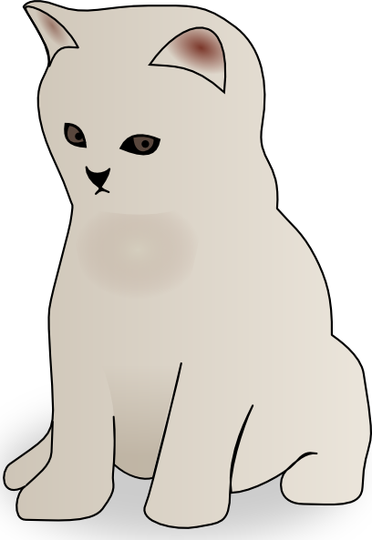

Il y a combien de chats?
pas mal!
Il y a sept chats.

Slide 16
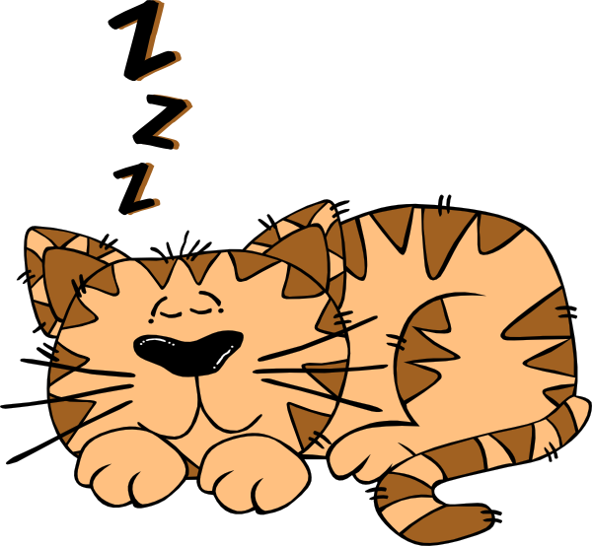
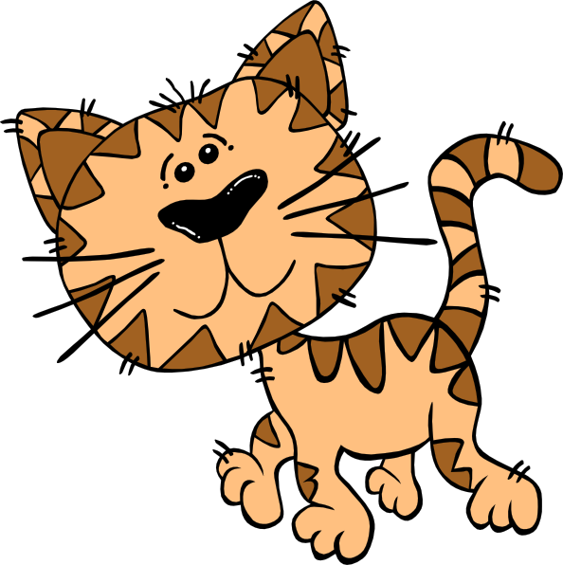
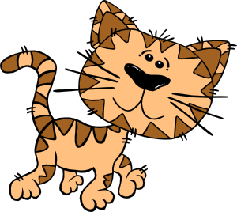
Il y a combien de chats?
pas mal!
Il y a quatre chats.

Slide 17
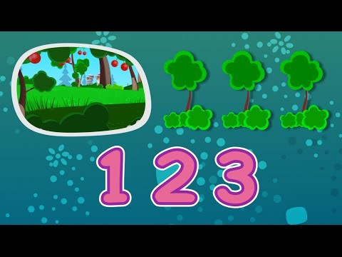

Slide 18
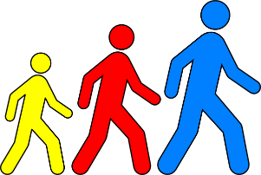
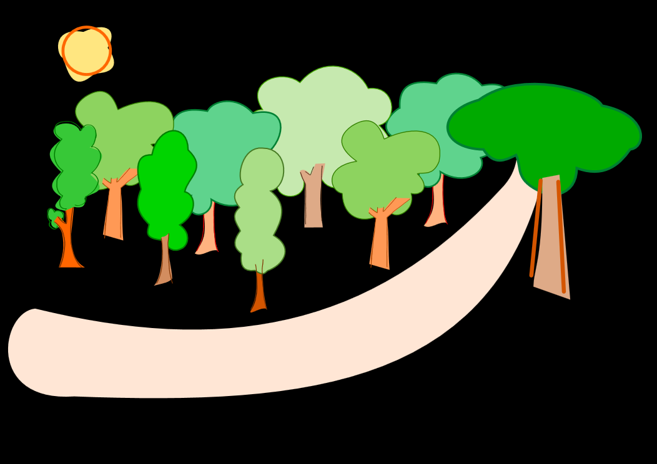

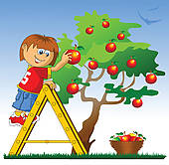


Un, deux, trois
Quatre, cinq, six
Sept, huit, neuf
Dix, onze, douze
Nous irons au bois
1 2 3
4 5 6
Cueillir des cerises
7 8 9
Dans mon panier neuf
10 11 12
Elles seront toutes rouges
Notes:
Bottom left play button – click this for the whole song in one go.
Click the numbers or images for each phrase individually, to practise and repeat.
Call and answer gives a sense of ask and answer at the earliest possible stages of language learning.
With this simple rhyme the 8 lines break nicely into pairs so that one half of the class can say the numbers and the others reply with the corresponding line.

