Slide 1
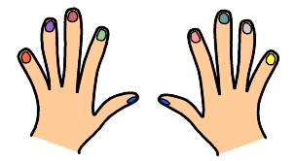
C’est quel numéro?
Notes:
Count the numbers with pupils.
They put their hands up like in the slide and repeat after the teacher.
Do this two or three times.

Slide 2
Tu as combien de doigts?
trois
huit
deux
neuf
quatre
sept
un
dix
cinq
six
Notes:
How many fingers are there? We’re going to practise… More familiarisation with the written form of the numbers. Pronunciation on click.
Isolate and practise the dipthongs shown in pink

Slide 3
Un, deux, trois quatre
Un, deux, trois quatre
Ci-nq six
Ci-nq six
Se-pt hu-it ne-uf
Se-pt hu-it ne-uf
Dix dix dix!
Dix dix dix!
Notes:
Teacher sings: 1, 2, 3, 4,
Students repeat in song: 1, 2, 3, 4
T: 5, 6,
S: 5,6,
T:7, 8, 9
S: 7,8 ,9
T:10, 10, 10,
S 10, 10 , 10!

Slide 4
1, 2, 3, 4
1, 2, 3, 4
5-- , 6
5-- , 6
7-- ,8--, 9--
7-- ,8--, 9--
10, 10, 10
10, 10, 10
Notes:
Teacher sings: 1, 2, 3, 4,
Students repeat in song: 1, 2, 3, 4
T: 5, 6,
S: 5,6,
T:7, 8, 9
S: 7,8 ,9
T:10, 10, 10,
S 10, 10 , 10!

Slide 5
Notes:
Call out a number and pupils have to show you the correct number of fingers.
NB: teachers need to know the order of number, so they can call out before the answer appears!
Trois Dix
Six
Un
Huit
Cinq
Neuf
Sept
Quatre
Deux

Slide 6
Les mains
﻿Un, deux, Un, deux, trois, ça fait une main. Un, deux, trois, Quatre, cinq, ça fait cinq doigts. Six, sept, huit, neuf, dix, ça fait deux mains qui se disent : "bonjour".
Bonjour!

Slide 7
C’est quel numéro?
Notes:
Pupils should say which number of finger (according to previous slide) is being pointed at. The arrow only flashes once and then disappears so pupils have to stay focused to see which finger is being pointed at.

Slide 8
deux
onze
cinq
quatre
trois
sept
six
dix
douze
neuf
un
huit

Slide 9
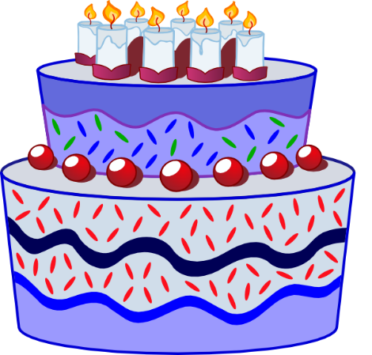
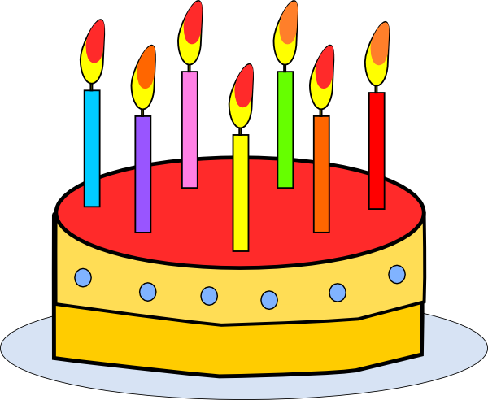
onze
douze
Notes:
Repeat the known numbers and introduce eleven and twelve

Slide 10
onze
douze
Notes:
Cakes disappear one by one and pupils say the number

Slide 11
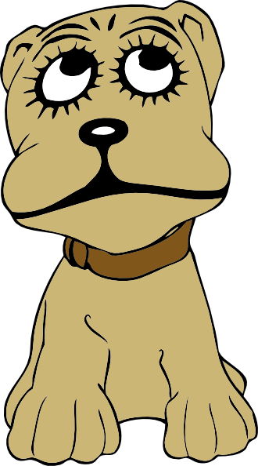
Il y a combien de chiens?
Il y a un chien.
Il y a deux chiens.
Très bien!

Slide 12
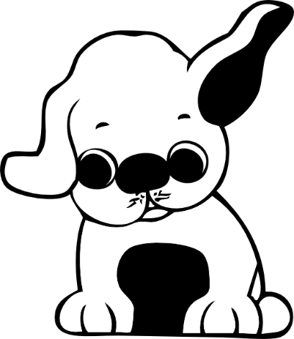
Il y a combien de chiens?
Il y a cinq chiens.
Très bien!

Slide 13
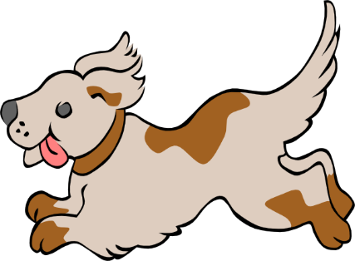
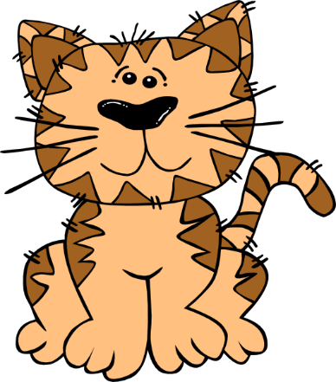
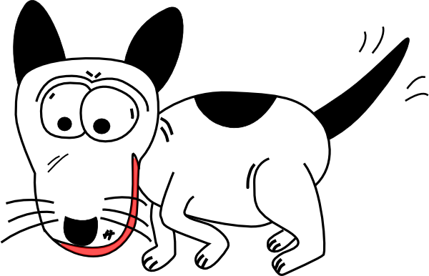
Il y a combien de chiens?
Il y a huit chiens...
et un chat.
Très bien!

Slide 14
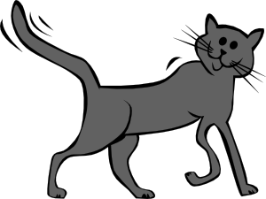
Il y a combien de chats?
Il y a trois chats.
pas mal!

Slide 15
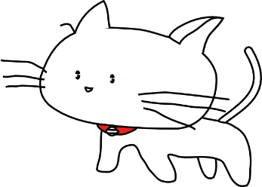
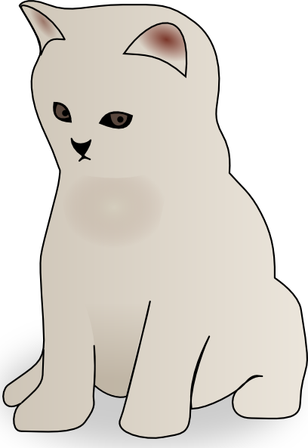
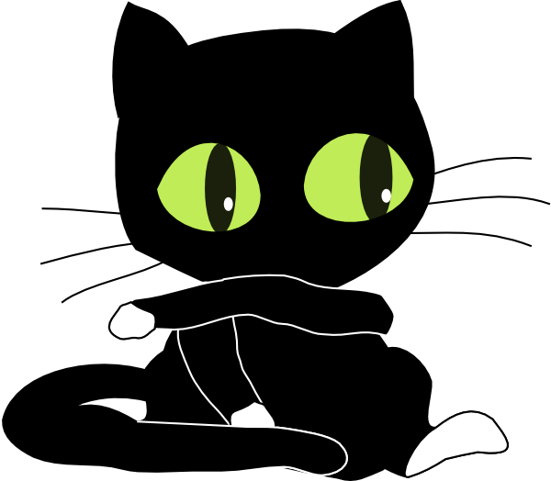
Il y a combien de chats?
pas mal!
Il y a sept chats.

Slide 16
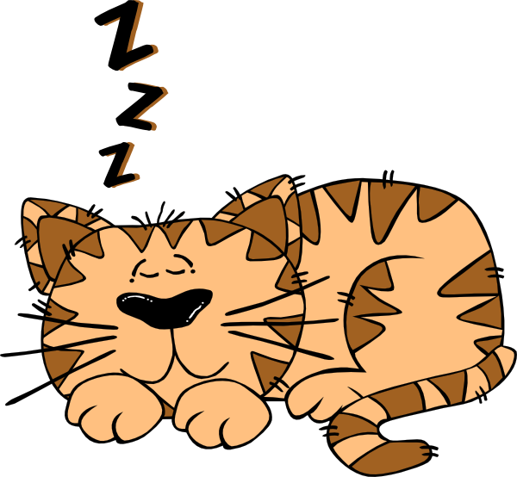
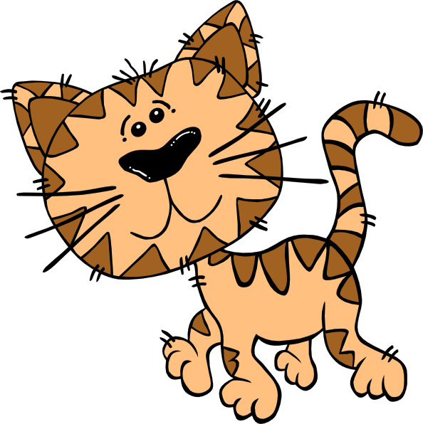
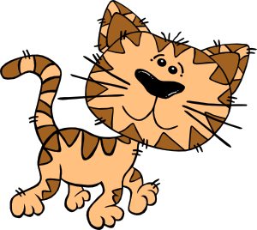
Il y a combien de chats?
pas mal!
Il y a quatre chats.

Slide 18
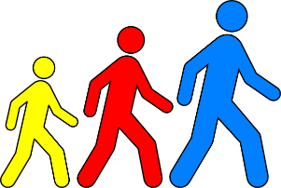
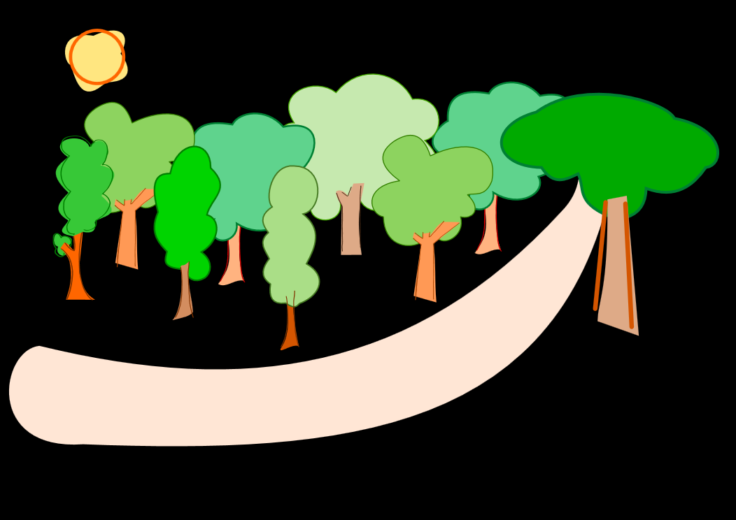
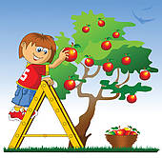
Un, deux, trois
Quatre, cinq, six
Sept, huit, neuf
Dix, onze, douze
Nous irons au bois
1 2 3
4 5 6
Cueillir des cerises
7 8 9
Dans mon panier neuf
10 11 12
Elles seront toutes rouges
Notes:
Call and answer gives a sense of ask and answer at the earliest possible stages of language learning.
With this simple rhyme the 8 lines break nicely into pairs so that one half of the class can say the numbers and the others reply with the corresponding line.

