Slide 1

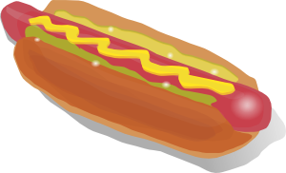



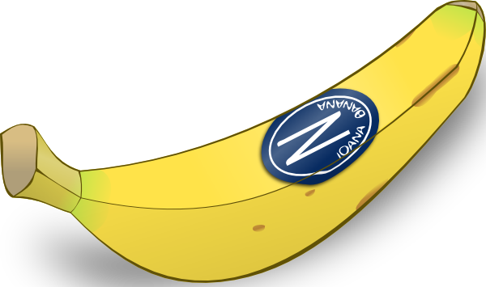



Notes:
Present the new vocabulary, using the indefinite article. The feminine items are presented first.
une salade
une banane
une glace
des frites
un hamburger
un jus d’orange
un coca
un hot dog
un sandwich
Stress the difference between un / une and make the link to the colour blue/red as usual
With the chips, draw attention to the green symbol and elicit the idea that chips are ‘plural’

Slide 2
1 | 2 | 3
4 | 5 | 6
7 | 8 | 9
Notes:
Use this slide to being to fix the vocabulary. Use the following steps:
1. Point at an item and say an item (which may be correct or incorrect). Pupils respond by a gesture for ‘c’est vrai’ i.e. a tick in the air or ‘c’est faux i.e. hands crossed over their chests.
2. Say an item and pupils volunteer the correct number. E.g. un jus d’orange? C’est quel numéro?
3. Say a number and give two alternatives. Pupils volunteer the correct word. E.g. Número 3 – un sandwich ou un hotdog? You can speed this up and give 3 x options too.
4. Play the repetition game up to 5 points.
5. Mouthe the word for an item and pupils volunteer the correct word. You can cue them into the correct article by vocalising the ‘un / une / des
6. Give a number and elicit the correct item.

Slide 3
Notes:
Disparition - disappearance
Items disappear one by one. Pupils tell you which item.

Slide 4
1
Notes:
FREEZE ON THIS SLIDE – then move to the next one to bring up the audio for each item.
Give pupils a set of the 9 cards – or they can have one set between two and work in pairs.
Pupils do not see the answers (on the next slide), but they have the blank grid so that they realise they need to place the pictures down in 3 rows of 3 starting from the top left corner.
The teacher says each item twice, slowly and carefully as this is the first time through with this activity. The pupils should end up with the 9 pictures in the correct formation.
Then bring the items up one by one for the pupils to check their answers.
There are two more slides with the pictures in a different order – with each successive time, the teacher can work a little more quickly and/or use less repetition.

Slide 5
1
Notes:
ANSWER SLIDE 1

Slide 6
2
Notes:
Round 2

Slide 7
2
Notes:
ANSWER SLIDE 1

Slide 8
3
Notes:
Round 3

Slide 9
3
Notes:
ANSWER SLIDE 1

Slide 10
Notes:
Use this slide to create cards for pupils to use in the listening activities.

