Slide 1


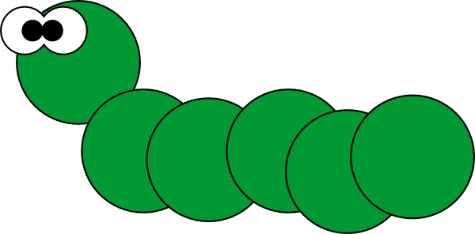







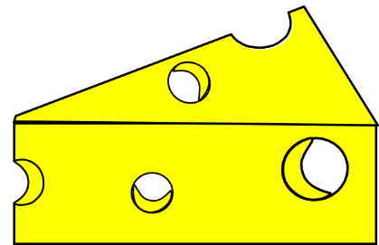

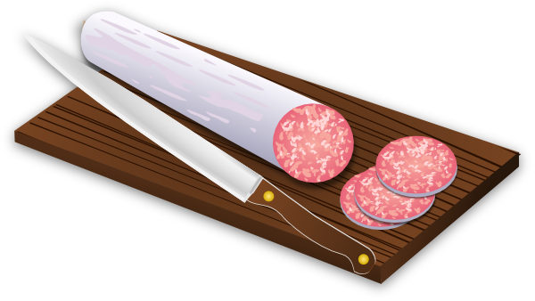






Notes:
Pupils can use these pictures as prompts when retelling the story in pairs, groups or individually to the teacher. Or they could use the pictures to make another mini-book of their own to re-tell the story in words etc.
Pupils should now attempt to cut out the pictures and glue them on to another sheet of paper in the correct order of the story. They should them attempt to re-tell the story in French using only the pictures.

