Slide 1
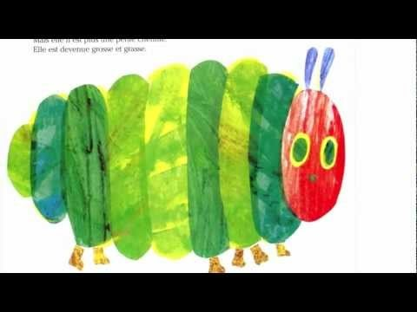
La chenille qui fait des trous
Notes:
French primary children reading the story.
Play video of story – write out text and pupils order it while they watch again

