Slide 1
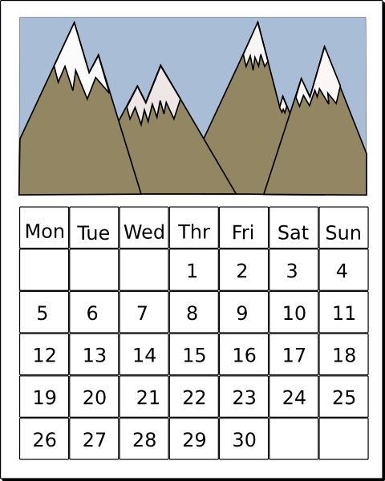
Les jours de la semaine
Lu
Ma
Mi
Je
Ve
Sa
Di

Slide 2
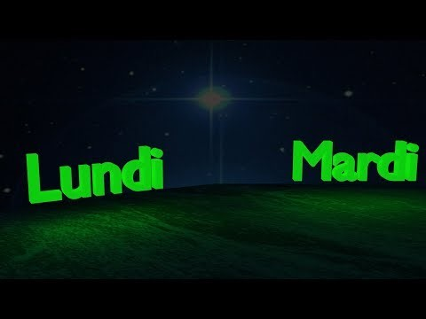
Les jours de la semaine
Notes:
https://www.youtube.com/watch?v=x-G1kkJR65Q
Just the days (repeated over and over). But the tune does end up sticking and the harmonies make it not unpleasant to listen to, despite the minion-type voices!

Slide 3

Les jours de la semaine
lundi
lundi
mardi
mercredi
jeudi
vendredi
samedi
dimanche
mardi
mercredi
jeudi
vendredi
samedi
dimanche
Notes:
Elicit the days obscured by the splats.

Slide 4
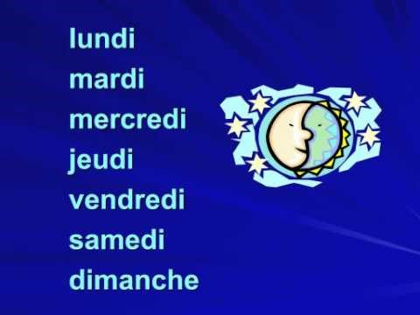
Les jours de la semaine
Notes:
https://www.youtube.com/watch?v=xVHzu60QVKI
This song has additional words, but it is catchy and pupils can speed up their production of the days of the week by singing along to the chorus.

Slide 5
Les jours de la semaine
Lu
Ma
Mi
Je
Ve
Sa
Di
Notes:
Elicit the days from the starting two letters.

Slide 6
Les jours de la semaine
l-n-d-
m-rd-
m-rcr-d-
j—d-
v-ndr-d-
s-m-d-
d-m-nch-
l-n-d-
m-rd-
m-rcr-d-
j—d-
v-ndr-d-
s-m-d-
d-m-nch-
Notes:
Elicit with the vowels missing.
The words on the RHS are animated to appear with audio.

Slide 7
Quelle est la date aujourd’hui ?
Mardi , 7 avril
jour = day
mois = month
date = date
aujourd’hui = today
Notes:
This routine needs building in during the summer term of Year 3. Asking the class what day and date it is will be a regular feature from now on. NB – the date will need changing on this slide to reflect the date / day of the lesson.

Slide 8






Combien de fruits y a-t-il ?
un
Il y a …
deux
trois
quatre
cinq
six
sept
huit
neuf
Notes:
Revise the fruits from the previous lesson to finish.

