Slide 1
a
e
i
o
u
les voyelles
Notes:
Pupils will learn how to pronounce the vowel sounds in French - ‘las voyelles’ = the vowels.

Slide 2
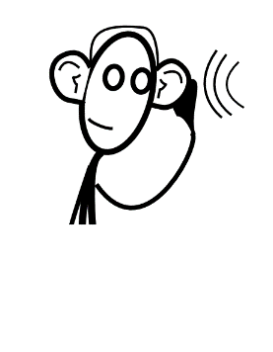



Nous allons…
regarder
écouter
penser
parler
Notes:
Part of essential classroom language – introduce pupils early to infinitive verbs by miming and saying these 4 skills that pupils are going to use in their learning today (and in lots of future lessons).
Ensure pupils know what they mean, and what ‘nous allons’ means.

Slide 3
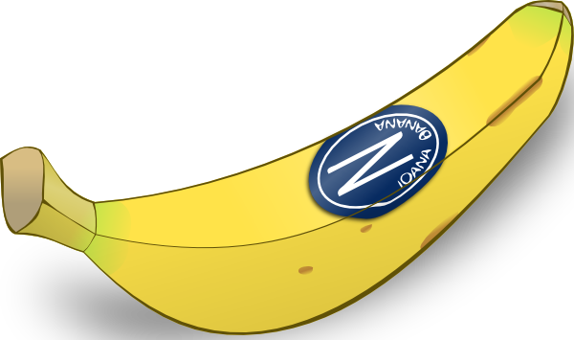
a
la banane
Notes:
Present each of these five key phonics sounds, saying the letter alone, the whole word, and doing a gesture for ‘banana’ – I just suggest making the shape of a banana with both hands – start with finger tips together in the middle, pull them apart and upwards to trace the shape of a banana.

Slide 4

e
le cheval
Notes:
Gesture for horse – mime of horseriding

Slide 5

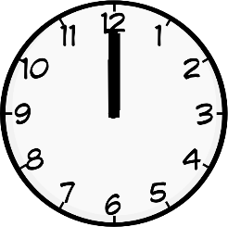
i
à midi
Notes:
Gesture for midday – raise both arms above your head, palms touching to mime 12 o’clock.

Slide 6
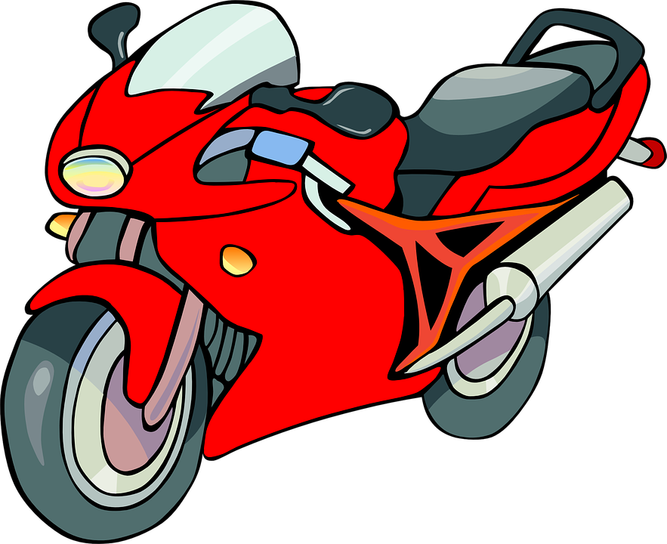
o
la moto
Notes:
Gesture for moto – hands out in front as though gripping the handle bars, sway right and left as if riding quickly round corners.

Slide 7
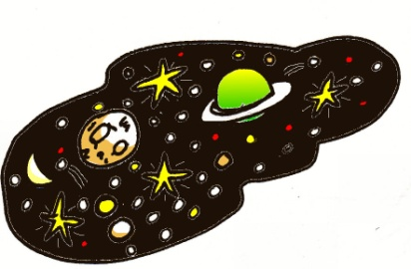
u
l’univers
Notes:
Gesture – start with hands in front about eye level and touching – draw them apart and around to trace the shape of the earth (yes, I know the earth is not the universe, but it’s a helpful gesture for the sound as well)

Slide 8
a
e
i
o
u
Notes:
Elicit the vowel sounds together.

Slide 9
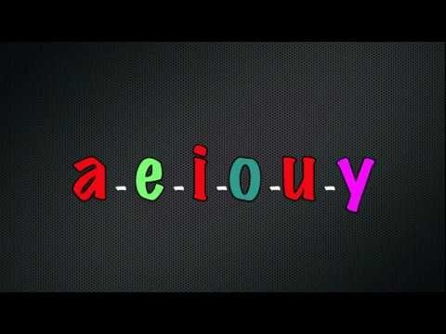
La chanson des voyelles
Notes:
https://www.youtube.com/watch?v=lXPUmC51wGc
This song is good to sing along to – it includes ‘y’ as a vowel, but the pronunciation is the same ‘I’ when used as a vowel.
Pretty soon pupils will learn this, when they learn ‘stylo’ and also ‘il y a’ when it is an adverbial pronoun meaning ‘there’

Slide 10


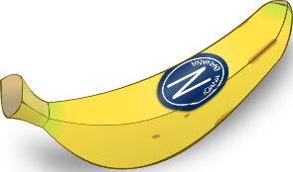



a e i o u
la le li lo lu
ma me mi mo mu
da de di do du
ta te ti to tu
Notes:
Pupils should imagine how these syllable sounds will be pronounced in French (by slotting in the vowel sounds they already know). These is designed to reinforce the fact that their knowledge of English will at times be helpful in their French learning.
They can do this in pairs.

Slide 11
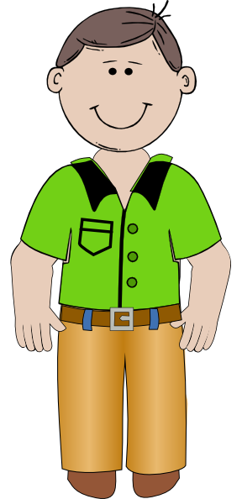

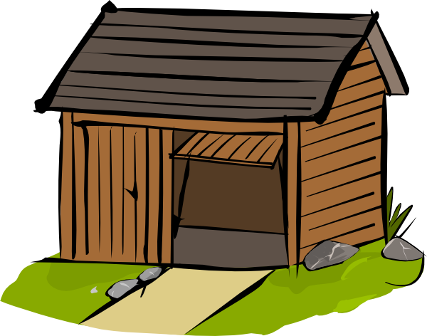



Papa va à la cabane
Le cheval aussi, à midi
Notes:
Whole class reading
Use gestures to build up repetition of these phrases – ensure that pupils understand the meaning of the new words, too.

Slide 12

La moto perdue, dans l’univers
[in]
a – e – i – o – u
Notes:
conclude the ‘comptine’ with a-e-i-o-u
Say it all with pupils several times, then try to elicit all of the French from just the pictures, on the next slide.

Slide 13


a – e – i – o – u
Notes:
A slide to recap the whole ‘comptine’

Slide 14



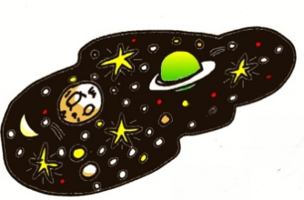
Notes:
Finally…
To finish with, a sure fire way to embed words and sounds in longer term memory – a song!
First, elicit the words line by line without any singing.
Then click on the icon to hear the song (or sing it yourself).
This can get faster and faster.
Pupils can sing and do the actions at the same time.
Teachers to focus on pupils’ pronunciation and ensure that it remains good even when speeding up!

