Slide 1
L’histoire de l’ours brun
Notes:
https://www.youtube.com/watch?v=4C_nBszH_no

Slide 2
Ours brun, ours brun, dis-moi ce que tu vois?
Je vois un oiseau rouge qui regarde par ici…..

Slide 3
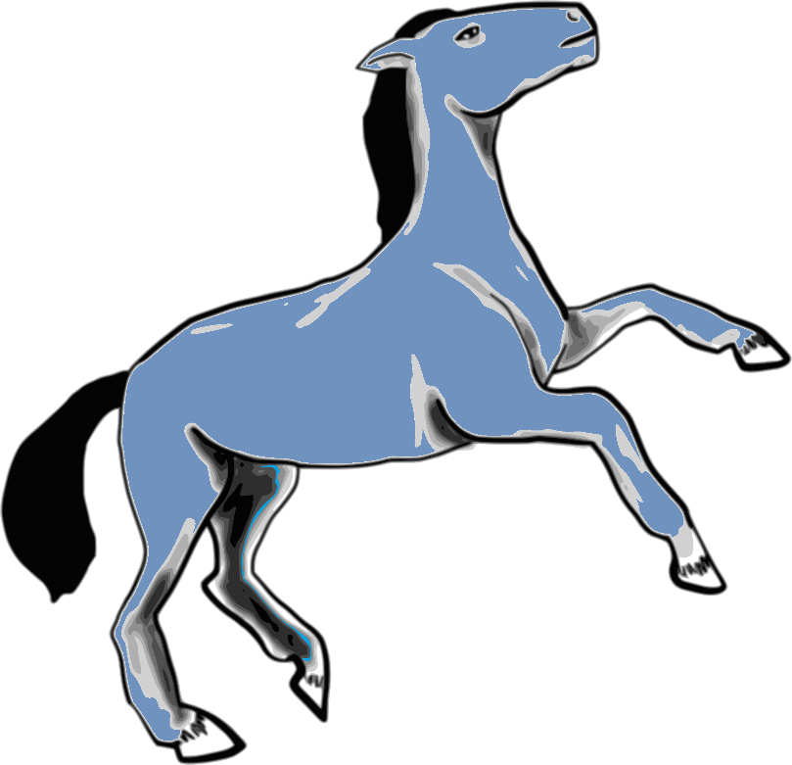
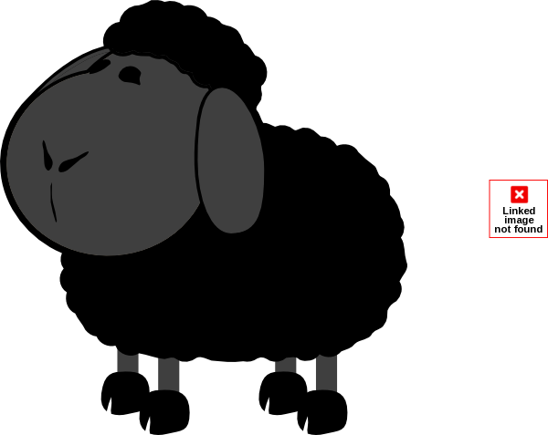
brun
rouge
blanc
noir
bleu
violet
jaune
orange
verte
Notes:
Pupils choose the correct adjective which they heard with the animal in the story.

Slide 4
Ours brun, ours brun, dis-moi ce que tu vois?
brun
rouge
blanc
noir
bleu
violet
jaune
orange
verte
Je vois un oiseau rouge qui regarde par ici.
Notes:
This time do a ‘re-telling’ of the story. The underlined words change each time. You use the previous animal in the question and the new animal in the answer.

Slide 5
1 Je vois un ours brun et un oiseau rouge
2 Un canard jaune , un cheval bleu
3 Une grenouille verte , un chat violet
4 Un chien blanc, un mouton noir
5 Un poisson orange et une institutrice.
Notes:
Est-ce que ces mots sont dans le texte ? Oui ou non? Lignes un, un cheval ? (Are these words in the text? Yes or no? Line one, a horse?)
Asking questions like this focuses attention on listening and matching the sound to the written word.

Slide 6
1
Notes:
NB: You will need pupils to have a set of cards for this activity. Use the final slide in this PowerPoint to create the cards. It works well in pairs (and cuts down on the work to create the resources).
Use these three slides to do listening and response.
Pupils place the cards down in the order in which they hear them (in a 3 x 3 formation on their desk)
This slide has the audio. Click the audio icon. Use the next slide to show the answers. If pupils are able, the teacher can elicit the answers one by one in French.

Slide 7
1
Notes:
Use these three slides to do listening and response.
Pupils place the cards down in the order in which they hear them (in a 3 x 3 formation on their desk)
This slide has the audio. Click the audio icon. Alternatively, teachers can call the animals themselves. Use the next slide to show the answers. If pupils are able, the teacher can elicit the answers one by one in French.

Slide 8
2
Notes:
The audio is a little quicker on this one.

Slide 9
2
Notes:
ANSWERS

Slide 10
3
Notes:
The fastest round. Tell pupils this is for fun and a challenge and not to worry if they get lost. (Of course, you can play the audio several times).

Slide 11
3
Notes:
ANSWERS

Slide 12
Notes:
Un ours brun c’est possible ? Oui ou non? (go through all of the animals)
When we are asking ‘is it possible’ we are talking about the difference between the colours these animals are in nature, as opposed to fiction / imagination. I think we would logically say ‘yes’ to everything except the blue horse and purple cat.

Slide 13
Ours brun, ours brun, dis-moi ce que tu vois? | Je vois un oiseau rouge qui regarde par ici…..
Oiseau rouge, oiseau rouge dis-moi ce que tu vois? | Je vois un canard jaune qui regarde par ici…..
Canard jaune, canard jaune dis-moi ce que tu vois? | Je vois un cheval bleu qui regarde par ici…..
Cheval bleu, cheval bleu dis-moi ce que tu vois? | Je vois une grenouille verte qui regarde par ici…..
Grenouille verte, grenouille verte dis-moi ce que tu vois? | Je vois un chat violet qui regarde par ici…..
Chat violet, chat violet dis-moi ce que tu vois? | Je vois un chien blanc qui regarde par ici…..
Chien blanc, chien blanc dis-moi ce que tu vois? | Je vois un mouton noir qui regarde par ici…..
Mouton noir, mouton noir dis-moi ce que tu vois? | Je vois un poisson orange qui regarde par ici…..
Notes:
1 Choral reading. Teacher drops out and pupils carry on. 2 Choral reading. Cover all / most / some of the text. with the splats.

Slide 14
Listening and responding
- to key sounds / phonics | Est-ce que ces mots sont dans le texte ? Oui ou non? Lignes un à trois, un cheval ? (Are these words in the text? Yes or no? Lines one to three, a horse?)
- to individual words | Levez la main quand vous écoutez une couleur / un animal.
- to meaning | Un ours brun c’est possible ? Oui ou non? (go through all of the animals)
- to mood / emotions
Reading and responding
- read aloud for pronunciation / fluency | Choral reading. Teacher drops out and pupils carry on.
- de-coding of words / idiom / meaning behind the word | Comment dit-on ‘teacher’ en français? (How do you say ‘…’ in French?)
- grammatical focus | In this text you could look at masculine / feminine nouns, adjective placement.
- comparison of two texts – sounds / words / imagery / rhymes / rhythm / style
Notes:
NB: Not for display to the class – ideas for teachers to use, depending on the class.

Slide 15
Speaking and Writing - responses
Memory – individual words / phrases | Cover the text. Which words can they remember? Gap fill. Cover words up. Can students tell you which are missing?
Memory – whole text | Choral reading. Cover all / most / some of the text. Teacher begins to read – pupils join in and supply the missing words when the teacher pauses.
Memory → spoken performance | Work in pairs. Je suis allé(e) à l’animalerie et j’ai acheté……trying to list all the items in order.
Re-writing – individual words / substitution | Comment dit-on ‘a red cat’ en français? Change the animal / colour details
Re-writing – different ending / different point of view / similar piece in the style of | Pupils tell a different story. In this case it would be one with different animal/colour combinations.
Creating in a new genre – a dialogue / a letter / a diary entry / narrative / rap | Tu as un animal? Oui, j’ai un(e) … C’est comment? C’est (rouge).

Slide 16
Notes:
TEMPLATE for printing

Slide 17
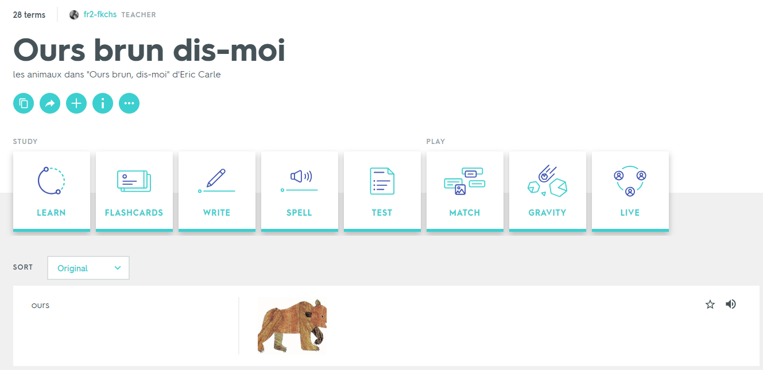
https://quizlet.com/25191490/ours-brun-dis-moi-flash-cards/
Notes:
This is an online resource created and uploaded by an unknown teacher, not associated with this project.

Slide 18
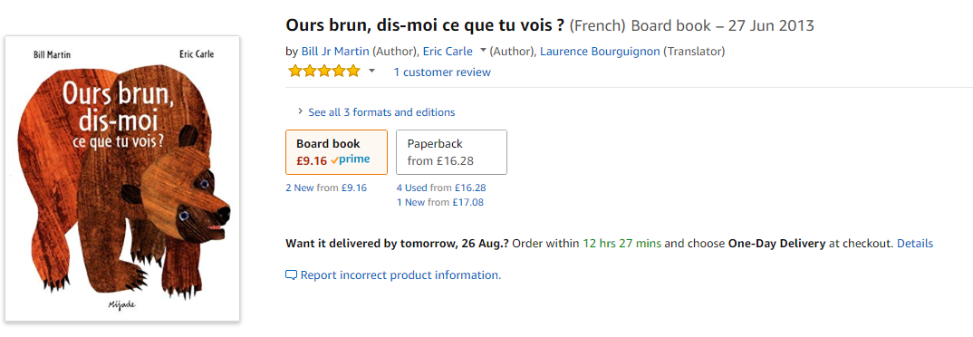
https://www.amazon.co.uk/Ours-brun-dis-moi-que-vois/dp/287142845X/ref=sr_1_8?ie=UTF8&qid=1535180304&sr=8-8&keywords=bill+martin+and+eric+carle
Notes:
The French version of the book is available on Amazon and worth buying to read with pupils all together.

