Slide 1
un
une
le
la
Singulier et pluriel
(a, the, some)
des
des
les
les
Notes:
Here the pupils are introduced to all the words for a/some/the which remain colour-coded blue for masculine and red for feminine. The is an important skill to grasp as most sentences which contain a noun will also contain an article (definite or indefinite). The activity is designed to be interactive whereby pupils can come to the front and press/click on the buttons they believe to be appropriate to the animal featured. They will hear audio telling them whether they are correct or not. Pupils will hear ‘tant pis’ (bad luck) if they choose something inappropriate, or praise & a translation if they choose something appropriate (grammatically correct).

Slide 2
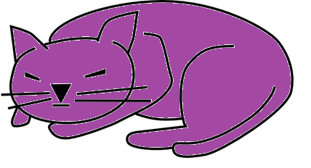
un
une
le
la
Notes:
Pupils should choose blue buttons because they have learnt that ‘un chat’ is masculine/blue. Because they have already learnt ‘un’ chat they should choose that button easily and then follow the blue pattern to get the correct word for ‘the’.

Slide 3
some cats =
des
chats
the cats =
les
chats
Notes:
In French some = des and the (plural) = les, irrespective of the gender. It’s important that pupils have practice in recognising and producing the different plural articles, though, as misuse of direct/indirect articles is often something that causes errors, which can lead to miscommunication.

Slide 4
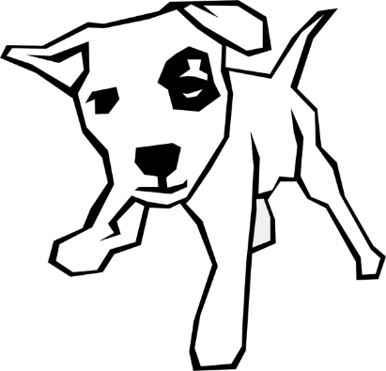
un
une
le
la
Notes:
Instructions as per slide 2&3.

Slide 5
some dogs =
des
chiens
the dogs =
les
chiens
Notes:
Instructions as per slide 2&3.

Slide 6
un
une
le
la
Notes:
Instructions as per slide 2&3.

Slide 7
some fish =
des
poissons
the fish =
les
poissons
Notes:
Instructions as per slide 2&3.

Slide 8
un
une
le
la
Notes:
Instructions as per slide 2&3.

Slide 9
some ducks =
des
canards
the ducks =
les
canards
Notes:
Instructions as per slide 2&3.

Slide 10
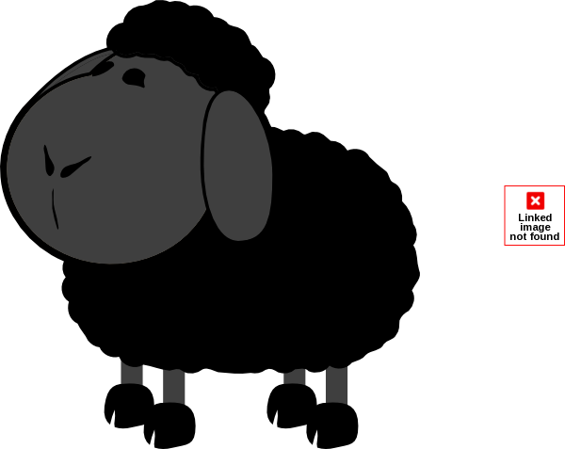
un
une
le
la
Notes:
Instructions as per slide 2&3.

Slide 11
some sheep =
des
moutons
the sheep =
les
moutons
Notes:
Instructions as per slide 2&3.

Slide 12
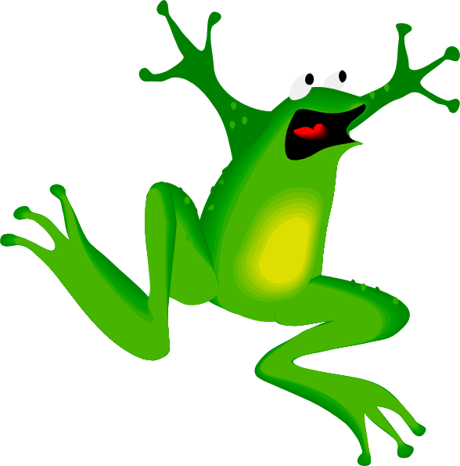
un
une
le
la
Notes:
Instructions as per slide 2&3.

Slide 13
some frogs =
des
grenouilles
the frogs =
les
grenouilles
Notes:
Instructions as per slide 2&3.

Slide 14
un
une
l’
la
Notes:
Instructions as per slide 2&3.

Slide 15
some bears =
des
ours
the bears =
les
ours
Notes:
Instructions as per slide 2&3.

Slide 16
un
une
l’
la
Notes:
Instructions as per slide 2&3.

Slide 17
some birds =
des
oiseaux
the birds =
les
oiseaux
Notes:
Instructions as per slide 2&3.

Slide 18
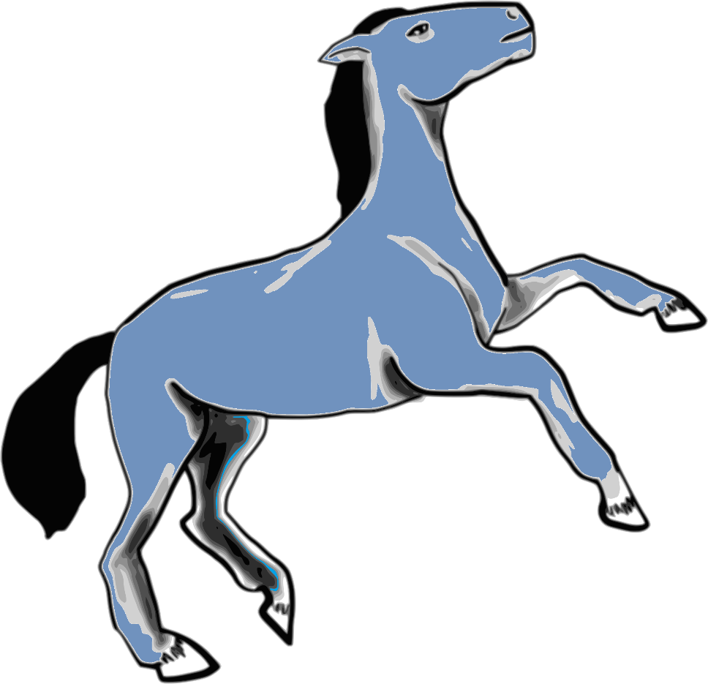
un
une
le
la
Notes:
Instructions as per slide 2&3.

Slide 19
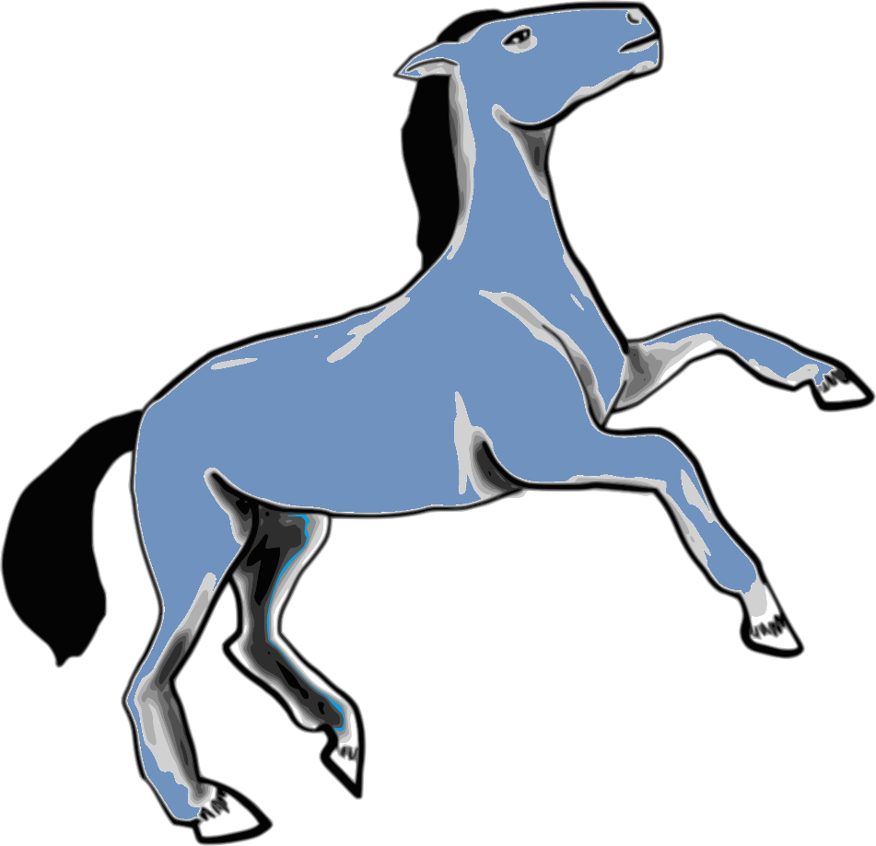
some horses =
des
chevaux
the horses =
les
chevaux
Notes:
Instructions as per slide 2&3.

Slide 20
Comment dit-on en anglais…?
1
some ducks
des canards =
la grenouille =
les moutons =
les chevaux =
un chien =
2
the frog
3
the sheep (more than one)
4
the horses
5
a dog
Notes:
¿Ça se dit comment en anglais? = How do you say it in English? Here pupils are asked to reproduce the vocabulary and the appropriate word for a/some/the according to the gender/number of the word in question. They might answer orally or write down their answers referring to a vocabulary list if necessary.
Click on the numbers to hear each French animal item pronounced.

Slide 21
Comment dit-on en anglais…?
6
des oiseaux =
le chat =
un poisson rouge =
les ours =
un mouton =
some birds
7
the cat
8
a goldfish
9
the bears
10
a sheep
Notes:
Click on the blue numbers to hear pronunciation of the French nouns.

Slide 22
Comment dit-on en anglais…?
11
un canard =
des chats =
l’oiseau =
les chiens =
le cheval =
a duck
12
some cats
13
the bird
14
the dogs
15
the horse
Notes:
Click on the blue numbers to hear pronunciation of the French nouns.

