Slide 1
Une carte de Noel
Notes:
Christmas card colouring pictures taken from here:
http://www.coloring.ws/christmas4.htm

Slide 2
Notes:
Model to pupils that they will choose their Christmas card design (OR draw their own if they prefer) and fold the A4 card as shown. Ensure that they know the greeting on the card means ‘Happy Christmas’.

Slide 3
Qui
Papa/Jean/grand - père
Papa et Jean Maman et Papa
Maman, Marie et grand-mère
Notes:
Model to pupils that they will write Dear + Name on the inside of the card

Slide 4
Bonne Année!
Notes:
Model to pupils that they will write Próspero Año Nuevo on the inside, too (Happy New Year)

Slide 5
Bisou Grosses bises Meilleurs voeux
Ecris ton nom
Notes:
Model the different possibilities for signing off the card.

Slide 6
Joyeux Noel!

Slide 7
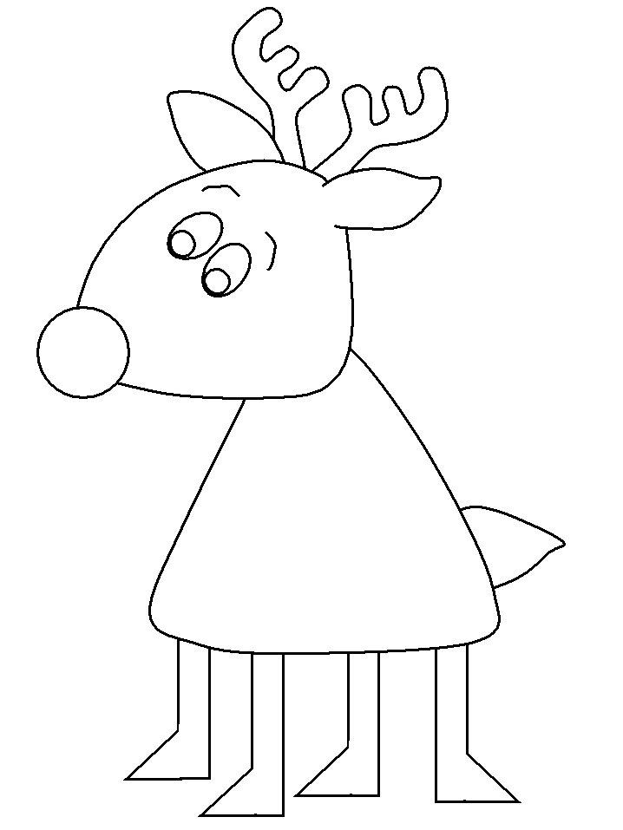
Joyeux Noel

Slide 8
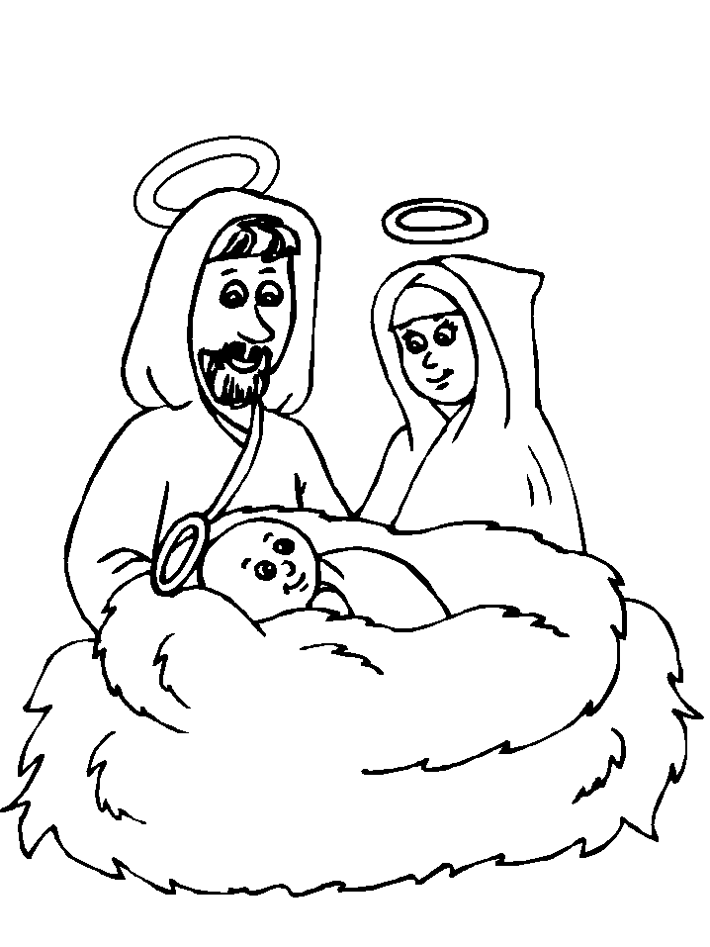
Joyeux Noel !

