Slide 1
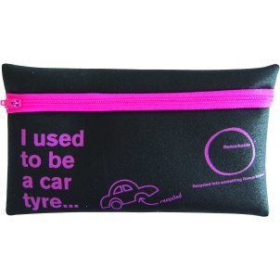
Qu’est-ce que tu as dans ta trousse?
Notes:
What do you have in your pencil case?

Slide 2
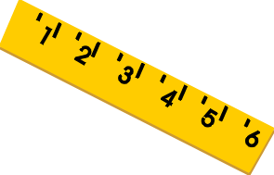
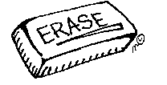
Strip Bingo
Notes:
Give pupils a strip of paper which they fold into six equal pieces so it looks like the one on this slide.
In each of the six sections they draw an item from the pencil case, in any order. Teacher then calls out all of the items in any order (repeating items over and over). Alternatively a pupil can call them out. Remember that there is a list of the pencil case vocabulary in the Y3 study booklet. Pupils are allowed to tear off their sections at either end, but can’t tear anything out of the middle. The game is one when the pupil has no sections left.

Slide 3
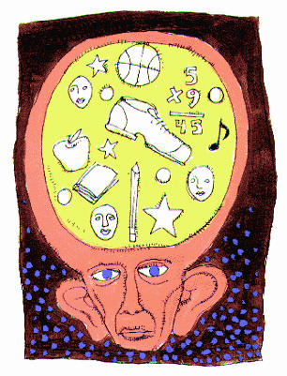
mémoire
Notes:
memory Click word to hear it pronounced.

Slide 4
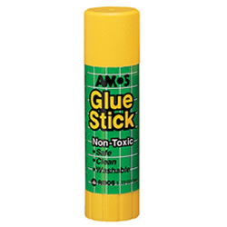
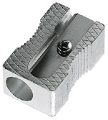
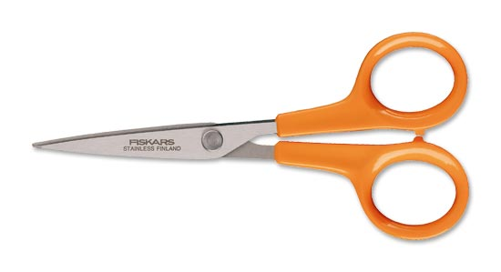
Le grand jeu de la mémoire
Prenez 10 secondes pour mémoriser !
Notes:
le grand jeu de la mémoire (The big memory game). Prenez 10 secondes pour mémoriser ! = You all have 10 seconds to memorise! Click on text to hear instructions pronounced. The curtains open on click and then close when 10 seconds has passed. Pupils must use the time to memorize which items are on the tray and then recall them orally. Encourage them to remember whether they need to use un / une / des with each bit of vocabulary. If you ask different pupils for one item each then this will hopefully be manageable. The items are shown again on the next slide. Remember: if it’s too difficult/fast for pupils you can always repeat the slide.

Slide 6
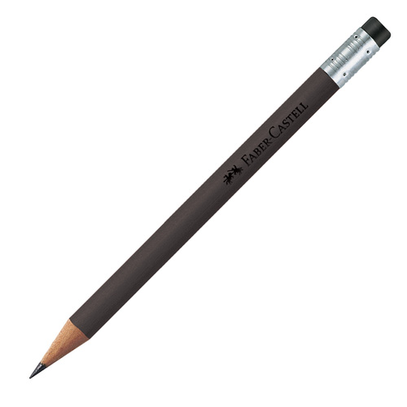
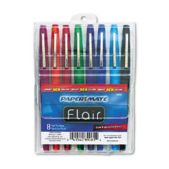
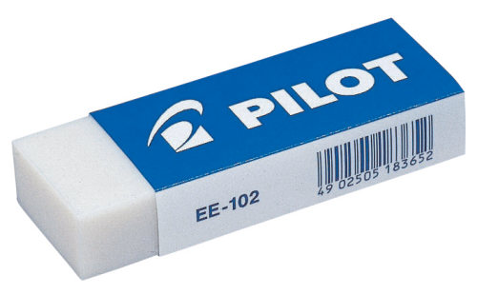
Le grand jeu
Prenez 8 secondes pour mémoriser
Notes:
As before but pupils now only have 8 seconds to memorize to increase the challenge. (Sounds still included.)

Slide 8
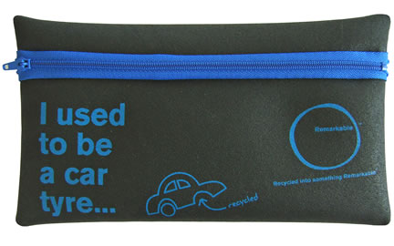
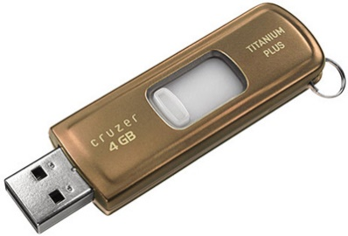
Le grand jeu
Prenez 6 secondes pour mémoriser !
Notes:
As before but pupils now only have 6 seconds to memorize. (Sounds still included.)

Slide 10
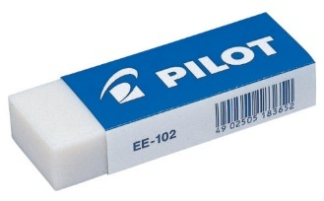
1
Qu’est-ce que tu as dans ta trousse ?
Dans ma trousse j’ai une gomme, un crayon, un stylo, une règle et des ciseaux.
Notes:
Pupils have to say how the description differs from what they see and give answers orally
E.g. J’ai un gomme, un crayon et des ciseaux mais je n’ai pas de stylo ou de regle.

Slide 11
2
Qu’est-ce que tu as dans ta trousse ?
Dans ma trousse j’ai un stylo, une règle, un taille-crayon et un usb.

Slide 12
3
Qu’est-ce que tu as dans ta trousse ?
Dans ma trousse j’ai des feutres, un crayon, un bâton de colle et une règle.

Slide 13
4
Qu’est-ce que tu as dans ta trousse ?
Dans ma trousse j’ai une gomme, des ciseaux, un taille-crayon et deux stylos.

Slide 14
5
Qu’est-ce que tu as dans ta trousse ?
Dans ma trousse j’ai deux gommes, des feutres et une règle.

