Slide 1
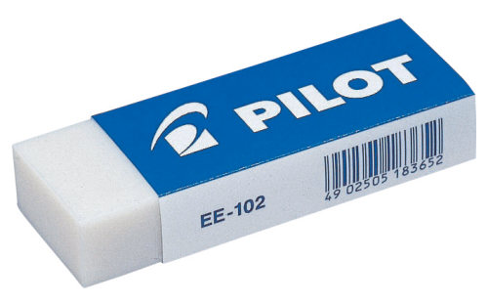
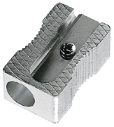
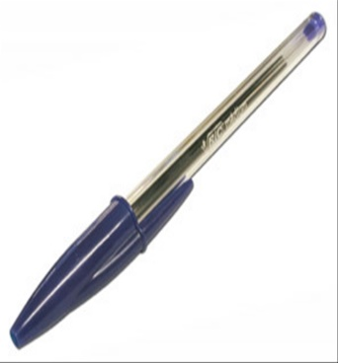
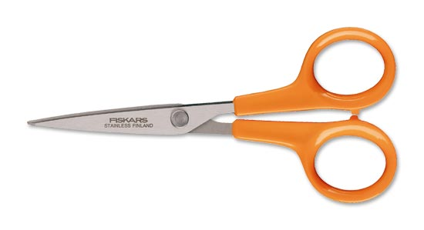
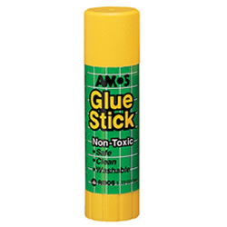
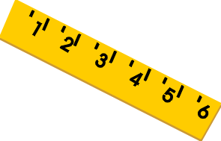
Notes:
Introductory slide to see what pupils remember.

Slide 2
Dans le miroir
Dans le miroir
Notes:
dans le miroir= in the mirror (click to hear pronounced) In this activity pupils will see the word written backwards, as if in a mirror, and will have to volunteer the correct answer.

Slide 3
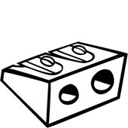
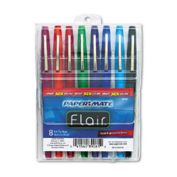
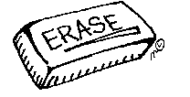
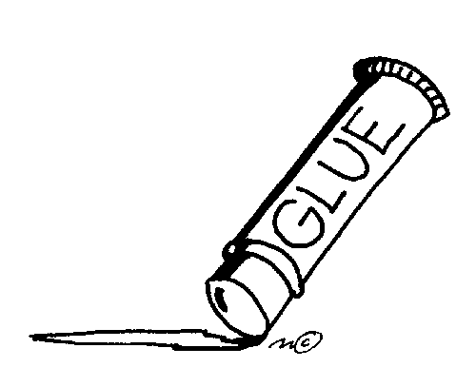
Un taille-crayon
Un taille-crayon
Un stylo
un stylo
Une règle
une règle
des feutres
Des feutres
Un usb
Un usb
Un crayon
Un crayon
Des ciseaux
Des ciseaux
Une gomme
une gomme
Un bâton de colle
un bâton de colle
Une trousse
une trousse
Notes:
Activity to allow the pupils to pronounce/recall the vocabulary as much as possible. Mirror writing. Pupils guess what the correct word is. Click on the correct word to hear it pronounced.

Slide 4
Que’est-ce qui manque?

Slide 5
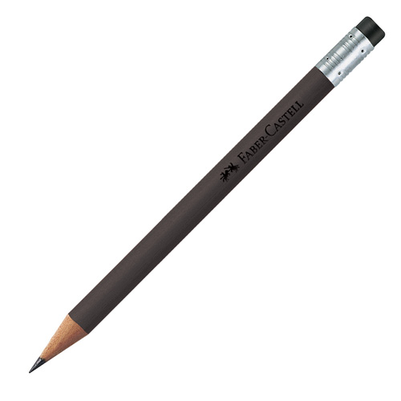
Que’est-ce qui manque?
Exemple
il n’y a pas de gomme.
Notes:
What’s missing? One item disappears on every click. Pupils have to say what is missing.

Slide 6
Quelle est la différence?
Notes:
Quelle est la différence?
= What difference is there?
Version of ‘Spot the difference’.

Slide 7
1
Exemple
2
Exemple
Quelle est la différence?
Notes:
Spot the difference game. Click on the question to hear pronunciation. Click on ‘ejemplo’ (example) to hear an example. Pupils should be encouraged to use ‘Dans la photo numéro un il y a …. mais dans la photo deux il n’y a pas de …

Slide 8
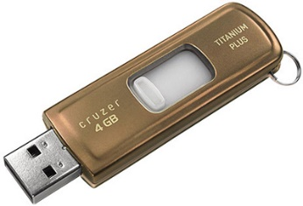
1
2
Quelle est la différence?
Notes:
New game.

Slide 9
1
2
Quelle est la différence?
Notes:
New game.

Slide 10
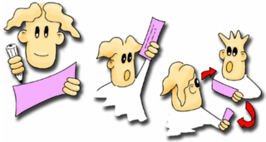
Questions !
Questions!
Notes:
To give pupils the opportunity to practise asking and answering Do you have + pencil case items, make some copies of the final slide and give pupils one card each. They should go around the classroom asking ‘Do you have…?’ until one of the two pupils guesses correctly and then they can swap cards and ask again with someone else.

Slide 11
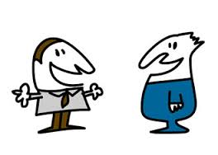
Tu as un ?
Oui, J’ai un Tu as une ?
Non, je n’ai pas de règle
Notes:
This slide models the question and answer they will use in the activity.

Slide 12
Notes:
Introductory slide to see what pupils remember.

