Slide 1
Saying what I and others do
En clase
verde
Follow ups 1-5
Notes:
Artwork by Steve Clarke. All additional pictures selected are available under a Creative Commons license, no attribution required.
The frequency rankings for words that occur in this PowerPoint which have been previously introduced in the resources are given in the SOW (excel document) and in the resources that first introduced and formally re-visited those words.
For any other words that occur incidentally in this PowerPoint, frequency rankings will be provided in the notes field wherever possible.
Phonics: Stress 1
Vocabulary (new words in bold): a menudo [958] aprender [428] beber [1085] comer [347] [347] correr [343] hacer [26] leer [209]
Revisit 1: tiene [8] cantante [2105] cara [337] gafas [>5000] nariz [1570] ojo [169] pelo [873] profesor / profesora [501] azul [811] corto [1055] grande [66] gris [1751] largo [300] moreno [3304] negro [307] pequeño [202] rubio [2861] redondo [2470] verde [812] los / las [1]
Revisit 2: hay [13] cuántos/cuántas [580] capaz [645] difícil [374] fácil [584]
Source: Davies, M. & Davies, K. (2018). A frequency dictionary of Spanish: Core vocabulary for learners (2nd ed.). Routledge: London

Slide 2
Follow up 1:
Stress 1
[A] Escucha: ¿Dónde está el estrés?
escuchar
Escribe el acento 📝.
 | ¿Quién?
 | Anton Gomez Padron
 | Monica Benitez Gonzalez.
 | Alvaro Rodriguez Pendulo
 | Nicolas Lopez Fernandez
 | Ines Chavez Cordoba
hablar
E
´
´
´
1
´
´
´
In Spain and Spanish American countries, each person has two surnames. Traditionally, the first surname comes from the father, while the second surname from the mother.
´
´
´
2
3
´
´
´
4
´
´
´
[B] Practica en parejas.
Notes:
Timing: 5 minutes
Aim: to apply knowledge of Stress 1.
Procedure:
Pupils to listen and identify the stressed syllable, then they write down the accent where necessary. Provide pupils with a paper copy of this task if possible.
Click to reveal written answers and pictures.
Click to bring up cultural info re surnames in Spain and Latin America.
For further practice, pupils to work in pairs to pronounce the name – surname combinations. Alternatively, teachers can ask pupils to choose their own combinations.
NB. All these words have been carefully selected to ensure they have an accent.
Transcript: Antón Gómez Padrón
Mónica Benítez González
Álvaro Rodríguez Péndulo
Nicolás López Fernández
Inés Chávez Córdoba

Slide 3
Follow up 2:
[A] Escucha: ¿Qué palabra es?
escuchar
Escribe la pregunta en inglés 📝.
E
face | nose | hair
Does s/he do two activities every day?
1
short | long | blond
E
¿Hace ejercicio en el patio?
2
small | round | short
Do you often read a book?
1
3
blue | green | black
¿Lees un libro a menudo?
Do you drink hot chocolate?
4
able | difficult | big
2
¿Bebes chocolate caliente?
5
the (pl., f.) | the (pl., m.) | How many? (f)
Does you learn new words?
3
¿Aprendes palabras nuevas?
6
teacher (f) | there is/are | s/he has
Do you eat fruit every day?
4
¿Comes fruta cada día?
Notes:
Timing: 5 minutes
Aim: to practise aural comprehension of this week’s new vocabulary and revisiting adjectives from week 2-6. Connecting sound with meaning.
Procedure:
(Part A) Click to listen. Students circle the correct word (if they have the sheet printed). If not, they can use numbers 1,2,34. Click for answers.
(Part B) Students listen to 1-5 and write the sentences, selecting from the options given (there are additional words that are not needed).
Click to reveal answers.
Transcript A:
Ejemplo: pelo
largo
corto
azul
difícil
las
hay
Transcript B:
E. ¿Hace ejercicio en el patio?
¿Lees Un libro a menudo?
¿Bebes chocolate caliente?
¿Aprendes palabras nuevas?
¿Comes fruta cada día?

Slide 4
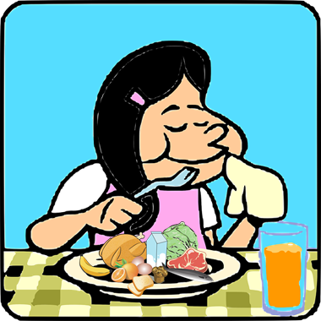
Follow up 3:
Sofía escribe a Max.
She draws pictures for some of the words for Max to practise his Spanish.
leer
you
¡Hola, Max! ¿Cómo estás ?
Cada día Quique y yo hacemos actividades en clase.
Quique aprende 10 palabras de inglés cada semana.
Y tú, ¿cuántas palabras de español aprendes ?
En la escuela trabajo. Leo con mis compañeros y respondo a preguntas.
read
En el patio bebo mucha agua porque es importante.
Y tú, ¿qué comes normalmente en el patio?
Luis, Quique y yo aprendemos sobre Inglaterra y es interesante.
Max, ¿haces actividades así en tu escuela?
porque – because | así – like this
Notes:
Timing: 5 minutes
Aim: to practise written comprehension of vocabulary and structures from this week and revisited weeks.
Procedure:
Pupils use the visual prompts to complete Sofía’s letter to Max. Ensure these are clear and provide hints in English where necessary.
Are you
We make/do
He learns
Do you learn
I read
I reply to
I drink
Do you eat?
We learn
Do you make/do?

Slide 5
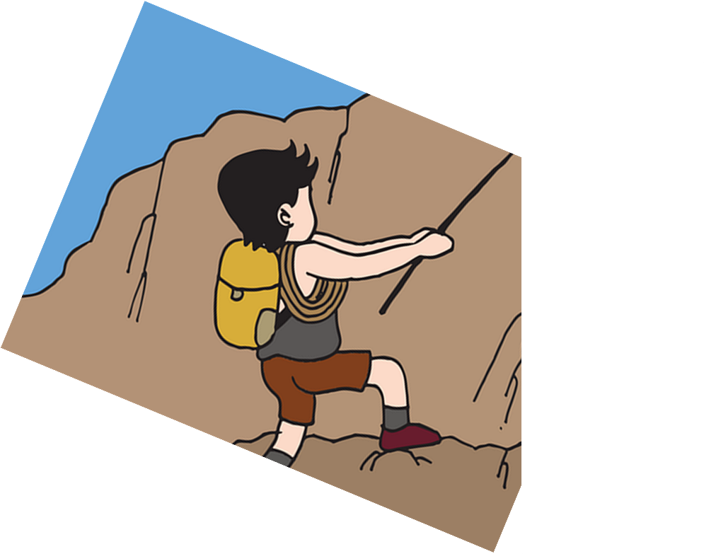
Follow up 4:
Habla en español [1/5]
Traduce 🗣
S/he reads some messages at home.
leer
hablar
5
cada semana.
en clase.
en casa.
en la escuela.
4
preguntas
mensajes
revistas
textos
3
más
cinco
unas
unos
2
Lee
Leo
Lees
Leemos
1
Notes:
Timing: 5 minutes [10 slides, 5 items]
Aim: to use correct forms of –er verbs and other previously taught vocabulary in guided oral production.
Procedure:
Tell students they need to use the words, starting from the bottom, to climb up the mountain (so that they translate the sentence!).
Ask students to work in pairs to practise first.
Click to trigger the timer (15 seconds per sentence).
Ask a volunteer from a pair to say the Spanish sentence out loud – next slide reveals the answer.
Repeat with the next 4 sentences (there are 5 in total).

Slide 6
Follow up 4:
Respuesta [1/5]
S/he reads some messages at home.
leer
hablar
Lee unos mensajes en casa.
cada semana.
en clase.
en casa.
en la escuela.
preguntas
mensajes
revistas
textos
más
cinco
unas
unos
Lee
Leo
Lees
Leemos

Slide 7
Follow up 4:
Habla en español [2/5]
Traduce 🗣
We make a special card.
leer
hablar
5
útil.
capaz.
especial.
4
tarjeta
nariz
actividad
regalo
3
un
una
la
el
2
Haces
Hace
Hacemos
Hago
1
Notes:
[2/5]

Slide 8
Follow up 4:
Respuesta [2/5]
We make a special card.
leer
hablar
Hacemos una tarjeta especial.
útil.
capaz.
especial.
tarjeta
nariz
actividad
regalo
un
una
la
el
Haces
Hace
Hacemos
Hago
Notes:
[2/5]

Slide 9
Follow up 4:
Habla en español [3/5]
Traduce 🗣
You drink water in the classroom.
leer
hablar
5
aula.
casa.
patio.
salón.
4
en el
en la
3
chocolate
agua
café
té
2
Bebo
Bebemos
Bebes
Bebe
1
Notes:
[3/5]

Slide 10
Follow up 4:
Respuesta [3/5]
You drink water in the classroom.
leer
hablar
Bebes agua en la clase.
aula.
casa.
patio.
salón.
en el
en la
chocolate
agua
café
té
Bebo
Bebemos
Bebes
Bebe
Notes:
[3/5]

Slide 11
Follow up 4:
Habla en español [4/5]
Traduce 🗣
You often learn some words in English.
leer
hablar
en inglés.
en clase.
en casa.
en español.
palabras
frases
preguntas
respuestas
5
unos
más
menos
unas
4
aprende
aprendemos
aprendes
aprende
3
2
Siempre
A veces
normalmente
A menudo
1
Notes:
[4/5]

Slide 12
Follow up 4:
Respuestas [4/5]
You learn some words in English.
leer
hablar
A menudo aprendes unas palabras en inglés.
en inglés.
en clase.
en casa.
en español.
palabras
frases
preguntas
respuestas
unos
más
menos
unas
Aprende
Aprendemos
Aprendes
Aprende
Siempre
A veces
normalmente
A menudo
Notes:
[4/5]

Slide 13
Follow up 4:
Habla en español [5/5]
Traduce 🗣
You watch a film in the hall.
leer
hablar
casa
salón
calle
árbol
el
la
5
en
por
de
4
mensaje
película
revista
espectáculo
3
unos
más
una
unas
2
Ve
ves
vemos
veo
1
Notes:
[5/5]

Slide 14
Follow up 4:
Respuesta [5/5]
You watch a film in the hall.
leer
hablar
Ves una película en el salón.
casa.
salón.
calle.
árbol.
el
la
en
por
de
mensaje
película
revista
espectáculo
unos
más
una
unas
Ve
Ves
Vemos
Veo
Notes:
[5/5]

Slide 15
Knowing who does what
[–er verbs: ‘s/he, it’ vs. ‘you’]
To mean ‘S/he, it’ with a verb, we remove –er and add -e.
⚠ to change a statement into a question, simply raise your voice at the end.
To mean ‘you’ with a verb, we remove –er and add –es.
you
S/he, it
Aprendes sobre España.
Aprende sobre Inglaterra.
S/he learns about England.
You learn about Spain.
¿Aprendes sobre España?
¿Aprende sobre Inglaterra?
Does s/he learn about England?
Do you learn about Spain?
Spanish uses two question marks – the one at the front is upside down!
Notes:
DO THIS BEFORE ATTEMPTIN FOLLOW UP 5.
Timing: 3 minutes
Aim: to reintroduce 3rd person singular and 2nd person singular of –er verbs; to revisit raised intonation (yes/no questions).
Procedure:
Click through the animations to present the new information.
Elicit English translations for the Spanish examples provided.

Slide 16
Follow up 5:
Pregunta (¿?) y marca
hablar
¿Comes un bocadillo en el aula?
Persona A
Turno 1
Person A Use your prompt card to ask questions. E.g. Do you eat a sandwich in the classroom ?
Person B Use your card to answer ‘yes’ or ‘no.
Persona B
Escucha y responde.
Then swap roles.
Notes:
Timing: 10 minutes (five slides)
Aim: to develop fluency in using 2nd person singular of –er verbs using intonation questions. Procedure: 1. Divide the class into A and B. Pupils can work in pairs or work chorally, in two class halves.
2. Pupil A asks questions to find out what Luis does, and where. 3. Pupil B answers “yes / no” according to their card (a card describing what Luis or Sofía does).
This is Pupil A’s task – Turno 1.
If needed, first practise further with the class. Elicit the question forms of the verbs and then of the locations from pupils, and then click the audio buttons to check.
Move forward for “turno 2” and model further if necessary.

Slide 17
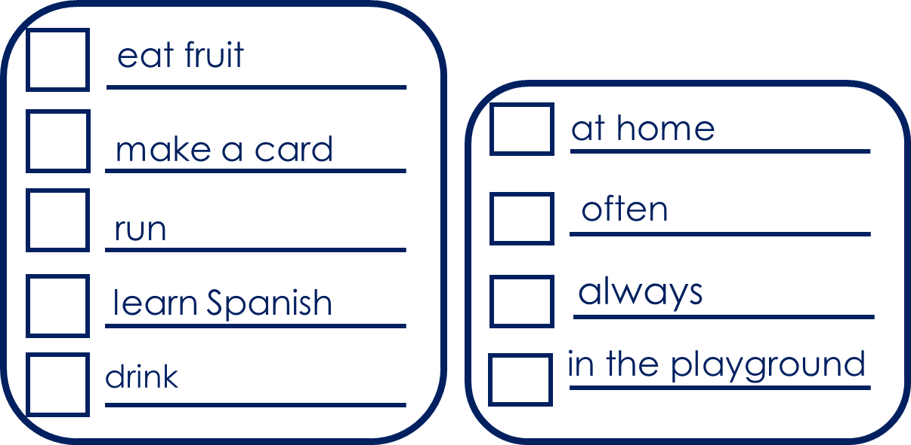
Follow up 5:
Pregunta (¿?) y marca
hablar
¿Comes fruta en casa?
Persona B
Turno 2
Person A Use your prompt card to ask questions. E.g. Do you eat fruit at home ?
Person B Use your card to answer ‘yes’ or ‘no.
Persona A
Escucha y responde.
Notes:
Timing: 10 minutes (five slides)
Aim: to develop fluency in using 2nd person singular of –er verbs using intonation questions. Procedure: 1. Divide the class into A and B. Pupils can work in pairs or work chorally, in two class halves.
2. Pupil A asks questions to find out what Luis does, and where. 3. Pupil B answers “yes / no” according to their card (a card describing what Luis or Sofía does).
This is Pupil A’s task – Turno 1.
If needed, first practise further with the class. Elicit the question forms of the verbs and then of the locations from pupils, and then click the audio buttons to check.
Move forward for “turno 2” and model further if necessary.
Answers in next slides.

Slide 18
Follow up 5
Respuestas para…
hablar
Persona A
eat a sandwich
in the classroom
understand the task
normally
learn words
drink
at school
read
in the hall
Notes:
ANSWER SLIDE Pupils will have noted answers on their task sheets.
Procedure:
Click to reveal answers for pupils to check.

Slide 19
Follow up 5
Respuestas para…
hablar
Persona B
eat fruit
at home
make a card
often
run
learn Spanish
always
drink
in the playground
Notes:
ANSWER SLIDE Pupils will have noted answers on their task sheets.
Procedure:
Click to reveal answers for pupils to check.

Slide 20
Follow up [extra]:

Escribe en español: Can you get at least 15 points?
 | round (f) | There is / are | How many? (f)
 | blonde (m) | dark (f) | difficult
 | glasses | eye | s/he has
 | hair | big | face
 | often | sometimes | to reply, replying
 | to learn, learning | to eat, eating | to drink, drinking
vocabulario
redonda
hay
¿Cuántas?
x3
rubio
moreno
difícil
las gafas
el ojo
tiene
x2
el pelo
grande
la cara
a menudo
a veces
responder
x1
aprender
beber
comer
Notes:
Timing: 5 minutes
Aim: to practise written production of vocabulary from this week and this week’s revisited sets.
Procedure: 1. Give pupils a blank grid. They fill in the Spanish meanings of any of the words they know, trying to reach 15 points in total.
Note: The most recently learnt and practised words are pink, words from the first revisit are green and those from the second revisit are blue, thus more points are awarded for them, to recognise that memories fade and more effort (heavy lifting!) is needed to retrieve them.

Slide 21
to print
Persona A
Persona B
1 Pregunta y marca
1 Escucha y responde.
|
|
|
|
|
|
|
|
|
|
|
|
|
|
2 Pregunta y marca
2 Escucha y responde.
Notes:
HANDOUT

Slide 22
Follow up [extra]: handout

Escribe en español: Can you get at least 15 points?
Follow up [extra]: handout
 | round (f) | There is / are | How many? (f)
 | blonde (m) | dark (f) | difficult
 | glasses | eye | s/he has
 | hair | big | face
 | often | sometimes | to reply, replying
 | to learn, learning | to eat, eating | to drink, drinking
vocabulario
x3
x2
x1
Notes:
Timing: 5 minutes
Aim: to practise written production of vocabulary from this week and this week’s revisited sets.
Procedure: 1. Give pupils a blank grid. They fill in the Spanish meanings of any of the words they know, trying to reach 15 points in total.
Note: The most recently learnt and practised words are pink, words from the first revisit are green and those from the second revisit are blue, thus more points are awarded for them, to recognise that memories fade and more effort (heavy lifting!) is needed to retrieve them.

