Slide 1
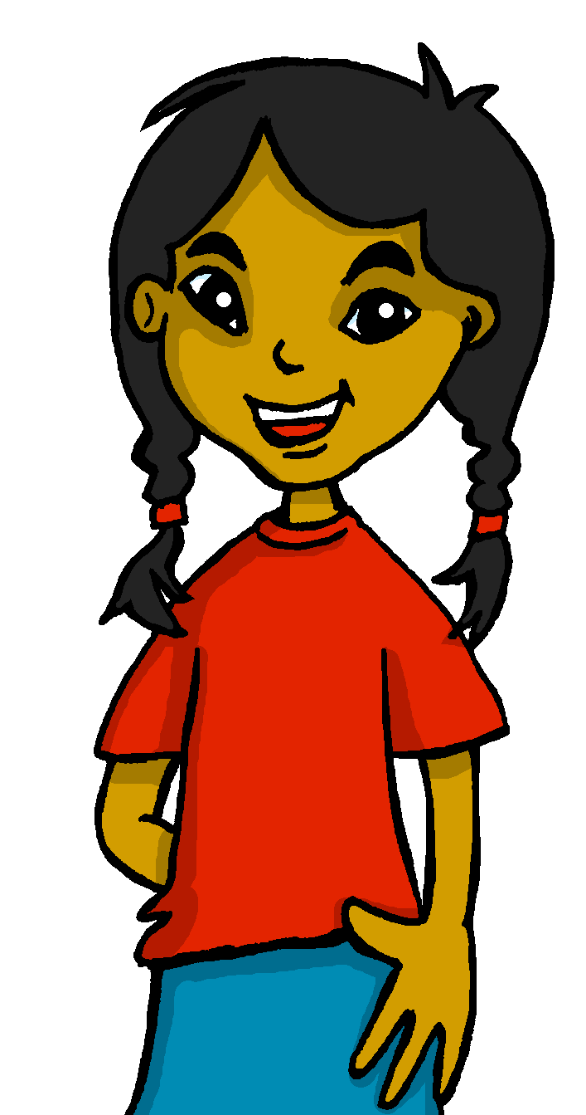
español, con Sofía

Slide 2
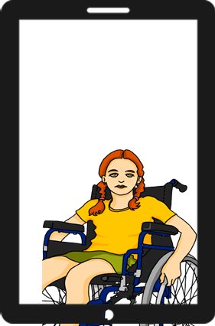
Saying what I and others have
tener: 1st, 2nd and 3rd person singular
Plural indefinite articles
SSC: [ca] [co] [cu]
verde
Notes:
Artwork by Steve Clarke. All additional pictures selected are available under a Creative Commons license, no attribution required.
The frequency rankings for words that occur in this PowerPoint which have been previously introduced in the resources are given in the SOW (excel document) and in the resources that first introduced and formally re-visited those words.
Phonics: cama [609] contar [172] cucaracha [>5000]
Vocabulary: tienes [tener 19] tiene [tener 19] árbol [748] calle [269] mentira [1673] universidad [387] verdad [176] cada [107] unos, unas [>5000] re-use noun: estadio [2581] iglesia [437] museo [1114] parque [1354] plaza [806] and adjectives: azul [811] bonito [891] divertido [2465] diferente [293] fuerte [435] grande [66] importante [171] independiente [1177] inteligente [2167] inútil [1753] lento [1569] normal [1000] pequeño [202] perfecto [1115] pesado [2166] serio [856] rojo [534] útil [3951] verde [812]
Revisit 1: están [21] son [7] cómodo [2237] importante [171] hoy [167] siempre [96] también [49] y [4]
Revisit 2: estar [21] estoy [21] estás [21] ser [7] soy [7] eres [7] quién [289] amigo(a) [210] profesor(a) [501] contento [1949] divertido [2465] elegante [2742] enfermo [1092] increíble [1642] inteligente [2167] lento [1569] perfecto [1115] pesado [2166] preparado [2092] rápido [870] serio [856] triste [1370] ¡Buenos días! [103/65] ¡Buenas tardes! [103/392] hola [1245]
Glossed: clasificar [2729]
For any other words that occur incidentally in this PowerPoint, frequency rankings will be provided in the notes field wherever possible.
lugar [144]
Source: Davies, M. & Davies, K. (2018). A frequency dictionary of Spanish: Core vocabulary for learners (2nd ed.). Routledge: London

Slide 3
pronunciar
[ca]
cama
[co]
contar
[cu]
cucaracha
Notes:
Timing: 2 minutes
Aim: to revisit SSC [a] [o] [u] in combination with [c]
Procedure:
Click to trigger [ca] and get students to repeat. Click to bring up the image. Say the word again together.
Bring up [co] and [cu] and elicit the the SSC, and the source words.

Slide 4
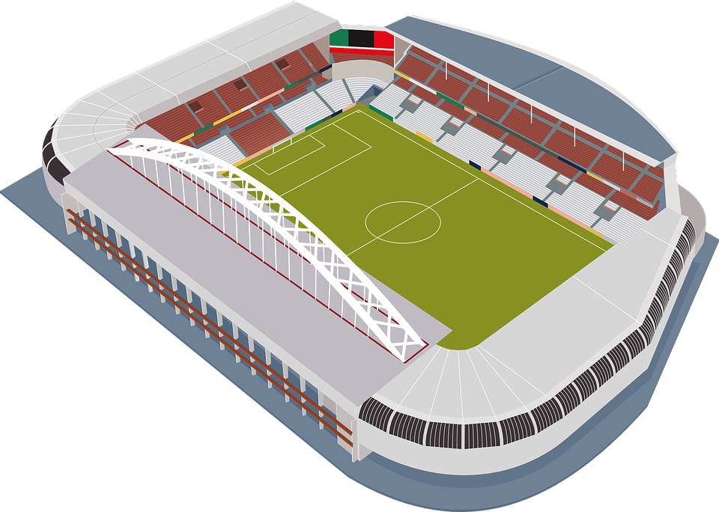
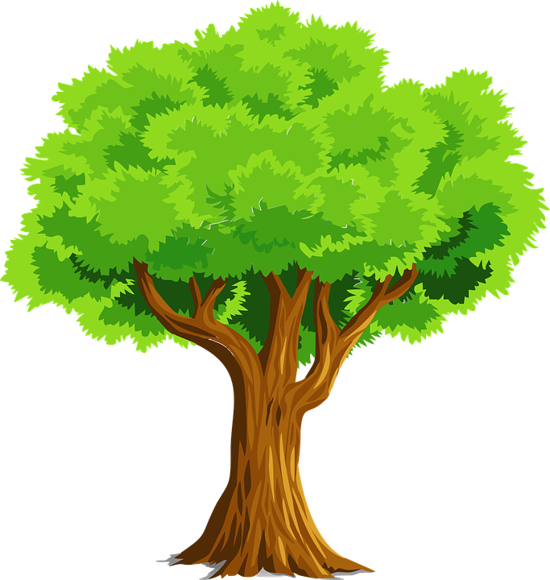
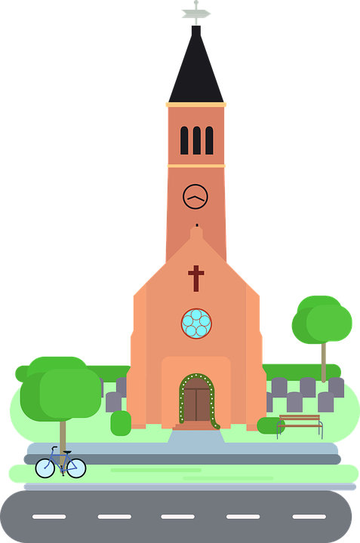
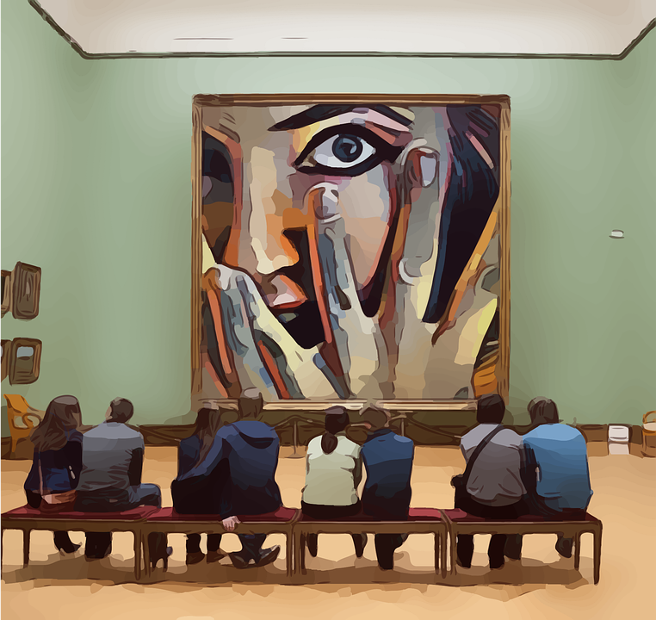
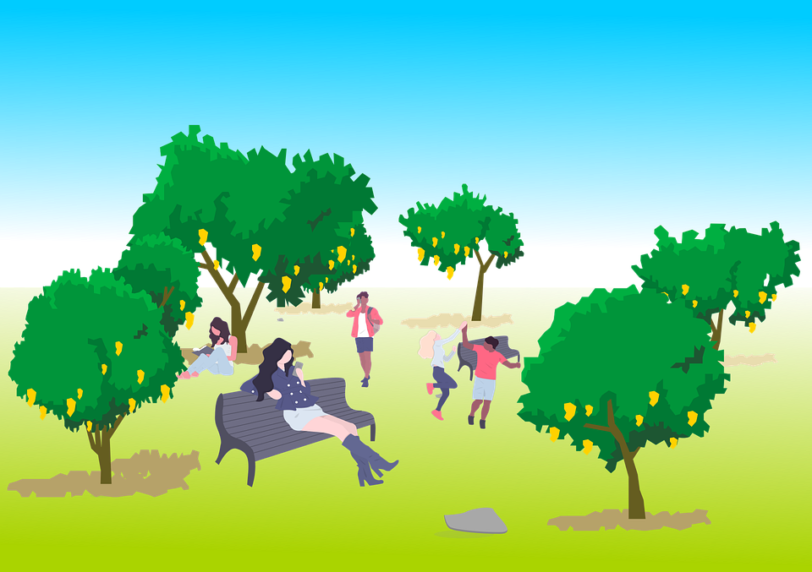
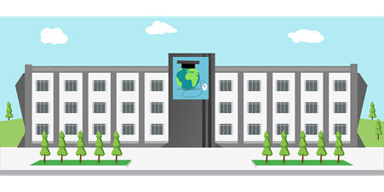
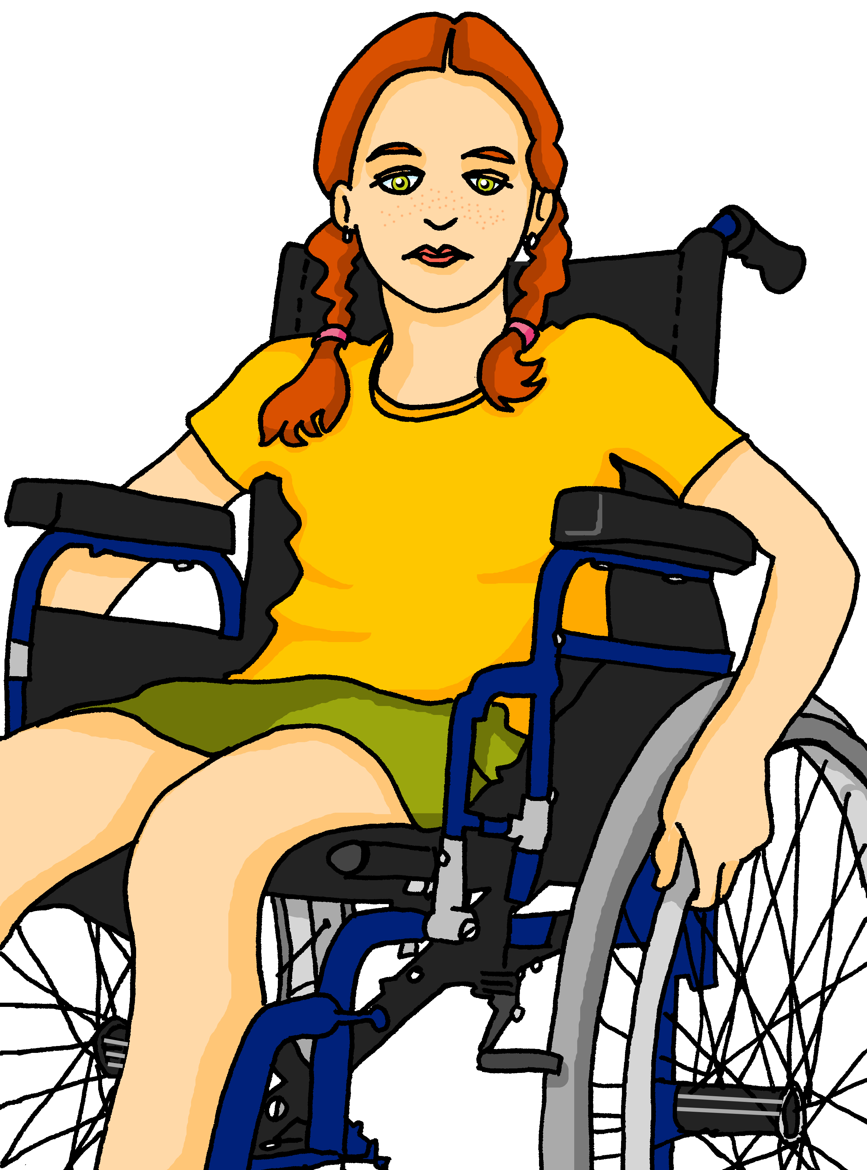
leer
Krina, una amiga de Inglaterra
Krina es la compañera de Sofía. Ella es de Inglaterra y aprende español.
Krina and Sofía are learning about their hometowns.
Lugo tiene …
un estadio
un árbol
una iglesia
un museo
una calle
un parque
una universidad
Notes:
Timing: 5 minutes (2 slides)
Aim: to introduce Krina, a new character & 3 new items of vocabulary.
Procedure:
Click x2 to bring up text in English and clarify who Krina is
Click to bring up speech bubble – explain to pupils that Sofía is telling Krina what Lugo has.
Introduce x3 new items of vocabulary (árbol, calle, Universidad).
1) get students to repeat the word 2) bring up the picture

Slide 5
hablar
¿Que es en español?
Lugo tiene …
un museo
un parque
una calle
un árbol
un estadio
una calle
una iglesia
un parque
una universidad
un árbol
una iglesia
una calle
un estadio
un museo
Notes:
Procedure:
Click bring up picture and two possible answers. Elicit correct Spanish words from pupils.

Slide 6
Talking about things in the plural:
Plural nouns and indefinite articles (unos/unas)
Remember! To talk about more than one thing (plural), Spanish often adds ‘s’ to the end of the noun.
Tiene un museo.
It has a museum.
Tiene dos museos.
It has two museums.
To say ‘some’ before a plural noun, use unos or unas.
Tiene unos estadios.
Tiene unas piscinas.
It has some stadiums.
It has some pools.
unos
unas
For plural masculine nouns, use _____. For plural feminine nouns, use ______.
Notes:
Timing: 2 minutes
Aim: to introduce the new grammar features (plural ‘s’ on nouns and plural indefinite articles)
Procedure:
1. Click to bring up each new part of the explanation
2. Interactive elicitation: Try to elicit the English meaning in each of the example sentences.
After showing the examples (and before showing the final line of text), ask students why it’s ‘unos amigos’ but ‘unas amigas’ to elicit 1) nouns have gender 2) libro is masculine and moneda is feminine.
3. After showing the examples (and before showing the final line of text), ask students why it’s ‘unos libros’ but ‘unas monedas’ to elicit 1) nouns have gender 2) amigo is masculine and cama is feminine.
4. Ask students if they can think of any other words that could take ‘unos’ or ‘unas
Last week’s vocabulary: unos (libros, padres, animals, profesores, jardines); unas (camas, casas, sillas, madres, profesoras)

Slide 7
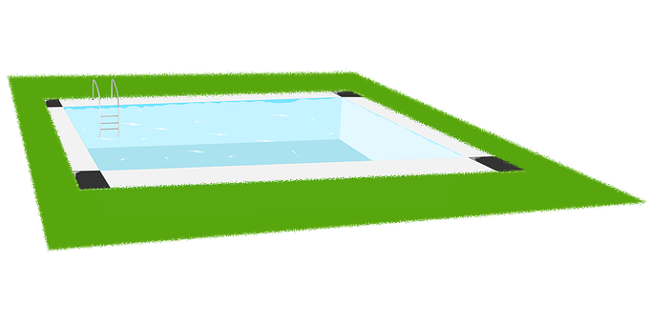
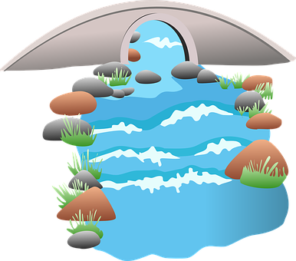
leer
¿Es verdad [V] o mentira [M] ?
Escribe 1 – 7 y [V] o [M].
Krina describe Cambridge para Sofía pero hay unos errores.
Tengo un puente.
Tengo una escuelas.
Tengo unos estadios.
Tengo unas piscinas.
Tengo un parque.
Tengo unas plazas.
[V]
1
x1
[M]
x3
2
3
[M]
x4
[V]
x2
4
5
[M]
6
[V]
x2
1
Notes:
Timing: 5 minutes
Aim: to practise written comprehension of singular and plural nouns based on the connection to the singular or plural indefinite articles.
Procedure:
Read the title – ‘¿Es verdad o mentira?’ Ensure that pupils understand the title. These two words are new for this week.
Explain that this is a list of what KRINA says she has in her town, but is she telling the truth or has she forgotten what she has, and it’s a lie? Tell them they need to pay attention to whether there is one or more than one of the item to decide.
Do [1] with them to model the task.
Paying attention to the indefinite article and comparing it to what they can see is on the presentation slide, pupils write [V] or [M].
Note: the end of the nouns is obscured to focus all of pupils’ attention on the indefinite article.

Slide 8
escuchar
Sofía habla. Escucha.
¿ Cuántos tiene?
Marca
Marca I (singular) o II+ (plural).
¿Qué tiene Lugo?
I (singular) | II+ (plural)
escribe ✍
E
unos museos
1
una universidad
2
un estadio
3
unas calles
4
unos árboles
5
unas iglesias
Notes:
Timing: 5 minutes
Aim: to practise aural comprehension of singular and plural nouns.
Procedure:
Pupils write 1-6 in their books and I (singular) and II+ (plural).
Click to listen to the example. Pupils decide whether the noun is ‘one’ or ‘more than one’.
Click to listen again. Pupils transcribe the word in Spanish. (Note: a comprehension activity for the same nouns is on slide 10).
Complete the task with items 1-6, listening once for number.
Click to correct for number.
Listen again to transcribe.
Click to reveal answers to the transcriptions.
Transcript:
Ej. Tengo unos museos. 1. Tengo una universidad
Tengo un estadio. 3. Tengo unas calles. 4. Tengo unos árboles. 5. Tengo unas iglesias.

Slide 9
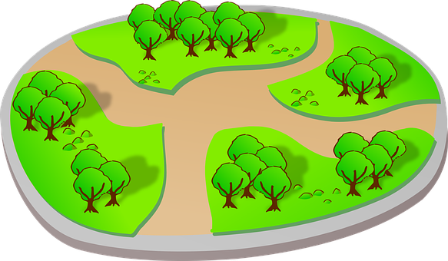
Asking yes/no questions
Remember! Turn a statement into a yes/no question by making
your voice go up at the end.
Tiene una iglesia.
S/he, it has a church.
¿Tiene una iglesia?
Does s/he, it have a church?
Remember how to say ‘you have’:
Tienes unos parques allí.
You have some parks there.
Ask someone else ‘do you have?’ using tienes and making your voice go up.
¿Tienes unos parques allí?
Do you have some parks there?
Notes:
Timing: 2 minutes
Aim: to recap tienes and raised intonation questions.
Procedure:
1. Click to bring up each new part of the explanation.
2. Elicit the English for the Spanish examples.

Slide 10
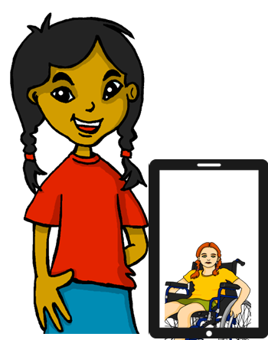
escuchar
Escucha.
Sofía habla.
Is she asking herself or Krina?
Marca
Marca I o you.
Do I have… here? | Do you have… there? | en inglés
E
some streets
1
a stadium
2
some churches
3
some trees
4
a university
5
some hotels
6
some schools
Notes:
Timing: 6 minutes
Aim: to practise aural comprehension of singular and plural nouns and differentiate between tengo and tienes, connecting these with their meanings in yes/no questions.
Procedure:
Pupils write 1-6 in their books and I and you.
Click to listen to the example. Pupils decide whether question means do I have or do you have.
Click to listen again. Pupils write the meaning of the noun in English, paying careful attention to whether it is singular or plural.
Complete the task with items 1-6, listening once for the verb
Click to correct.
Listen again to understand the nouns.
Click to reveal noun answers.
Transcript:
Ej. ¿Tengo unas calles aquí? 1. ¿Tengo un estadio aquí?
2. ¿Tienes unas iglesias allí?
3. ¿Tienes unos árboles allí?
4. ¿Tengo una universidad aquí?
5. ¿Tienes unos hoteles allí?
6. ¿Tienes unas escuelas allí?

Slide 11
hablar
Sofía describe Lugo
Remind her what she has in her home town. ‘You have…’
1. __________ árboles.
⚠ when a noun ends in –e, it could be masculine or feminine. Watch out for the gender of ‘calle’ and ‘parque’!
2. __________ iglesias.
¿Qué tiene Lugo?
¡Muchas cosas!
mm…
3. __________ calles.
4. __________ plaza.
Ej. __________ parques.
5. __________ museo.
a (m)
a (f)
some (mpl)
some (fpl)
un museo
una plaza
unos parques
unas iglesias
unos árboles
unas calles
Notes:
Timing: 2 minutes
Aim: to practise oral production of indefinite articles and their connection to matching noun forms.
Procedure:
Do the example with the class. Elicit ‘Tienes unos parques.’ and click twice for the noun to appear under the correct article.
Continue with items 1 – 5.

Slide 12
¡adiós!
verde

