Slide 1
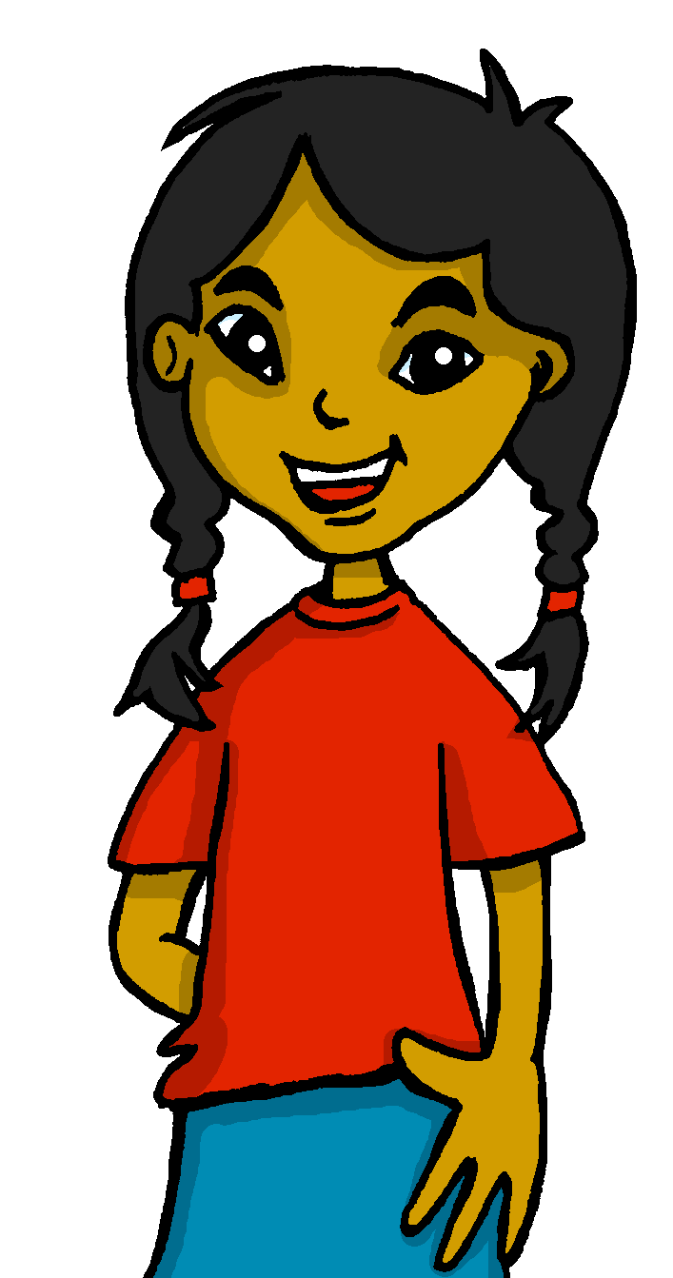
español, con Sofía

Slide 2
Saying what I and others have
tener (to have): tengo (I have), tiene (s/he, it has)
postnominal adjective agreement
vowels [revisited]
verde
Notes:
Artwork by Steve Clarke. All additional pictures selected are available under a Creative Commons license, no attribution required.
The frequency rankings for words that occur in this PowerPoint which have been previously introduced in the resources are given in the SOW (excel document) and in the resources that first introduced and formally re-visited those words.
Phonics: All vowels revisited: leer [209] aceite [2101] aeropuerto [2492] aire [401] boina [>5000] casa [106] cho-co-la-te [3408] dos [64] elefante [5000] feo [2373] oeste [2416] universo [1603] in-te-re-san-te [616]
Vocabulary: tener [19] tengo [tener 19] tiene [tener 19] compañero / compañera [551] escuela [424] hotel [1163] piscina [4604] puente [1715] bastante [308] muy [43] un [6] una [6] re-use adjectives: bonito [891] curioso [1811] diferente [293] divertido [2465] grande [66] importante [171 inteligente [2167] negativo [1804] pequeño [202] perfecto [1115] pesado [2166] serio [856]
Revisit 1: cuál [445] día [65] espectáculo [1622] exposición [1317] fecha [756] lunes [1370] martes [3101] miércoles [1816] jueves [1650] viernes [1259] sábado [1179] domingo [693]
Revisit 2: --
For any other words that occur incidentally in this PowerPoint, frequency rankings will be provided in the notes field wherever possible.
Glossed:
té [2552] inglés (language – noun)
Source: Davies, M. & Davies, K. (2018). A frequency dictionary of Spanish: Core vocabulary for learners (2nd ed.). Routledge: London

Slide 3
pronunciar
Lee las palabras en orden alfabético
a
↓
z
elefante
feo
aceite
feo
cuándo
aire
idea
universo
60
a
↓
z
antiguo
interesante
casa
puente
boina
leer
chocolate
antiguo
casa
oeste
idea
aceite
chocolate
puente
dos
aire
universo
cuándo
interesante
boina
dos
0
oeste
elefante
leer
INICIO
Notes:
Timing: 2 minutes
Aim: to practise spoken production of words containing all vowels and vowel combinations practised so far this term.
Procedure:
Read the instruction in Spanish.
Ensure meaning of ‘orden alfabético’ is clear and elicit first word from a volunteer.
3. Click on ‘inicio’ to start the timer. Pupils practise in pairs for one minute.
4. Start the timer again. This time, elicit responses chorally from pupils, as words appear on the right. Answers are animated (two clicks per word – one for disappearance effect, one for entrance).

Slide 4
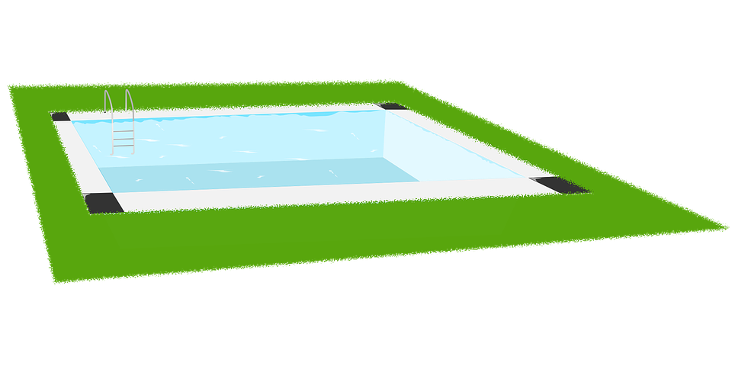
hablar
‘inglés’ can be a noun if it refers to the language, or an adjective if it refers to the nationality.
(el) té = tea
escribir = to write
Tabú inverso: ¿Qué palabra es?
familia
chico
grande
pequeño
país
inglés
té
clases
aprender
profesor
escribir
papel
mandar
verano
agua
divertido
hermano
Inglaterra
escuela
carta
piscina
mandar
¿Cuántos nombres hay en total?
¿Cuántos adjetivos hay en total?
¿Cuáles son los verbos?
Hay ____________ nombres en total.
quince
aprender,
escribir,
mandar
Hay ____________ adjetivos en total.
tres
Los verbos son ___________________________.
casa España piscina hermano
hermana Inglaterra carta escuela
country
tea
to send
paper
to learn
summer
fun
Notes:
Timing: 5 minutes
Aim: to recap previously introduced vocabulary as well as introduce context-specific words.
Procedure:
Part 1
Read the instruction in Spanish. Check understanding of ‘palabra’.
Tell students they need to figure out which word is being described. They have the possible options at the bottom. Por ejemplo, chico, grande & pequeño. Is it ‘España’, ‘hermano’ or ‘hermana’?
3. Mouse over each box and click to trigger the box to make it disappear and reveal the right answer (hermano).
4. Pupils work in pairs to read the word for each “card” (box) and work out the word being described.
5. Elicit answer from students and click on each box to reveal the answer.
Part 2:
Click to bring the ‘cards’ (boxes) back again.
Click to bring the first English word (country) and elicit Spanish word from students (país). Click to bring the tick next to ‘país’. Repeat x5.
Part 3
Click to bring the question on grammatical categories. Ensure meaning of ‘nombres’ is clear.
Elicit answer from students.
Repeat x1 (adjectives) & click to bring the speech bubble for the two meaning of ‘inglés’ (language and nationality).
4. Bring question to ask students to identify the three verbs & elicit answers.
escribir [198] té [2552] inglés (language – noun)

Slide 5
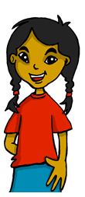
Tener: I have & s/he, it has
[to have | having]
In Spanish the verb tener means ‘to have’.
Tengo un compañero.
Sofía tiene un compañero en Inglaterra.
I have a partner.
Sofía has a partner in England.
She has a partner in England.
Notes:
Timing: 2 minutes
Aim: to revisit 1st and 3rd person singular of ‘tener’.
Procedure:
Read the grammar explanation on tener (to have).
Elicit English translation for the Spanish examples provided.

Slide 6
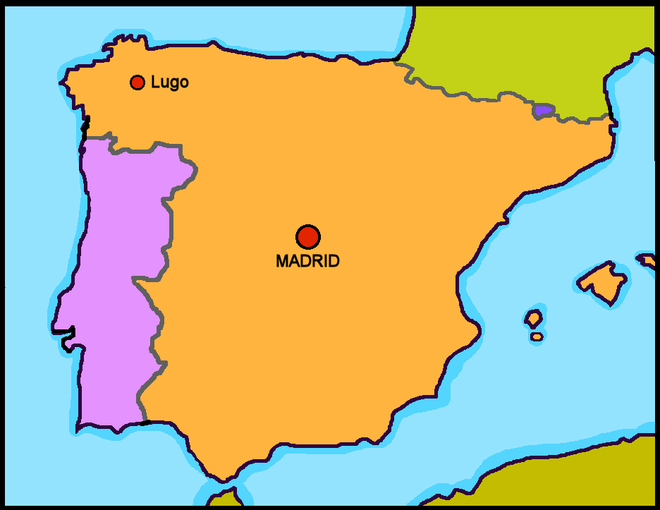
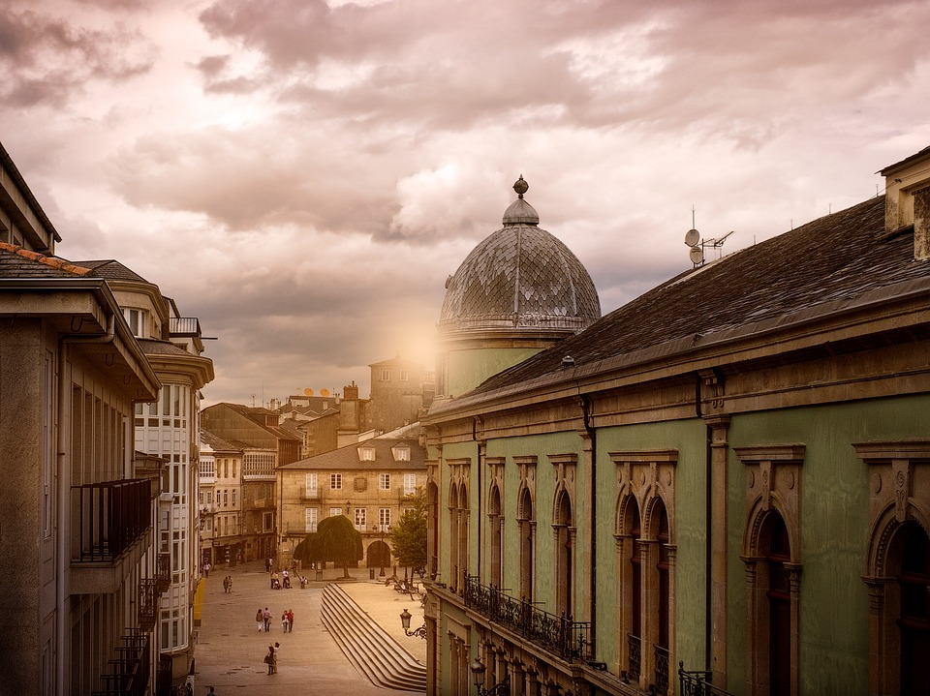
leer
Sofía tiene un compañero en Inglaterra.
Tengo un compañero en Inglaterra, Max.
Notes:
Time: 1 minute
Aim: to introduce Max, Sofía’s pen pal friend from the UK.
Procedure:
Read the context and clarify meaning of ‘compañero’.
Click to bring up speech bubble and elicit translation from pupils.

Slide 7
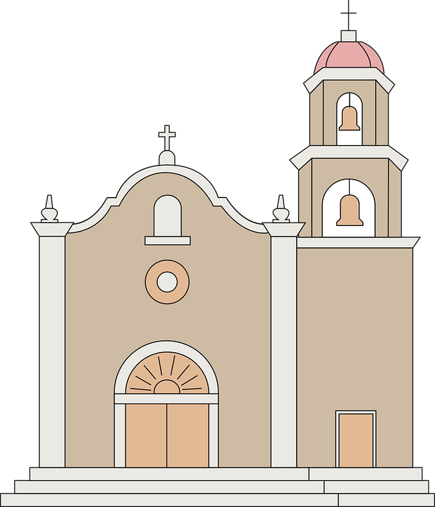
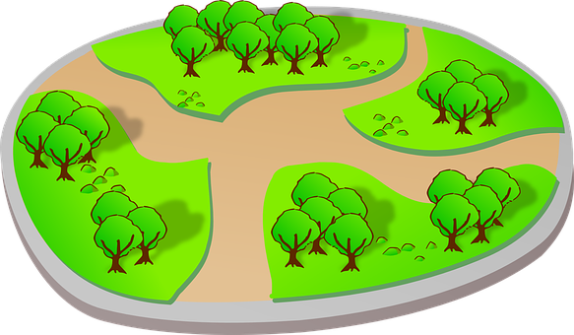
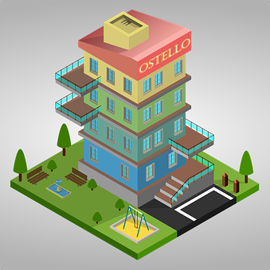
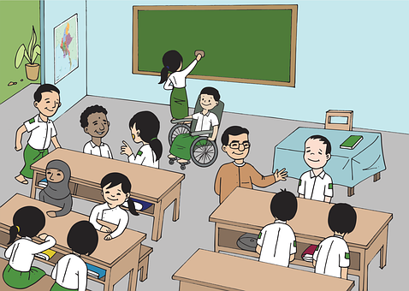
leer
Una carta para Max.
Sofía describe Lugo. ¿Qué tiene Lugo?
Lee las frases y escribe la letra.
D
A
1
Tiene un hotel.
B
2
Tiene una piscina.
E
E
3
Tiene un parque.
A
B
4
Tiene una escuela.
F
F
5
Tiene una iglesia.
D
C
6
Tiene un puente.
C
describe = s/he describes
Notes:
Time: 4 minutes
Aim: to revisit vocabulary & introduce ‘hotel’ & ‘puente’
Read the context of the task and ensure it’s clear. Remind pupils Max is Sofía’s pen pal friend and she has send Max a letter describing Lugo, where she lives.
Click to bring up instruction in Spanish.
Pupils read the sentences out loud and match with the correct picture.
Click to bring up answers.

Slide 8
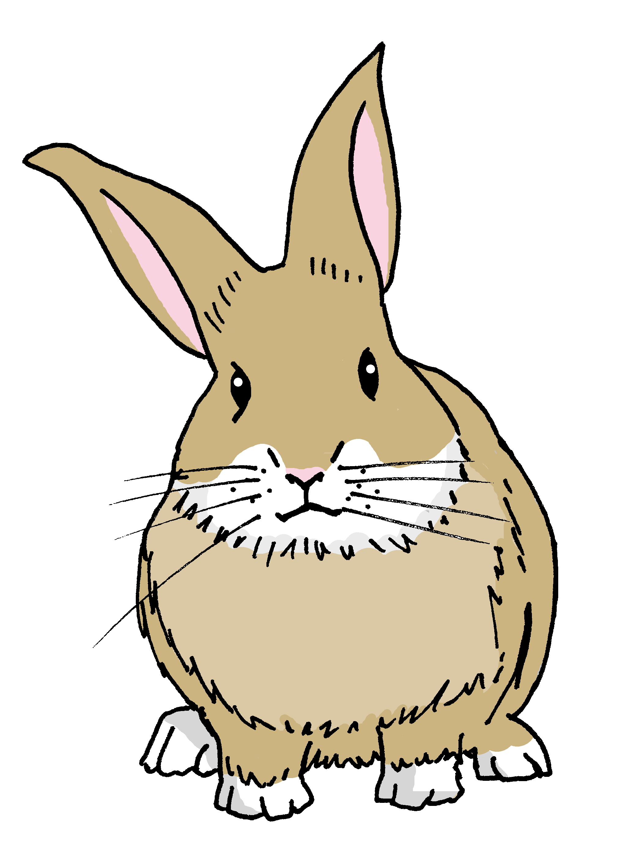
leer
Pancho destroza la carta de Sofía...
¡ñam ñam!
destroza = s/he destroys
Lee:¿Es Sofía, Max o los dos?
¿Qué es ‘boat’?
¿Qué es ‘pool’?
¿Qué es ‘brother’?
¿Qué es ‘teacher’?
Tiene un gato.
Tengo un profesor.
Completa el diagrama en inglés.
Tengo un hotel.
Tiene un barco.
Los dos
Tengo una piscina.
Sofía (I)
Max (he)
cat
hotel
Tengo un hermano.
brother
bridge
teacher
Tiene un puente.
boat
pool
Tiene un profesor.
Notes:
Timing: 5 minutes
Aim: To practise written understanding of ‘tengo’ and ‘tiene.
Procedure:
Read the task title in Spanish & click to bring further instruction.
Click x1 to bring Venn diagram and instruction, then draw students attention to the sentences. Was Sofía writing about herself or Max? Are there any things they both have? (I have +he has).
3. Ask pupils to draw the diagram (or a table) and write down the Spanish words in the correct part of the diagram.
4. Go through answers together, answers are animated in groups (first Max, then Sofía, lastly ‘los dos’).
Part 2
Click to bring up the question to check knowledge of the vocabulary used in this activity (puente, barco, hermano, piscina). Elicit Spanish from students.

Slide 9
Adjectives following the noun
In Spanish, many adjectives follow the noun:
In English the adjective comes before the noun.
un hermano negativo
a negative brother
⚠ Remember: Adjectives that end in -e describe describe feminine and masculine nouns.
una compañera curiosa
a curious (female) partner
una iglesia grande
un puente grande
a big church
a big bridge
Notes:
Timing: 2 minutes
Aim: to introduce post-nominal adjective agreement.
Procedure:
Read the grammar explanation on post-nominal adjective agreement.
Elicit English translation for the Spanish examples provided.
Callout 1 flags up the difference between English and Spanish.
Callout 2 reminds students about gender agreement of adjectives ending in –e.

Slide 10
escuchar
Escucha. ¿De quién es el objeto?
Marca
Escribe en inglés.
Sofía (I) | Max (he)
descripción
objeto
E
important
bridge
1
quite old
park
2
fun
brother
3
independent
friend (female)
annoying
cat
4
5
big
school
new
pool
6
Notes:
Timing: 5 minutes
Aim: to practise listening out for ‘tengo’ & ‘tiene’ and process the person of the verb they refer to. Then, to practise aural recognition of postnominal adjectives and vocabulary.
Procedure:
Read the instruction in Spanish from the board.
Click to bring further instruction (Marca).
Tell them that they will hear Sofía talking about herself or one of her friends. Tell students they need to pay attention to whether they hear “tengo” or “tiene”. They can write the verb down for support or tick directly.
4. Do the example with them.
5. Ask pupils to write 1-6 in their books.
6. Do [E] with them. The first time they listen, pupils should identify whether the object belongs to Sofía or Max and tick the correct box.
7. Play 1-6 once.
8. Go through answers 1-6 (use of tener)
9. Pupils listen one more time. The second time they listen, they need to write down the adjective in English. Many pupils will also be able to write the object.
10. Click to correct answers.
Transcript:
Ej. Tengo un puente importante en Lugo.
Tiene un parque bastante viejo.
Tengo un hermano divertido en casa.
Tiene una amiga independiente en la escuela.
Tiene un gato pesado en casa.
Tengo una escuela grande.
Tiene una piscina nueva.

Slide 11
hablar
Habla.
Say the Spanish sentence. [1/4]
You do not need all of the words!
I have a church.
15
Tengo una iglesia.
S
una
un
tiene
iglesia
hotel
tengo
piscina
0
INICIO
Notes:
Timing: 4 minutes (4 slides)
Aim: to practise oral sentence building. Targeted features: tengo / tiene | nouns revisited.
Procedure:
Click for English sentence and Spanish prompt words. 2. Click inicio to start the timer.
3. Pupils select from the words given to create and say the sentence out loud before the time elapses. 4. Click for the extra words to disappear.
5. Click for for the Spanish sentence to appear.

Slide 12
hablar
Habla.
Say the Spanish sentence. [2/4]
You do not need all of the words!
He has a bridge.
15
Tiene un puente.
S
una
un
piscina
compañero
puente
tengo
tiene
0
INICIO
Notes:
Timing: 4 minutes (4 slides)
Aim: to practise oral sentence building. Targeted features: tengo / tiene | nouns revisited.
Procedure:
Click for English sentence and Spanish prompt words. 2. Click inicio to start the timer.
3. Pupils select from the words given to create and say the sentence out loud before the time elapses. 4. Click for the extra words to disappear.
5. Click for for the Spanish sentence to appear.

Slide 13
hablar
Habla.
Say the Spanish sentence. [3/4]
You do not need all of the words!
I have a new (female) partner.
15
Tengo una compañera nueva.
S
nueva
una
un
compañera
escuela
compañero
tengo
tiene
nuevo
0
INICIO
Notes:
Timing: 4 minutes (4 slides)
Aim: to practise oral sentence building. Targeted features: tengo / tiene | nouns revisited.
Procedure:
Click for English sentence and Spanish prompt words. 2. Click inicio to start the timer.
3. Pupils select from the words given to create and say the sentence out loud before the time elapses. 4. Click for the extra words to disappear.
5. Click for for the Spanish sentence to appear.

Slide 14
hablar
Habla.
Say the Spanish sentence. [4/4]
You do not need all of the words!
He has quite an old school.
15
Tiene una escuela bastante vieja.
S
escuela
un
piscina
una
vieja
grande
tengo
tiene
viejo
bastante
0
INICIO
Notes:
Timing: 4 minutes (4 slides)
Aim: to practise oral sentence building. Targeted features: tengo / tiene | nouns revisited.
Procedure:
Click for English sentence and Spanish prompt words. 2. Click inicio to start the timer.
3. Pupils select from the words given to create and say the sentence out loud before the time elapses. 4. Click for the extra words to disappear.
5. Click for for the Spanish sentence to appear.

Slide 15
¡adiós!
verde

